Slide 1
COMPUTER STUDIES
FORM 1
COURSE WORK
Ref: Longhorn Bk 1,Onunga Bk 1, Log on to IT for CSEC, Internet and Other Handouts

Slide 2
COURSE OUTLINE
Introduction to computers
Computer systems
-Elements of a computer system
-Computer hardware
=Input devices
=Central processing unit
=Output devices
=Secondary storage
=Computer ports
=Basic setup and cabling
-Computer software
Operating systems (OS)

Slide 3
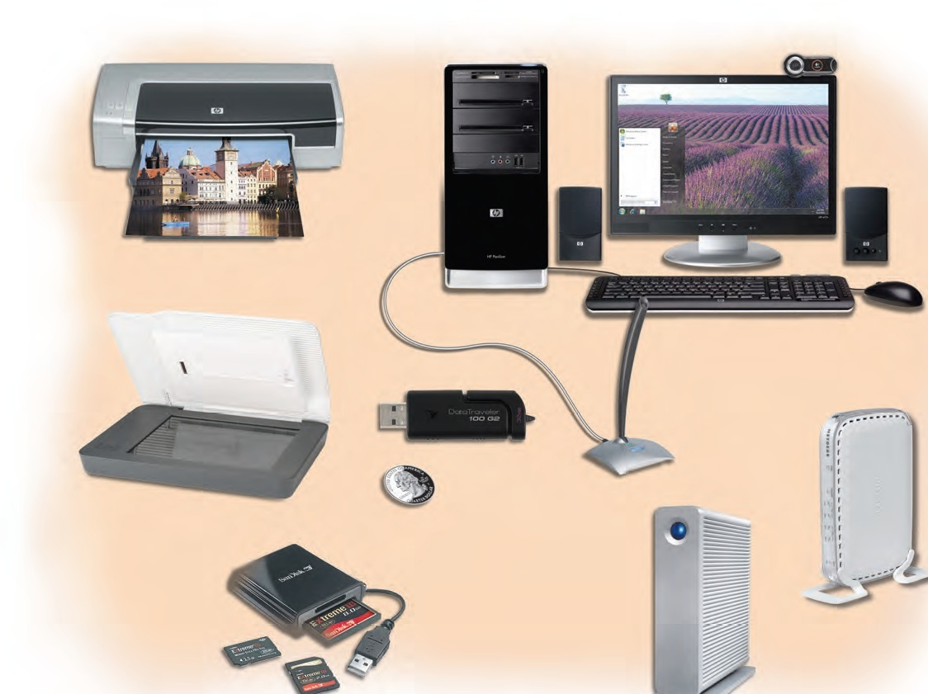

Slide 4
INTRODUCTION TO COMPUTERS
Definition of a computer:
A computer is an electronic device, operating under the control of instructions stored in its own memory, that can accept data, process the data (manipulation), and produce information useful in decision making.
A computer is also an electronic device that works under the control of stored programs/instructions.
It is also an electronic device that accepts data as input, manipulates the data (processing) to produce information as output useful in the decision making process.

Slide 5
The block diagram below shows the input, process and output functionality.
Definition of terms:
Data: refers to a collection of unprocessed items or raw facts. It can include text, images and audio data.
Data processing: an activity of manipulating the raw facts to generate a set or an assembly of meaningful information.
Information: refers to processed data directly useful in decision making.
Program: a set of instructions given to the computer to perform various operations on the data supplied to it and has to be planned in an orderly manner.
Input (data)
Process (manipulation)
Output (information)

Slide 6
Advantages of computers
Speed: computers operate at high speed hence saves on costs.
Computer results (information) are accurate and reliable.
Storage: computers can store large amounts of data and information.
They are consistent and can work continuously without getting tired.
Versatile: they can work on voluminous data items.

Slide 7
6) Simulation: they can operate on risky environment e.g. volcanic sites, lethal chemical plants etc. which are hazardous to human life.
7) Computers help to reduce paper work significantly.
8) They reduce the number of workers required to perform various organisation activities hence saves costs in terms of salaries to the organisation.
9) The use of computers for office activities reduces the requirements of office space.

Slide 8
Disadvantages of computers
Computers are costly to purchase, install and maintain.
Due to rapid changes in technology, they become outdated so fast hence posing a risk to capital loss.
Computers lead to loss of jobs or change in job status for the unskilled employees i.e. job replacement and job displacement.
Garbage in garbage out (GIGO)-given the wrong instructions, the computer gives wrong output.
If the computer system crashes, it may lead to data and information loss hence backup procedures must be enhanced though expensive.
Access to computers through the internet has led to moral and cultural decay to some members of the society.

Slide 9
Physical parts of a computer
Monitor/screen
Web cam
System unit
speaker
keyboard
mouse
NOTE: this area will be covered later in the topic

Slide 10
System unit components
There are two common types of system units i.e. tower and desktop.
The motherboard:
This is a fibre glass device that does not conduct electricity and allows components inside the system unit to be mounted on it.
Each component thus remains insulated from other components.
It contains chips embedded on it called the motherboard chipset.
A chip is a small rectangular piece of silicon on which most Integrated Circuits are implemented.
An Integrated circuit (IC) is a complete electronic circuit contained within a single piece of silicon material.
Some of the motherboard components include:

Slide 11
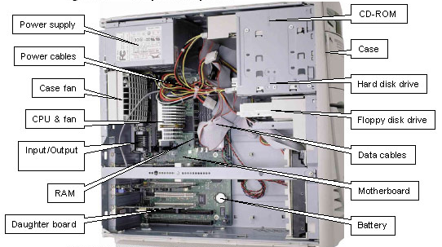
SYSTEM UNIT COMPONENTS

Slide 12
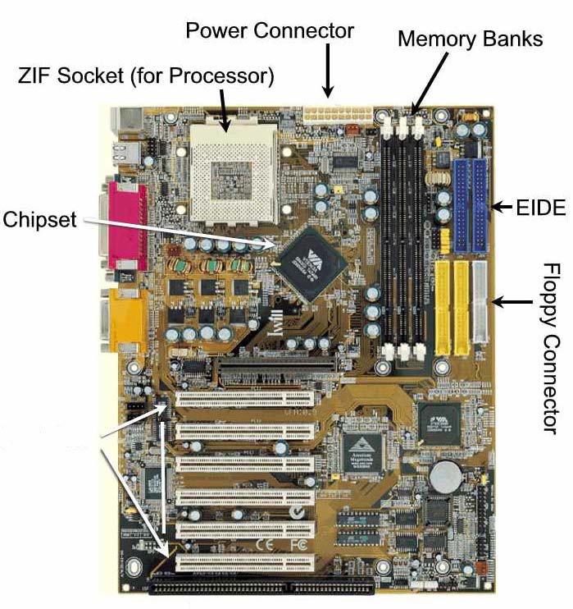
THE MOTHER BOARD
Expansion
slots

Slide 13
CMOS battery: (Complementary Metal Oxide Semiconductor battery). It is a dry cell that resembles that of a digital watch. The battery provides constant power for the system clock and date/time stamp. It keeps the clock running even when the computer is switched off.
Power supply unit: it converts the potentially lethal 240 volt A.C (alternating current) into a steady low voltage D.C (direct current) usable by the computer ranging from 5 volt to 12 volt supply.
Input/output ports: the system communicates with outer hardware via ports. A port is a connector on the back of the system unit or any other device.
Expansion slots: they facilitate for additional connectors where expansion cards are fitted. Each slot leads to a bus on the motherboard. A bus is a path that enables various parts of the computer to communicate with one another.
Hard disk: it is the computer’s main storage unit where all data and programs are stored.

Slide 14
History and Development of computers
The first computing machine was known as ABACUS. It was used in ancient China and Japan. It had bead-like parts that moved along rods. It was used for simple and small volumes of arithmetic.
The next significant aid to calculation was the invention of logarithms by John Napier who published his log tables in 1614.

Slide 15
In 1620, the slide rule was invented by William Oughtred.
In 1623, Blaise Pascal invented the mechanical calculator that had the ability to add and subtract numbers.
In 1671, a calculating machine with capabilities to multiply and divide numbers was invented by Gottfried Von Leibniz.

Slide 16
In 1822, Charles Babbage (regarded as the father of computing) developed the analytical engine which combined arithmetic process with decision based on its own logic.
1847-1854, George Boole discovered boolean algebra, whose principles are the basis of today's computers logic gates.
Around mid 1880’s, Herman Hollerith developed the Hollerith machine for Card Punching and reading. He formed a company called “The Computing Tabulating Recording Company” known today as the “International Business Machine Corporation” (IBM).

Slide 17
In 1906, Lee De Forest made a breakthrough in developing the technology of Thermionic Valve which was the first electronic component.
I937-1944, the Mark I was built by Howard Aiken with support from IBM.
From 1946 onwards, the progress in digital computers has been tremendous.

Slide 18
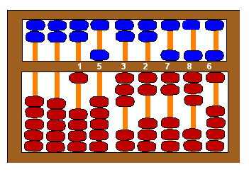
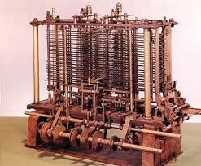
The ABACUS
The Analytical Engine

Slide 19
Generations of computers
Computers can broadly be categorised into five generations. These generations are based mainly on the basic electronic component or the internal working mechanism that was used to build the computer.

Slide 20
FIRST GENERATION (1945-1956)
They used vacuum tubes or thermionic valves as the main electronic component to process data.
They used magnetic drum memories for storage.
They used big physical devices in their circuitry hence were very big in size.
they consumed a lot of power and generated a lot of heat.
They were programmed directly using machine language. This made the computer difficult to program and limited in its speed. Examples of computers in this generation include Harvard Mark I, UNIVAC, IBM 700 series etc.

Slide 21
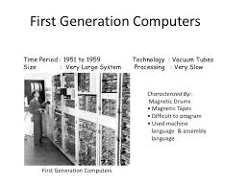

Slide 22
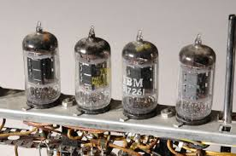
VACUUM TUBES

Slide 23
SECOND GENERATION (1956-1963)
They relied on transistor technology and magnetic core memories. Transistors are tiny solid-state electronic devices used to open and close a circuit.
Transistors were much smaller than vacuum tubes.
These computers produced less heat, were much faster, smaller in size and more reliable.
They were programmed using assembly language, allowing abbreviated programming codes to replace long and difficult binary codes (machine language) used in the 1st generation computers.
Examples of these computers include: IBM 1400 and 1600 series, UNIVAC III, NCR 300 series, ATLAS LEO Mark III and Honeywell 200.

Slide 24
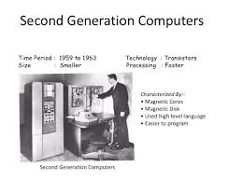

Slide 25
THIRD GENERATION (1964-1970)
These computers relied on electronic devices called Integrated Circuits (IC)-made by combining several transistors together etched on a semiconductor called a silicon chip.
They used magnetic disk for storage purposes.
Computers became even smaller, faster, more reliable, more energy efficient and cheaper.
They were programmed using High Level Languages which used English words and the base ten number (decimal) systems.
Examples of these computers include: IBM System 3 and System 7, UNIVAC 9000 series and NCR Century series.

Slide 26
FOURTH GENERATION (1971-present)
From 1970, further technological improvement was done on the silicon chip design by compressing more tiny circuits , hundreds and thousands of transistors into even smaller spaces.
This design produced Large Scale Integrated (LSI) and Very Large Scale Integrated (VLSI) circuits.
Computers became even smaller, cheaper and much more reliable.
Their processing capabilities increased accordingly.
These computers are characterised by very low emission of heat, are small in size and easier to use and maintain.
Examples of these computers include: IBM System 3090 and RISC 6000, HP 9000 and the Cray 2 XMP.

Slide 27
FIFTH GENERATION (present-future)
Today’s computers fall in these generation.
They have high processing power and speed. Their size is becoming smaller and smaller.
These computers will be able to mimic human beings through the use of special instruction sets that allow them to support complex programs.
These computers are characterized by artificial intelligence, parallel processing and 3 dimension circuits (3 D).

Slide 28
They are capable of performing multiple, simultaneous operations using more than one micro-processing chip.
The eventual goal of these generation is to develop devices that respond to natural language input and are capable of ‘learning’. An artificial intelligence program would therefore eliminate the need for users to write programs since they could communicate their orders to the computer via ordinary English.

Slide 29
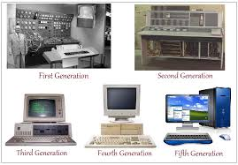

Slide 30
The trend in computer technology is that computers are:
Becoming more smaller in size.
Having more storage capacity.
Having more memory.
Having a higher processing speed.
Becoming more cheaper and affordable.

Slide 31
CLASSIFICATION OF COMPUTERS
Computers can be classified into three categories i.e.
According to:
Physical Size
Purpose
Functionality.
Classification according to physical size
Based on physical size, computers can be categorized into four main groups.

Slide 32
Supercomputers (monsters):They are the fastest largest, most expensive and powerful computers available. They are able to perform many complex operations in a fraction of a second. Due to their weight, they are kept in a special room.
Their great processing power makes them generate a lot of heat and therefore require special cooling systems.
They are mainly used for scientific research which require enormous computations, aerodynamic design and simulation, petroleum research, defense and weapon analysis among others. They use multiple processors. They include: CRAY T3D & NEC-500

Slide 33
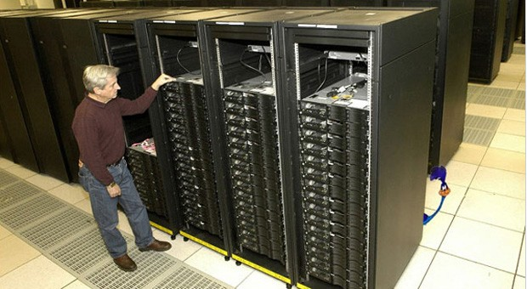
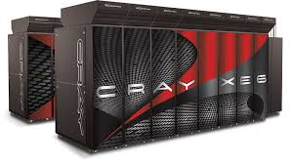
Supercomputers

Slide 34
b) Mainframe Computers:
They are big in size but less powerful and less expensive than supercomputers.
They also have a high processing speed.
They are used for processing data and performing complex mathematical computations.
They have a high storage capacity and support a variety of peripheral devices.
They can handle more than a thousand users at a time.
They are found in large organisations such as banks, government agencies, insurance companies and corporations where they perform tasks that require a lot of computational power.
They include: IBM zSeries 990 Model D32, ICL 39 and CDC Cyber series.

Slide 35
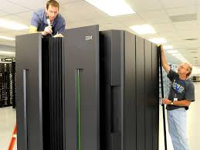
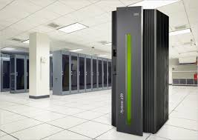
Mainframe computers

Slide 36
c) Minicomputers:
Minicomputer resembles the mainframe but is slightly smaller.
It supports fewer peripheral devices, cheaper, less powerful and slower than the mainframe.
It was developed as a cheaper alternative to the mainframes for smaller organisations.
They are mainly used in scientific laboratories, research institutions, engineering plants and areas where processing automation is required.

Slide 37
d) Microcomputers:
A microcomputer is a small, relatively inexpensive computer with a microprocessor as its central processing unit (CPU). It includes a microprocessor, memory, and input/output (I/O) facilities. Microcomputers became popular in the 1970s and 80s with the advent of increasingly powerful microprocessors. They are also referred to as PC’s (Personal Computers).

Slide 38
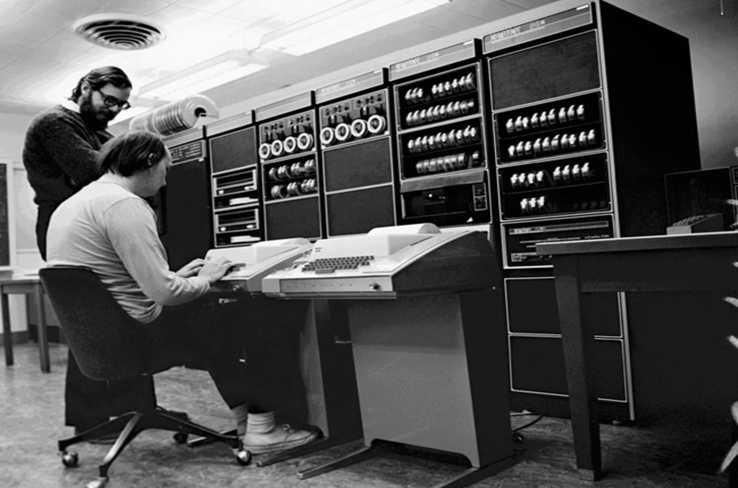
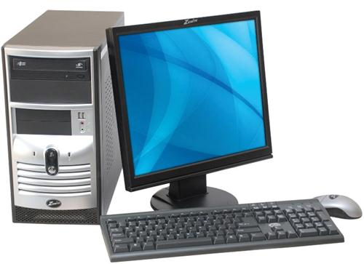
minicomputer
microcomputer

Slide 39
Technological advancement has seen the development of smaller microcomputers. These smaller microcomputers include:
Laptops: A laptop computer is a portable version of a PC (personal computer).
It is equipped with a flat liquid crystal display (LCD) screen. The two principle types of laptops are notebooks and sub-notebooks.

Slide 40
A notebook computer is portable, roughly the size of a thick notebook and has a fairly large LCD colour screen (about 30cm across).
They also have a fairly large keyboard, usually with a small touch sensitive pad which serves as a mouse.
A sub-notebook is smaller and can even fit in a large jacket pocket. It has a small screen, small keyboard without the mouse function. It can perform many of the functions of a notebook but not the same degree of complexity.

Slide 41
Tablets
A tablet PC is a computer similar to a notebook except that data can be entered through the use of a touch screen keyboard or through the use of a special pen called a stylus.
Personal digital assistants (PDA)/palmtop and electronic organisers
They are small in size, are hand held and less powerful than notebooks.
They can fit into a shirt pocket.
They might have a small keyboard or a palm size screen which can be written on with a special pen.
Technological advancement has led to the reduction in size of computers, high processing power, high speed and higher storage capacity.

Slide 42
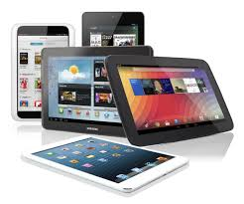
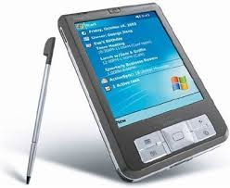
Tablets
Personal digital assistant/palmtop with a stylus.

Slide 43
2. Classification according to purpose
Computers can be classified according to the tasks they perform as follows:
General purpose computers: these computers have been designed to perform a variety of tasks when loaded with appropriate programs. They are the most common computers used today. Their flexibility enables them to be applied in a wide range of applications like; document processing, calculations, accounting, drawings etc.

Slide 44
ii. Special purpose computers: they are designed to serve a specific purpose or to accomplish one particular task. Such computers cannot perform any other task apart from the one they are meant to. Examples include; robots used in manufacturing industries, electronic calculators and mobile phones for communication.
iii. Dedicated computers: these are general-purpose computers that are committed to a specific job or task. They are however, capable of performing a variety of tasks. An example is a computer set aside for graphic design or payroll processing.

Slide 45
3. Classification according to functionality
Computers can be categorised into three types according to the type of data they process.
Digital computers: They are the most commonly used computers and process data that is discrete in nature. Discrete data also known as digital data is usually represented using a two-state square waveform. They are discrete in that their data has two possible states i.e. 1 or 0, on or off, true or false. Digital computers are used in many areas such as reservation systems, scientific research, electronic games among others.
+ 1
- 1

Slide 46
Analog computers: these are computers that process data which is continuous in nature. Continuous data is usually represented using a continuous waveform. They represent data as physical quantities and are used to perform comparison by measuring changes in the physical magnitude. They are commonly found in forms such as water meters, speedometers, thermometers and analog electric meters.
iii. Hybrid computers: these computers are meant to process both analog and digital data.
+ 1
- 1

Slide 47
Areas where computers are used
Supermarkets
Offices
Banks
Business and Industries
Hospitals
Transport
Communication
Law enforcement agencies
Education
Domestic and entertainment
Library services
Assignment:
Expound on areas where computers are used.

Slide 48
The Computer Laboratory
A computer lab, is a special room set aside and prepared specifically for safe installation and use of computers. The following factors must be considered when preparing a computer lab.
The security of computer hardware and software.
Reliability of the source of power.
Number of computers to be setup.
Maximum number of users.

Slide 49
A computer laboratory contains the following:
General purpose computers.
Printers
Network cabling
Uninterruptible power supply (UPS)
General user software
Fire extinguisher etc.

Slide 50
Safety Precautions and practices in a computer laboratory
The computer room should be well laid out to avoid overcrowding.
Ensure that the room is fitted with burglar proofing to deter forceful entry.
The room should be fitted with fire prevention and control equipment such as smoke detectors, non-liquid and non-powder based fire extinguishers. Gaseous types are recommended. Powder or water may corrode and cause rust to some metallic parts of the computer.

Slide 51
4. Computers should be provided with stable power supply to prevent damage from power surges (transients/high voltage) or under voltage (power sags/brownout). An Uninterruptible Power Supply (UPS) and surge suppressor/protectors are best suited for this purpose.

Slide 52
Dust and damp should be controlled by fitting good window curtains and covering computers with dust covers. Dampness and humidity should be controlled using dehumidifiers.
The room should be properly ventilated to avoid dizziness caused by lack of oxygen and to allow computers to cool.
Food and drinks should not be allowed in the computer lab. Food particles may clog moving computer parts like the keyboard keys.

Slide 53
8. Cables and power sockets should be properly insulated to avoid short circuits that can cause damage to some computer components.
9. Cables should be properly laid out from users path to avoid tripping on them.
10. Standard furniture should be provided to avoid poor sitting and working posture which may lead to strain injury and limb fatigue.

Slide 54
Cathode Ray Tube (CRT) monitors should be fitted with antiglare screens (light filters) and adjustable screens to avoid eye strain and fatigue caused by overbright light.
Walls should not be painted with overbright reflective oil paint to avoid glare caused by bright backgrounds.
Accidents should be reported immediately
When in doubt, always ask.

Slide 55
15. Label disks properly and insert them properly in their drives.
16. Handle equipments and other devices carefully to avoid breakages.
17. Ensure that all computers are installed with latest anti-virus software.
18. Scan disks before use.

Slide 56
THE COMPUTER SYSTEM
Definition:
System:
It is a set of items, equipments, processes and /or people working jointly with an aim of achieving common goals.
Computer system:
It can be described as a set of hardware, software and liveware (users), working together for the purpose of producing information useful in decision making.
The computer system therefore comprises of three elements/components/parts namely:
The hardware.
The software.
The liveware (user)

Slide 57

A). HARDWARE
Hardware refers to all physical, electronic, electrical and mechanical parts of the computer.
They are classified into four categories namely: input devices, the central processing unit, output devices and storage devices.
Computer functional organisation diagram.
C.P.U (central processing unit)
Control unit
Arithmetic and Logic Unit (ALU)
input
Main memory unit (MMU)
Output
Backing/secondary/ Auxiliary storage
Data/instruction flow
Command/signal flow

Slide 58

1). INPUT DEVICES
These are devices that are used to enter data into the computer.
An input device accepts data and sends it to the central processing unit
Input devices convert user input which is in human readable form to machine language that the computer can process. These devices can be classified according to the methods that they use to enter data namely:
Keying devices.
Pointing devices.
Scanning devices.
Voice recognition devices

Slide 59
1) Keying devices
The keyboard
These devices are used to enter data through typing.
The keyboard is a keying device used to input textual data into the computer through typing.
The keyboard layout: Just like the typewriter, the first keys on the upper left of the typical keyboard are Q, W, E,R, T, Y. It is therefore commonly referred to as the QWERTY keyboard. The keys on the keyboard can be classified into five categories namely:
function keys
alphanumeric keys
numeric keypad
special purpose keys
cursor movement and editing keys.

Slide 60
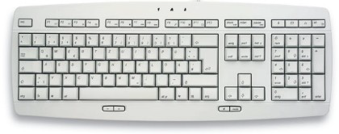
Function keys
Numeric
keypad
Special purpose key
Alphanumeric keys
Cursor movement and editing keys

Slide 61
Alphanumeric keys: they are labeled with alphabets A-Z, numbers 1, 2…0 and special symbols such as ?,*,%,$,#,<,> and @. This group also contains the caps lock, enter, tab, space bar and backspace keys.
Caps lock: pressing these key enables the user to switch between capital letters and small letters and vice versa.

Slide 62
Enter key (return key): pressing this key enables the text cursor to move to the beginning of the next line.
The enter key is also used to instruct the computer to execute a selected command.
Tab (Tabulator) key: this key is used to move the text cursor at set intervals to the right on the same line.
Space bar: this bar creates a space between words during typing.
Backspace key: this key when pressed deletes characters at the cursor position from right to left on the same line.

Slide 63
Function keys: these keys are usually located along the top of the keyboard and are labeled F1, F2 up to F12. They are used to activate task that frequently occur in various programs.
Cursor movement and editing keys: cursor movement keys are used to move the cursor to a point on the screen. They include:
Arrow keys: there are four arrows key that enable the user to move the text cursor up, down, left and right during typing.

Slide 64
Page up and page down keys: pressing these keys enables the user to move one page up or one page down in a large document.
Home key: pressing Home key takes the cursor to the beginning of the current line.
End key: Pressing End key moves the cursor to the end of the current line.
Insert key: this key helps the user to insert or replace a character at the cursor position.
Delete key: this key deletes characters from the right of the text cursor.

Slide 65
The Numeric Keypad: it is located on the right side of the keyboard and is usually used to enter numbers and perform calculations. In order to use the numeric pad, you must press the Num Lock key first. You will notice usually a green light indicating that the Num Lock keys are on.
Special purpose keys: These keys are used in combination with other keys to give certain commands to the computer. These keys include: SHIFT, CTRL (control), ALT (alternate) and ESC (escape).
Print screen (PrtSc): used for copying and printing the screen currently displayed

Slide 66
Toggle keys: these keys are used to activate or deactivate other keys on the keyboard. They include:
-Caps Lock: pressing these key enables the user to switch between capital letters and small letters and vice versa.
-Num Lock: pressing these key enables the user to activate or deactivate the Numeric keypad.

Slide 67
Using the typing tutor:
A typing tutor is a program designed specifically to allow the user enhance his keyboard skills. It helps the user to:
Increase the typing speed.
Increase the typing accuracy.
Understand the keyboard keys and their location.
Enhance a comfortable sitting and typing posture.

Slide 68
Types of keyboards:
Traditional keyboard: it is the most commonly used keyboard on most computers.
Flexible keyboard: it is a more portable keyboard that can be folded and packed in a bag.

Slide 69
Ergonomic keyboard: an angular keyboard specially designed to provide comfort and alleviate wrist strain.
Keypad: a miniature keyboard used on portable devices such as PDA’s, laptops and mobile phones.
Braille keyboard: keyboard designed for use by the blind. It consists of keys identified by raised dots.

Slide 70
2) Pointing devices:
Pointing devices are used for controlling a pointer cursor on the screen. They include:
a). Mouse
It is a pointing device used as an alternative to the keyboard to provide direct-online input. It is used to select options from menus or from a set of icons (simple graphical images). It moves a pointer or cursor on the screen.

Slide 71
Mouse skills:
The four common mouse skills are:
Clicking: this means pressing and releasing the left mouse button once. A click always selects an object.
Double clicking: this means pressing the left mouse button twice in quick succession. This action usually opens a file or starts a program.

Slide 72
Right clicking: pressing the right mouse button once displays a list of shortcut commands/pop-up menu or context sensitive menu from which a user can make a selection by clicking the left mouse button.
Drag and drop: this is an action where a user clicks and moves an item from one location on the screen to another. This action is accomplished by clicking an item, then pressing the left mouse button and holding it down, then sliding the mouse until the pointer reaches the desired position, then releasing the left mouse button. The item will be dropped in the new location.

Slide 73
Types of mouse:
Standard mouse/traditional mouse: it has a ball underneath, two buttons and an optional scroll button located between the left and right buttons.
Optical mouse: it does not have any moving parts. It works using a tiny digital camera to take 1,500 pictures every second on the surface where it is resting. Interpreting the pictures indicates the direction of the mouse movement hence the pointers position on the screen.

Slide 74
Cordless/wireless mouse: It is a battery powered mouse that uses radio or infrared waves to move the pointer instead of being physically connected to the system unit.
Trackball: it works just like the mouse, only that its ball is located at the top. Instead of moving the device on a flat surface, the user rotates the ball using a finger. Some keyboards come with an integrated track ball, hence no need for a mouse.

Slide 75
Joystick/game pads: it is an input device that lets the user to control the movement of an object on the screen by operating a small lever. It is usually used for playing computer games.
Digitising tablet/graphics tablet: it is a board like input device that can detect the position of a pointing device such as a stylus (a pen like pointing device for a graphics tablet). The user draws images and graphics on the tablet using a stylus. The digitizer is used for tracing highly detailed engineering and architectural drawings and designs.
Touch-sensitive screens: this technology lets the user interact with the computer by touching the screen using a finger or a stylus in order to write or select an item. They are mostly used in retail stores, Smartphone's, PDA’s etc.

Slide 76

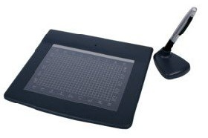
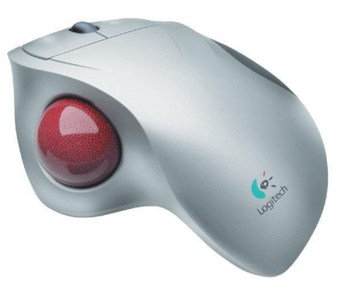
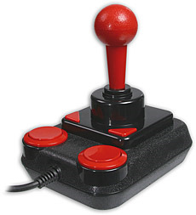
Light pen and stylus: it is a pen like device held in the hand is sensitive to the presence or absence of light through a light sensitive cell at its tip. The pen is usually connect to the monitor. Making selections using the light pen is far more accurate than using the finger to make selections on a touch sensitive screen. They also allow users to draw directly on the screen.
Optical mouse
Graphics tablet
trackball
joystick

Slide 77
3). SCANNING DEVICES
Scanning refers to capturing data whether graphical or textual and converting it into digital format. There are two categories of scanners namely optical scanners and magnetic scanners.
Optical scanners: they capture data using optical or light technology. A light beam passes over an object and the image is analysed by a specialised software. Examples of optical scanners include:

Slide 78
Optical Mark Recognition/Reader (OMR) scanners:
OMR detects marks made on a white paper using ink or soft pencil by passing an infrared beam over them. The marks are made on empty pre-printed boxes on the paper.
OMR’s are mainly used in assessing multiple choice examinations, structured questionnaires and selecting correct number combinations from lottery tickets.

Slide 79
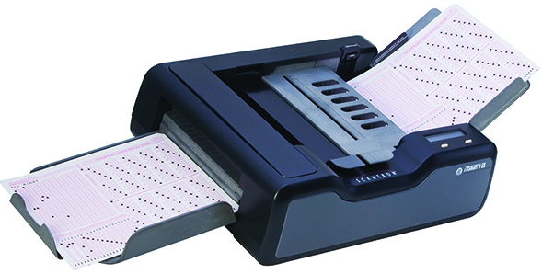
OMR DIAGRAM

Slide 80
ii. Optical Character Recognition (OCR) scanner:
It is used to read typewritten, computer printed or handwritten characters and transform the images into a soft copy that can be manipulated using a word processor. More advanced OCR scanners can be used to capture pictures and real objects.

Slide 81
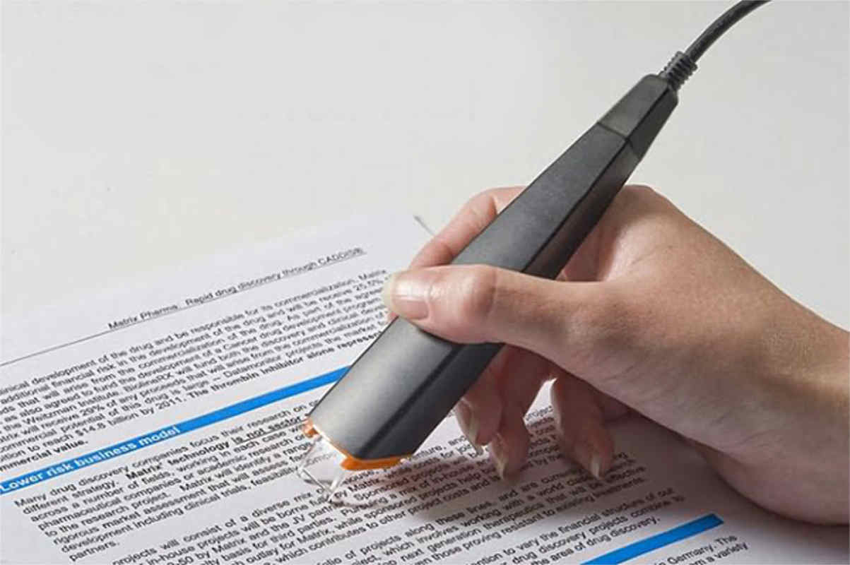
OCR

Slide 82
Optical Bar Recognition (OBR)/Barcode Readers: A barcode or Universal Product Code (UPC) is a set of vertical lines of varying thickness with a string of numbers printed at the bottom. The barcode is read by a scanner in which laser beam scans the barcode and the light is reflected back into the scanner and sent to the computer for processing. Barcodes hold the following details:
Manufacturers details.
Product code.
Product name.
Item price (though the price varies from place to place).

Slide 83
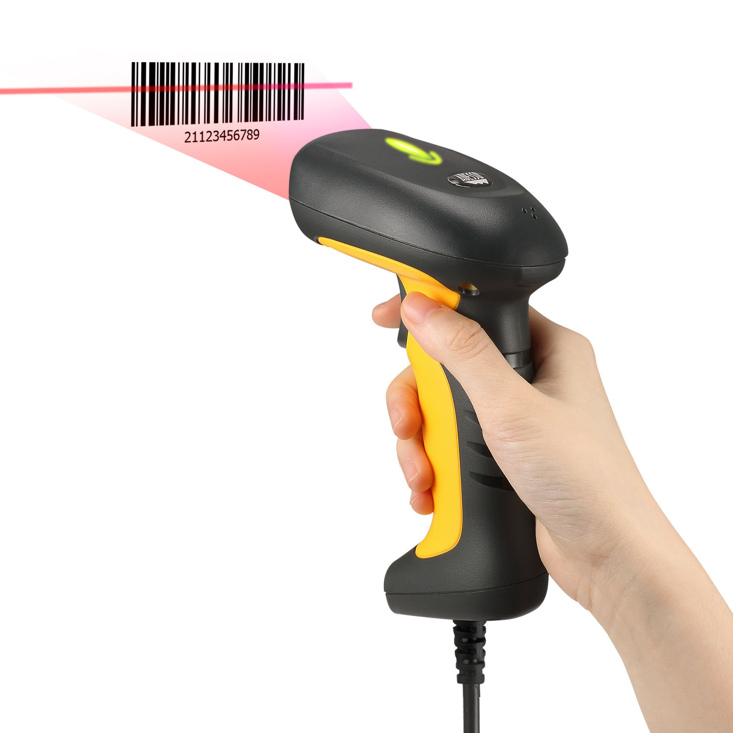
BCR

Slide 84
Point of sale (POS) terminal: barcodes form part of the POS system usually found at retail outlets. A terminal is connected to a central computer which records details after the barcode of an item has been scanned. The price of the item is displayed on a monitor at the POS.
b) Magnetic scanners: They are used to read data written using magnetic ink or coded onto a magnetic strip. The most common readers are Magnetic Ink Character Recognition (MICR) and card readers.

Slide 85
i. Magnetic Ink Character Recognition (MICR):
These devices are used to read characters written using magnetic ink. They are mainly used in banks to read cheques.
ii. Magnetic strip codes:
A magnetic strip is a short length of magnetic coated tape printed on the surface or sealed into a ticket or card. It contains information to identify the ticket or card and its user. The card is read by swiping it through a reader.

Slide 86
What are turnaround documents?
These are documents that have been output by the computer, some extra details added and then later used as input. Document readers or scanners are used to read turn around documents.

Slide 87
Other input devices include:
Digital cameras
Digital video cameras
Biometric systems
Remote controls
Microphones (for voice input).
Interactive smartboard
assignment:
Expound on the above input devices.
Check for the advantages and disadvantages of the following document readers: OBR, OCR, OMR and MICR---(Onunga Bk 1 pg 59-63, KLB Log On Bk 1)

Slide 88
far quicker and more accurate than typing in each code using a keypad. Barcode can be found on many other items that have numeric codes which have to be read quickly and accurately ‐ for example ID cards. Sensors A normal PC has no way of knowing what is happening in the real world around it. It doesn’t know if it is light or dark, hot or cold, quiet or noisy. How do we know what is happening around us? We use our eyes, our ears, our mouth, our nose and our skin ‐ our senses. A normal PC has no senses, but we can give it some: We can connect sensors to it... A sensor is a device that converts a real‐world property (e.g. temperature) into data that a computer can process. Examples of sensors and the properties they detect are... Sensor What it Detects Temperature Temperature Light Light / dark Pressure Pressure (e.g. someone standing on it) Moisture Dampness / dryness Water‐level How full / empty a container is Movement Movement nearby IT (9626) Theory Notes Proximity How close / far something is Switch or button If something is touching / pressing it A sensor measures a specific property data and sends a signal to the computer. Usually this is an analogue signal so it needs to be converted into digital data for the computer to process. This is done using by an Analogue‐to‐Digital Converter (ADC). Sensors are used extensively in monitoring / measuring / data logging systems, and also in computer control systems. Remote Control These devices are very common. They send data signals each time a button is pressed using infrared or radio signals. The signals can control a computer from some distance. They are often used to control a presentation slideshow.

Slide 89

Input devices selection criteria:
Device cost- initial and running cost should be weighed against the expected benefits.
Device speed- this is a crucial factor because if quicker response is required then a faster method of data input must be considered.
Data volume- the device selected should cope with the data volume to be input with appropriate timing.

Slide 90
Device accuracy
Device reliability- device must have a success record in the market for the application it is intended for.
Mode of operation- depends on the nature of the data processing system
Appropriateness and suitability- merits and demerits in light of where it is to be applied.
(Onunga bk 1 pg 67-68)

Slide 91
2). THE CENTRAL PROCESSING UNIT (CPU)
The CPU also known as the processor is the most important component of the computer.
It is regarded as the ‘brain’ of the computer because all processing activities are carried out here.
The CPU takes raw data and following a set of instructions (programs), converts it into information.

Slide 92
The speed at which the CPU works is measured in units called Hertz. The units hence progress from Hertz (Hz), Kilohertz (Khz), Megahertz (Mhz) to Gigahertz (Ghz).
In microcomputers, the CPU is housed inside the system unit and mounted on the motherboard.
The CPU is made up of three main components namely:
Control unit (CU)
Arithmetic and Logic Unit (ALU)
Main Memory Unit (MMU)

Slide 93
CONTROL UNIT (CU)
This unit controls, co-ordinates, supervises and oversees all activities in the computer.
It monitors the execution of any program processed.
It determines the sequence in which instructions are executed.

Slide 94
The control unit does not execute the instructions itself; instead it sends the data and instructions to the ALU for processing.
To co-ordinate these activities, the control unit uses a system clock. The clock sends electric signals as its means of communication.
The number of pulses per second determines the speed of the microprocessor. The faster the clock pulses, the faster the CPU hence the faster the computer can process data.

Slide 95
The control unit executes an instruction by performing the following steps:
Fetching the instruction from memory.
Decoding the instruction.
Fetching the data required by the instruction from memory.
Sending the data and instruction to the ALU for processing.
Sending the data to the memory unit after processing.
In order for the control unit to carry out the various functions, it contains a number of registers.
A register is a temporary storage location that holds a single instruction or data item before processing.

Slide 96
2. ARITHMETIC AND LOGIC UNIT (ALU)
The ALU is a unit of the central processing unit where all arithmetic and logical (decision making) operations are carried out.
The control unit issues out commands to the ALU, indicating where in the main memory to get data to be manipulated, where to place the results achieved and how to interrelate the data.
Basic arithmetic operations include: addition, subtraction, multiplication and division.
Logical operations i.e. arrangements and rearrangements e.g. sorting, matching and comparing are also carried out. Some of the logical comparison operators include:
Equal to (=) | Not equal to (≠)
Less than (<) | Less than or Equal to (≤)
Greater than (>) | Greater than or equal to (≥)

Slide 97
3. MAIN MEMORY UNIT (MMU)
It can alternatively be described as:
Primary storage unit.
Internal memory.
Core memory
Immediate access storage.
The main memory is directly accessible by the processor.
It is made up of bi-stable elements that hold data, instructions or information in a two state form i.e. in binary notations of 1’s and 0’s.
These bi-stable elements define the memory cells, which can hold either a ‘1’ or ‘0’ at any given instance but not both within the same memory cell.

Slide 98
The main memory unit can be classified into two: Read Only Memory (ROM) and Random Access Memory (RAM).
READ ONLY MEMORY (ROM)
ROM is used to store programmed instructions and data permanently or semi-permanently.
Data and instructions stored in ROM are those that remain unchanged for long periods of time.
Its is commonly used to store system-level programs such as BIOS (Basic Input/Output System) ,POST (Power On-Self Test) and basic utility or routine programs such as language translators, text editors, loaders, linkers, sort utility etc.

Slide 99
These instructions are fixed at the time of manufacture and therefore remain unchanged whether the power is on or off (non-volatile). ROM contents cannot be easily modified.
Depending on the permanence of the instructions or data written on it, there are four types of Read Only Memory namely:

Slide 100
Programmable Read Only Memory (PROM)
It allows the user to alter it only once after the contents have been written on it.
Mask Read Only Memory (MROM)
Once the contents have been written on it by the manufacturer, it cannot be changed.
Erasable Programmable ROM (EPROM)
It allows its contents to be changed and reprogrammed for re-use by exposing it to ultra violet light (UV)
Electrically Erasable Programmable ROM (EEPROM)
This type of ROM can be reprogrammed using electricity.

Slide 101
Characteristics of ROM:
Its contents can only be read but cannot be written (changed) unless it’s a special type of ROM.
It is non-volatile i.e. its content cannot be lost when the computer is switched off.
Its contents are manufacturer defined i.e. it stores permanent or semi-permanent instructions from the manufacturer called firmware.
Note: ROM can store semi-permanent instructions because some variations of ROM chips can be reprogrammed according to user specifications.

Slide 102
b. RANDOM ACCESS MEMORY (RAM)
RAM is also referred to as the working storage.
It is used to hold data and instructions needed by the currently running applications. Data and instructions are held temporarily during processing.
It also holds information that results from processing, temporarily, awaiting to be output or to be stored in a secondary storage device.

Slide 103
Programs and data stored in secondary storage must therefore be loaded into RAM before they can be processed.
RAM’s content is temporary and gets lost immediately the computer is switched off.
Since RAM’s content are temporarily held, it is therefore important to save your work in a secondary storage device before switching off the computer.

Slide 104
Characteristics of RAM:
Data can be read (retrieved) and written (stored) in it.
RAM is a temporary (volatile) storage i.e. its content disappears when the computer is switched off.
Its contents are user defined i.e. it is the user who dictates what is to be contained in the RAM.

Slide 105
There are two types of RAM namely:
i. Dynamic RAM: a relatively slower type of RAM and requires periodic recharging to maintain its data storage.
ii. Static RAM: a fast type of RAM mostly located inside a microprocessor. It is used on special purpose memories.
Note: RAM occupies the largest percentage of the main memory unit. The higher the RAM capacity, the faster the computer can operate. Both RAM and ROM chips are also mounted on the motherboard.

Slide 106
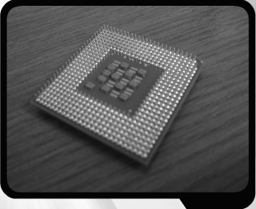
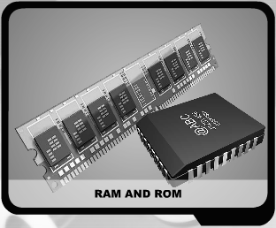
CPU

Slide 107
Assignment:
Using the characteristics of both RAM and ROM, give three main differences between the two. (3 mks)
Outline THREE main reasons why the primary storage/main memory is not used for secondary storage. (3 mks)
Differentiate between primary storage and secondary storage/backing storage. (4mks)
Make notes on Trends in microprocessor technology and speed (pg 47 Longhorn)

Slide 108
Special purpose memories:
Some minute or small types of memories are included inside a microprocessor or inside input/output devices in order to enhance performance. They include:
Cache memory: it is a very fast type of memory that the processor can access much more quickly than main memory RAM. It is located inside the microprocessor chip. Due to its high speed, it is used to interface the slow communicating main memory with the CPU.

Slide 109

b) Buffers: special purpose temporary memory location found in input/output devices. It holds data temporarily between communicating elements. For instance, printers have buffers where they can store massive documents sent by the CPU for printing, hence freeing the CPU to perform other urgent tasks.

Slide 110
Registers:
A register is a temporary storage location that holds a single instruction or data item before processing. Examples of registers are:
Accumulator: they are found in the ALU and are used to temporarily hold the results of the last processing step.
Sequence control register: selects the instructions to be carried out, reads it into the instruction register and automatically moves to the next instruction in the processing sequence.

Slide 111
iii) Instruction register: temporarily holds an instruction just before it is interpreted into a form the CPU can understand.
iv) Address register: temporarily holds the next piece of data waiting to be processed.
v) Storage register: temporarily holds a piece of data that is on its way to and from the CPU and the main memory.

Slide 112
The Control unit, Arithmetic and Logic Unit and the main memory use electrical pathways or links referred to as buses to communicate. There are three types of buses namely:
Control bus: this is the pathway for all timing and controlling functions sent by the control unit to other parts of the computer system.
Address bus: this is the pathway used to locate the storage location in memory where the next instruction to be processed is held.
Data bus: this is the pathway where the actual data transfer takes place.

Slide 113
MEMORY/STORAGE CAPACITIES
The memory capacity is measured in units called bytes as indicated below:
4 bits= Nibble (half a byte)
8 bits= 1 byte
1024 bytes= 1 Kilobyte (Kb)
1024 Kb= 1 Megabyte (Mb)
1024 Mb= 1 Gigabyte (Gb)
1024 Gb= 1 Terabyte
1024 Tb= 1 Petabyte
1024 Pb= 1 Exabyte
1024 Eb= 1 Zettabyte
1024 Zb= 1 Yottabyte

Slide 114

3. OUTPUT DEVICES
These are peripheral devices or equipments that a computer uses to give out, convey or display information produced after processing operations.
There are two types of outputs namely soft copy and hard copy output. Therefore, output devices are also categorised into two i.e. soft copy and hard copy output devices.
Soft copy output: refers to information displayed on a screen or in audio or voice form through speakers.
Hard copy output: refers to information printed on stationery or other permanent tangible medium.

Slide 115
The choice of an output device depends on the following considerations:
The speed at which the output is required.
The type of output required, whether soft or hard copy.
The volume of information output
The quality of output.
Initial and running cost of the method preferred as compared with the benefits derived.

Slide 116
a). SOFT COPY OUTPUT DEVICES:
Monitor/screen/visual display unit (VDU):
The monitor is used to display information in the form of text pictures and video, enabling the user to monitor what is going on in the computer. There are several technologies used with monitors namely; Cathode Ray Tube (CRT), Liquid Crystal Display (LCD), electroluminescent display, Field Emission Displays (FED) and Gas Plasma Display (GPD).
LCD and GDP are generally referred to as flat-panel displays.

Slide 117
Cathode Ray Tube Monitors (CRT):
It consists of a long glass tube with an electron gun on one end and a screen on the other. The electron gun shoots electrons to illuminate the screen and is coated with tiny phosphorus dots. The dots consists of three primary display colours i.e. Red, Green and Blue to make a pixel.
The CRT display is made up of small picture elements called pixels. The smaller the pixels, the better the image clarity, or resolution. It takes more than one illuminated pixel to form whole character.

Slide 118
Liquid Crystal Display (LCD) monitors:
This display uses liquid crystals which change their appearance when an electric current is passed through them.The flat-panel display refers to a class of video devices that have reduced volume, weight and power requirement compare to the CRT. You can hang them on walls or wear them on your wrists. Current uses for flat-panel displays include calculators, videogames, monitors, laptop computer, graphics display.

Slide 119
There are two technologies used to make LCD’s i.e. passive matrix and active matrix.
In passive matrix, LCD’s create images by scanning the entire screen. This type requires less power and has poor clarity. Active matrix displays are made using thin film transistor (TFT) technology. They consume more power and offer better clarity.

Slide 120
Gas Plasma Displays (GPD):
They resemble LCD’s only that they make use of gas instead of liquid crystals. They contain millions of pixels that are illuminated by charged neon gas. Unlike LCD’s, images displayed on the gas plasma do not suffer from angle distortion.
Currently, gas plasma technology is mainly used to produce high definition TV’s (HDTV) and wall display screens.

Slide 121
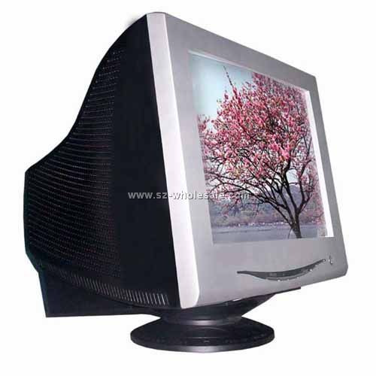
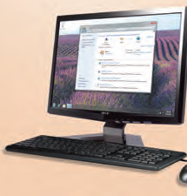
Liquid Crystal Display (LCD) monitor
Cathode Ray Tube (CRT) monitor

Slide 122
Monitor display terminologies:
Pixel: stands for picture elements-tiny dots which are used to form images displayed on the screen.
Colour depth: refers to the number of colours which can be displayed by a pixel.
Monochrome – This type of display uses only one type of colour or a grayscale.
Colour – This type of display uses more than one type of colour and is generally called RGB monitors. The RGB stand for Red, Green and Blue and a combination of these colours are used to display the image on the monitor.
Colour monitors can display range from 16 to16.7 million colours.

Slide 123
Display size: this is the diagonal dimension of the screen measured in inches e.g. 15”, 17” and 19”.
Refresh rate: the number of times an image is repainted on the screen per second. If the refresh rate is slow, the screen may appear to flicker.
Image aspect ratio: refers to the ratio of width to height of an image on the screen. Most screens have an image ratio of 4:3.
Resolution: refers to the clarity and sharpness of an image when displayed on the screen. It is usually given in dots per inch (dpi). The more the pixels, the higher the resolution.
Side NOTE:
A terminal is an integration of a VDU with a keyboard. There are two types of terminals, namely INTELLIGENT TERMINALS (having a CPU) and DUMB TERMINALS (no CPU)
- Intelligent terminals can do some local processing of data and then communicate with a main computer just to relay the results.
- In a dumb terminal, all processing must be done through the main computing system.

Slide 124
Video graphics adapters:
A video adapter determines the resolution and clarity of the monitor. Examples of video adapters include:
Colour Graphics Adapter (CGA)- displays text and images up to 16 colours. It is the oldest type.
Video Graphics Array (VGA)—640 x 480 pixels– displays using 256 colours.
Super Video Graphics Array (SVGA)—800 x 600 pixels- displays using more than 16 million colours.
Extended Graphics Array/Extended Video Graphics Array (XGA/XVGA)—1024 x 768 pixels– its popular with 17 inch and 19 inch monitors.
Super Extended graphics Array (SXGA)– 1280 x 1024 pixels– popular with 19 inch and 21 inch monitors.
Ultra Extended Graphics Array (UXGA)– 1600 x 1200 pixels– it’s the latest and highest standard.

Slide 125
Data projectors
These are devices used to create and deliver dynamic multimedia presentations (presentations in which sound, photos, video, text and other moving graphics may be combined to produce interesting effects).
Projectors display output from a computer or other electronic devices onto a plain white screen, wall or white board. Projecting is a creative way of presenting computer output to a large audience. There are several types of projectors i.e. film projectors, overhead projectors and LCD projectors.

Slide 126
Sound output:
An audio output device produces beeps, music, speech, or other sounds. A pair of speakers is an audio output device that generates sound.
The headphone is a pair of small speakers placed over the ears and plugged into a port on the sound card.
A woofer or subwoofer is used to boost the low bass sound and is connected to the port on the sound card.
Light emitting diodes (LED):
These are indicators that display light when an electric current is passed through them. Mostly, LED’s are used to give warnings.
A good example is the green or blue light displayed by the system unit or monitor that’s helps the user to know whether they are on or off. Modern LED’s are used in banking halls or retail shops to display some information about a product or service.

Slide 127
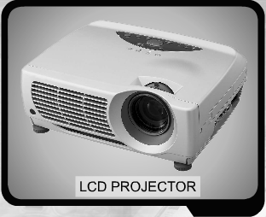
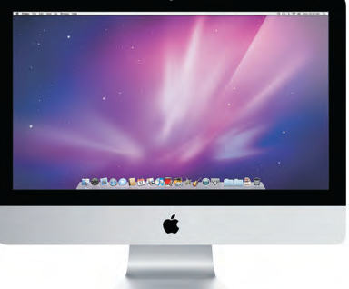
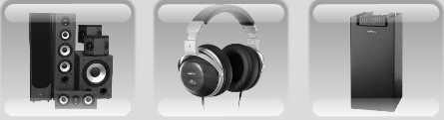
Some soft copy output devices
LCD monitor
speaker
headphones
woofer

Slide 128
Note:
Voice response systems:
These systems select from a set of digitised prerecorded words, phrases, music, alarms or other sounds stored on a disk. The system combines these prerecorded words into responses based on selection made by the user. The sounds must be converted from digital format back to analogue before being output by the speaker. Modern banking halls use these systems to guide the clients when a teller is free.
Speech synthesis:
This system converts written text into computer generated speech (text to speech). It is used for computer--aided—conversation by hearing and speech impaired persons, or for converting conversations/text from one language to another.

Slide 129
HARD COPY OUTPUT DEVICES:
It is important, at times, to have a permanent copy of output for physical recording and storage. Hard copy output devices are therefore used to create hard copy outputs. They include:
Printers:
Printers are hard copy output devices that are primarily used to present all kinds of information on paper such as letters, legal documents, scientific data and graphs, photographs and advertising material etc.
Classification of printers
Printers can be classified according to speed, how they produce the document prints (character, line and page), and how they provide the prints onto the stationery (impact or non-impact).

Slide 130
Classification of printers
printers
Low speed
High speed
Character printers
Line printers
Page printers
Impact printers e.g. dot matrix, golf ball, daisy wheel
Non-impact printers e.g.
thermal
Impact printers e.g. drum, chain printers
Non-impact printers e.g. electrostatic, inkjet printers
Non-impact e.g. laser, electrostatic, xerographic

Slide 131
Character printers:
They provide one character print on the stationery and are therefore comparatively slow and less costly than line and page printers. They are normally used with slow communicating terminals and low volume processing terminals where speed is not critical.
Line printers:
They provide one whole line of print at a time hence relatively more expensive and faster than character printers though slower than page printers. They are mainly used in network environments where several users share the printer.
Page printers:
They provide one whole page of print at a time, hence faster and relatively more expensive than both character and line printers. They are non-impact and provide high quality prints. They are used where high speed of printing is critical.

Slide 132
impact printers:
These printers provide prints using striking mechanism. This means that the printing head element comes into actual contact with the stationery through an inked ribbon. The inked ribbon is found between the stationery(paper) and the printing head element. Examples of these printers are dot matrix and daisy wheel printers.
Non-impact printers:
The printing head element in these printers does not come into physical contact with the stationery but use other means such as thermal or electrostatic principles to provide prints. Examples include inkjet, electrostatic, thermal, photo and laser printers.
Assignment:
Expound on the various types of printers. (longhorn bk 1 pg 53-56, Onunga bk 1 pg 87-91)

Slide 133
Comparison between impact and non-impact printers
Impact printers | Non-impact printers
-Slow in producing prints. | -Fast in producing prints.
-They use inked ribbons to provide prints. | -They use thermal or electrostatic principles.
-produce multiple copies | -produce single copies
-Cheap due to technology used. | -Expensive due to technology used.
-Noisy because of impact. | -Quiet because of non-impact.
-produce low quality prints | -produce high quality prints

Slide 134
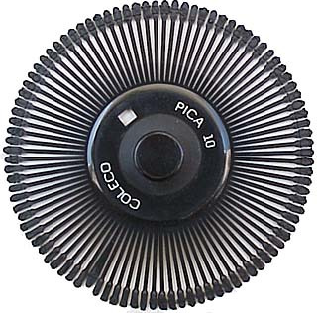
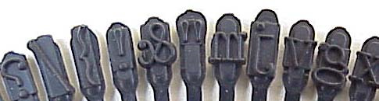
Daisy Wheel Printers
This type of printer is rarely used any more since new printer technology, which is more efficient and economic, has been discovered. The principle of this type of printer is that number and letter are each situated on metal leafs.
These leafs make part of the daisy wheel. In order to print, the daisy wheel rotates while a hammer will strike each character, which will make contact with the printer ribbon and the paper.

Slide 135
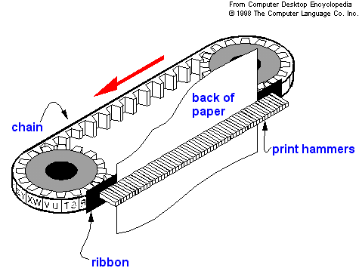
Chain Printers
All the alphabet and numbers are imprinted on a chain. In order to write on paper, a hammer will strike the right characters to print.

Slide 136
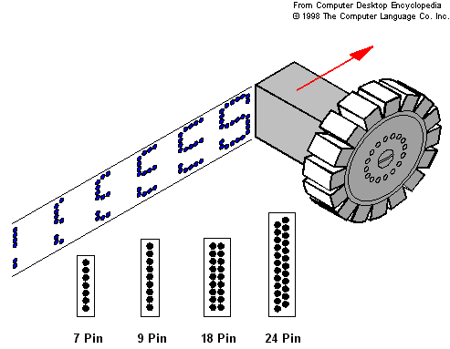
Dot Matrix Printers
Dot matrix printers are categorised as character printers because they type one character at a time. The printing head is made up of several pins, which form a column.
The printing head is attached to a belt which moves it from side to side along the width of the paper and at the same time the paper is rolled up by means of a roller.
In order to type, the head pins are fired with the aid of an electro magnet, which hits the ribbon and paper.

Slide 137
Inkjet Printers
These types of printers are the most popular nowadays. It is basically what most home users have today. These printers have good resolution, are silent and for small amount of printing are not particularly expensive. These printers are called page printers.

Slide 138
There are two types of technologies used:
1. The first type (called Bubble Jet) has a chamber containing ink. The ink is heated up with tiny electrical heaters. This will cause the ink to expand and form a bubble. The bubble will burst and the ink transferred on paper.
2. The second type (called Ink Jet) uses a piezo quartz nozzle. When electricity is passed through it, it vibrates and transfers the ink on paper.
In the inkjet printing mechanism, the print head has several tiny nozzles, also called jets. As the paper moves past the print head, the nozzles spray ink onto it, forming the characters and images.

Slide 139
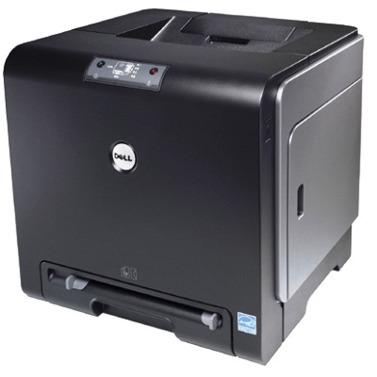
Laser Printers
Laser printers offer the best quality in terms of printout quality and resolution. On the other hand they are the most expensive to run.
Laser printers are called page printers since they print one page at a go.
The laser printer uses a laser beam, a drum and a toner.

Slide 140
Printer Glossary
CPS --characters per second (how many characters it is able to print in 1 second).
NLQ-- near letter quality (very good print).
Draft Mode--lowest printable resolution, it is also the quickest but not the best output, it is usually used for spell checking before the actual print.
DPI-- dots per inch, this gives the resolution of the print, the higher the dpi the higher the resolution.
Spooling-- A printer works relatively very slow when compared to a CPU. In order to free the CPU to attend to other tasks during printing, the printing job (file) is temporarily stored on disk, tape, or memory. The printer will then receive the file to print chunk by chunk – enough to keep it busy. This compensates for slow operating speeds of some peripheral devices. Spooling is done to a printer’s memory known as memory buffer.

Slide 141
Memory buffer-- Printers have memory buffers to speed up their operation. Printing speeds are very slow compared to computer speeds and the printing job is spooled to a printer’s memory buffer.
This is usually in the region of 10kb to 50kb RAM on small office printers. The computer downloads quickly in the fraction of a second the printing job to buffer memory.
When the data in the buffer is exhausted, the next chunk of printing data is downloaded again by the computer in a split second. Sophisticated printers use large memory buffers and buffer area may be split into two separate memory areas.
A peripheral device may be off-line or on-line:
ON-LINE: refers to when a peripheral device is under the control of the CPU i.e. connected to the computer and is being used.
OFF-LINE: refers to when a peripheral device is not under the control of the CPU

Slide 142
Factors to consider when selecting a printer:
Print quality: the nature of the final output in relation to the audience or recipients' needs.
Initial cost: purchasing cost in the market, some printers are cheaper than others.
Running cost: cost of maintenance and the cost of consumable items e.g. printing papers, ribbons and ink cartridges.
Printer speed: this depends on the volume of printing expected measured in pages per minute.
Colour printing: whether black and white, colour prints or both.
The interface with the computer system and printer brand.

Slide 143
Plotters
These are large hard copy output devices used for printing graphical, geographical, architectural and engineering drawings e.g. maps, advertisement posters to be placed on billboards etc. commonly commercially available graph plotters are the flatbed plotter and drum plotter.
1. Flatbed Plotter – This uses a flat paper which is fixed, and pens (or styluses) that move on it draw the required design.
2. Drum Plotter – Here the paper moves along a drum vertically while pens move side to side horizontally.

Slide 144
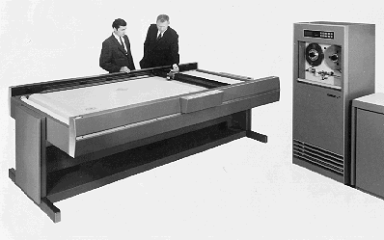
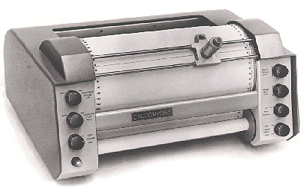
Flat bed plotter
Drum plotter

Slide 145
Computer output on Microform (COM)
COM is a method that is used to store computer documents by reducing them in size to fit on very small photographic prints.
This output method provides miniature film strips type of computer output into the microform. Microform are photographically reduced documents on films (synonymous to a photo negative).
Microfilm is a roll of film and microfiche is a rectangular sheet of film on which many frames/pages of information can be stored.

Slide 146
SECONDARY STORAGE DEVICES AND MEDIA
(BACKING/AUXILIARY STORAGE)
Secondary storage media is used to store data, instructions and information permanently.
Data and information stored is not lost when the power goes of (non-volatile). It is called secondary storage because it is not directly accessible by the processor.
Secondary storage is cheaper than primary storage and has a much higher storage capacity.
Secondary storage devices cannot be classified under input or output devices. These devices are used to store data for later use.

Slide 147
Secondary storage devices can be categorised in three main groups:
1. Magnetic storage media
2. Optical storage media
3. Electronic/solid state media
1. MAGNETIC STORAGE MEDIA
Magnetic storage devices store the data on a magnetic layer. Examples of such devices are:
a. Floppy Diskette
b. Hard Disk
c. Magnetic Tape
d. Zip disks
e. Jaz disks
f. Laser Servo 120 SuperDisks
g. High capacity floppy disk (HiFD)
The magnetic layer is magnetised when there is a binary ‘1’ and left un-magnetised when there is a binary ‘0’.

Slide 148
a) Floppy Diskette /Floppy disk drive (FDD)
Floppy disks store small amount of data typically not larger than 1.44MB. These small diskettes are used mainly to transport small files from one computer to another. The construction of the floppy is basically a plastic disk coated with magnetic material, enclosed in a plastic jacket to protect the magnetic material.
In order to write data to a floppy it must be formatted first. This procedure involves the creation of sectors and tracks. On the diskette, data is recorded on closed concentric rings (tracks).
Each track is divided into sectors. These are invisible wedged-shaped sections used by the computer for storage reference purposes.
Floppy diskettes are now obsolete in the market due to the entry of affordable mass storage media such as flash drives and memory cards.
Floppy diskettes are removable storage media because they are not housed inside the system unit.

Slide 149
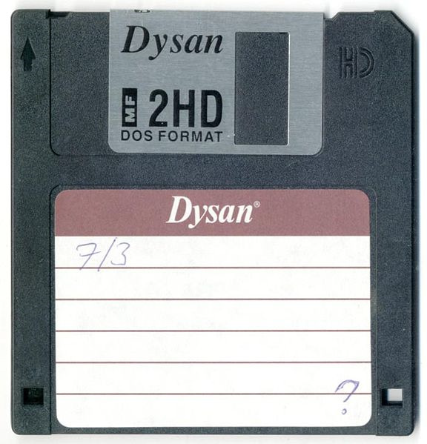
Data Access Area
Hard plastic jacket
Metal protective plate (shutter)
that moves aside (in disk
drives) to expose data access
are on disk
label

Slide 150
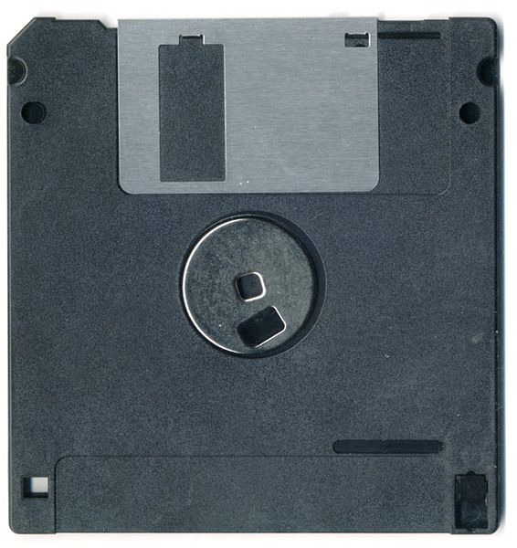
hub
Write Protection notch.

Slide 151
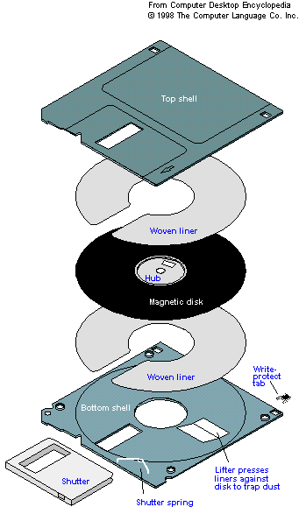
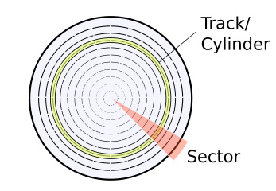
Surface of disk

Slide 152
b) Hard Disks/hard Disk Drive (HDD)
The hard disk is the computers’ main permanent storage media.
As the name implies, hard disks are built with metal or glass platters covered with a substance that allows data to be held in the form of magnetised spots.
Today hard disks are composed of more than one disk (also named as platter), which are stacked on each other. This technology gives the possibility of having large storage capacity. Typically computer systems today have an 80GB and more hard disk capacity.
Traditionally, the hard disk is mounted inside the system unit, hence, it is referred to as a fixed storage. However modern technology has brought about removable hard disks.
Most hard disks are connected to the motherboard via a channel called controller.
Some of these controllers are Integrated Drive Electronic (IDE), enhanced IDE or AT attachment (ATA).

Slide 153

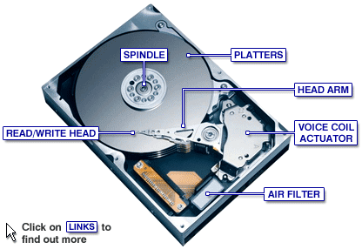
Hard Disk

Slide 154
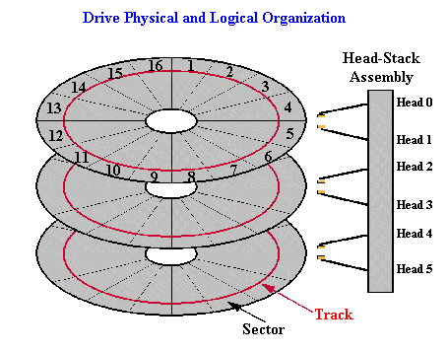
Read/write heads

Slide 155
c) Magnetic Tapes
This type of storage media is used in large computers where large amounts of data are stored. The tape is made up of a thin plastic ribbon coated with a thin layer of magnetic material composed of iron oxide. Data is read from or written to using a tape drive. The data to be stored is divided into:
a. The Header – Including file name and number of blocks
b. Block – of data separated by inter block gaps
c. Trailer – containing number of blocks, to be used as cross reference with the header.
Examples – Reel to Reel tape drive and Cassette Tape drive
Magnetic tapes are erasable, reusable and moderately durable and are made to store large quantities of data inexpensively. However, they are currently obsolete due to development of other cheaper removable storage devices.

Slide 156
d) Zip disks:
Zip disks are very popular for making backups both in the industry, offices and at home. They are magnetic disks but the media is made of high density magnetic material – meaning that the surface is more densely packed with magnetic particles. This allows for high density of data too.
Zip disks use special compression software which packs large amounts of data into smaller sized data. Zip disks require special zip drives and special software compression. Typical zip disks have 100Mb to 250Mb storage capacity.
e) Jaz disks
They resemble zip disks in every sense only that they can hold as much as 2 GB. Data is read and written using internal or external Jaz drives.
f)High capacity floppy disk (HiFD)
These are diskettes that can store up to 200 MB of data. HiFD drives can also read the 1.44 MB diskette.

Slide 157
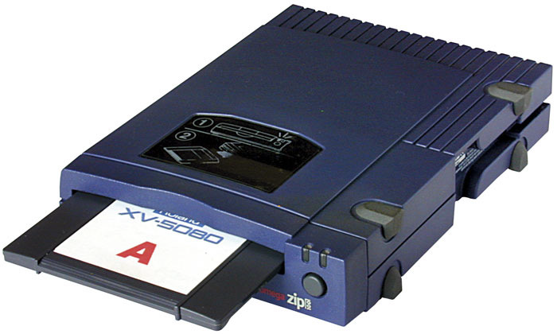
g) Laser Servo 120 SuperDisks
A diskette that resembles the 3.5 inch diskette but uses optical technology. It has a high storage capacity of up to 240 MB. The LS-120 drive can also read and write both the 3.5 inch floppy diskette and the 120 MB superdisk.
Zip disk and zip drive

Slide 158
Protection and care of Magnetic Storage media
1. Do not put media in areas where magnetic field is present. This would disorient the magnetic dipoles causing erasure of recorded data.
2. Do not bend (Floppy Disks and Tape) to avoid breaking or damaging them.
3. Do not store in high temperatures and / or in humid areas.
4. Do not store in dusty environment.
5. Do not touch the magnetic surfaces.
6. Do not remove a media from the drive when it is still being accessed by the computer. This may lead to data loss.
7. Do not drop magnetic media on the ground because the impact weakens magnetism.

Slide 159
2. OPTICAL DISKS
These are disks that are read using laser lights. The disk is made mainly with a type of plastic polycarbonate material. Data and information are stored on a layer inside the plastic. A metal coating (usually aluminium) reflects the laser light back to a sensor.
The data is encoded and read optically with laser light. Data is represented on the surface of the disk as a series of lands and pits. A pit is a small depression formed by the laser beam burning on the data layer when the disk is being created.
The land is the part between the pits on the smooth surface of the disk. The land represents a ‘1’ and the pit represents a ‘0’ bit.
The speed at which data is accessed depends on how fast the disk spins in the optical disk drive.

Slide 160
a) The CD-ROM
CD-ROM stands for Compact Disk – Read Only Memory. This is an optical disk where information is stored at the time of manufacturing.
Examples of CD-ROM are Music CD’s and software that one buys from computer shops such as games.
Optical disks write data with a high power laser beam, which records data by burning tiny pits onto the surface of the disk. In order to read data, a low power laser beam reads data by reflecting smooth areas, which are interpreted as 1 bit, and not reflecting pitted areas which are interpreted as 0 bit.
The typical storage capacity of a CD-ROM is 700Mb, which makes them a very versatile data storage media when it comes to store data for short and long term periods of time.
The process of storing data in a CD is called toasting, burning or writing.

Slide 161
b) CD-R
CD-R which stands for Compact Disk- Recordable is a CD format that allows users to use a CD-R drive to write data, only once, onto a specially manufactured disk that can then be read by a standard CD-ROM drive. It is also referred to as Write Once Read Many (WORM).
c) CD-RW
CD-RW stands for Compact Disk – Rewritable. This type of media allows users to copy and erase data. Thus, this disk can be used over and over again.
d)DVD’s
DVD stands for Digital Video Disk or Digital Versatile Disk. This optical disk looks like a normal CD but in fact, it can store much more data than a CD
The main types of DVD’s are DVD-ROM (read only), DVD-R (recordable) and DVD-RW (rewritable).

Slide 162
The following is a list of the most common DVD types with their respective capacities:
a. Single Sided / Single layer – 4.7Gb
b. Single Sided / Double layer – 8.5Gb
c. Double Sided / Single layer – 9.4Gb
d. Double Sided / Double layer – 17Gb
Typically, these types of disks are used to store movies, modern computer games , software and data files.
DVD drives can read both the DVD’s and CD’s. However, a CD drive cannot read a DVD due to its storage capacity and density.
DVD’s stores more information than CD’s because of the following reasons:
The tracks and sectors in a DVD are held closer together as compared to a CD thus allowing more tracks.
The pits in which data is stored are much smaller in a DVD than in a CD, hence more pits will fit on the disk allowing more information to be stored.
Some DVD’s are double sided. This allows data to be stored on both sides and therefore automatically the storage surface is increased

Slide 163
Care of optical disks:
They should be stored in their cases when not in use to protect them from being scratched (damage on the surface) or getting dirt.
Avoid soiling the surface of the disk-hold it by the edge or centre hole.
Keep the disks clean by wiping both sides with a clean dry cloth from the centre to the outer edge, not by wiping around the disk.
Do not write on the top side of the disk with a ball point or any other hard sharp object. This can damage the data layer on the other side.
Don’t write on the top side with a fine point marker or with any solvent-based marker. (solvent may dissolve the protective layer).
Do not expose the disk to high temperature or humidity for an extended period of time since the disk may warp (become bent or twisted out of shape as a result of heat or dampness).

Slide 164

DVD inside a DVD drive

Slide 165
3) Electronic/solid state media
Solid state storage is a non-volatile storage that employs integrated circuits rather than mechanical, magnetic or optical technology. They are referred to as solid state because they do not have movable parts. They include:
a) Universal Serial Bus (USB) flash drive
It is a data storage device that consist of flash memory; a non-volatile computer storage chip that can be electrically erased and reprogrammed. It has an integrated Universal Serial Bus interface.
Flash drives are typically removable, rewritable and physically small in size.
They can have storage capacities of 16 GB and above.

Slide 166
b) Flash memory card
It is an electronic flash memory data storage device used for storing digital information.
They are mainly used with many electronic devices such as digital cameras, mobile phones, laptop computers, MP3 players and video game consoles. They are small, re-recordable and non-volatile. They are approximately 1.5 cm in length, 1 cm in width and 2 mm in thickness.
Both the USB flash drive and flash memory card have become an integral part of modern living.

Slide 167
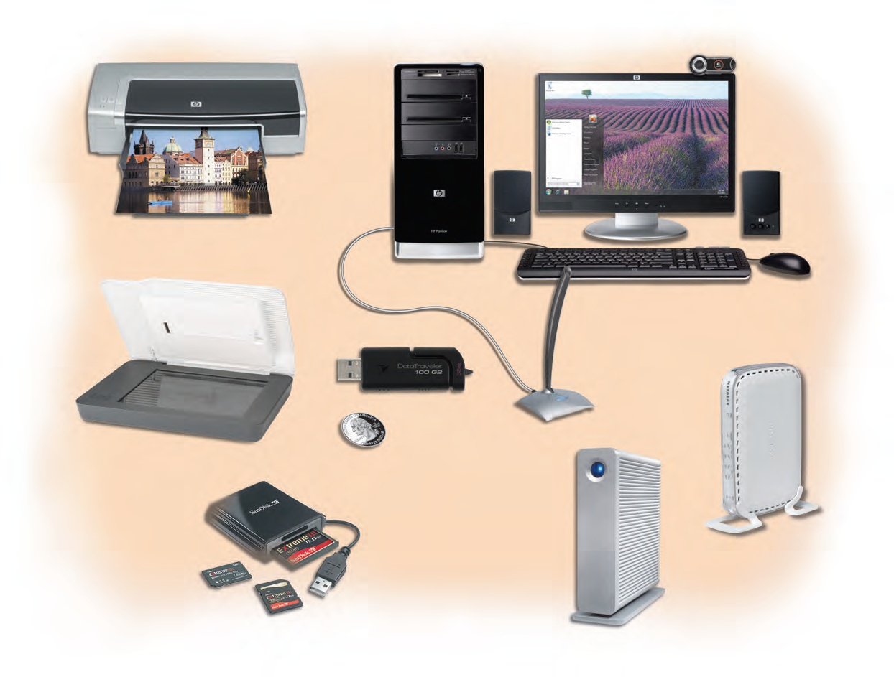
USB FLASH DRIVE
FLASH MEMORY CARD
In summary:
Flash memory is non-volatile solid-state computer memory storage that can be electrically erased and reprogrammed. It is a technology that is primarily used in memory cards and USB flash drives for general storage and transfer of data between computers and other digital products. It is a specific type of
EEPROM (Electrically Erasable Programmable Read-Only Memory)
This type of memory media has no mechanical moving parts and thus it offers some advantages when compared to the other type of media.

Slide 168
Advantages:
1. Very small in size hence portable.
2. Does not consume a lot of energy in order to function
3. Noiseless during data access
4. Limited heat emission
Disadvantages:
Limited amount of memory capacity when compared to the other type of media (Currently big advancements are being made and the maximum capacity of this media is 60GB).
Highly vulnerable to malware/virus
Because of their small size and big capacity, electronic memory is suitable to be used in portable devices. Today electronic memory is being used in Digital cameras, Mp3 Players, PDAs, Mobile phones and Laptops.

Slide 169
Comparison between primary storage and secondary storage
PRIMARY STORAGE | SECONDARY STORAGE
1. It is directly accessible by the processor | 1. It is not directly accessible by the processor.
2. It offers temporary storage (volatile). Its contents disappear once the computer is switched off. | 2. It offers permanent storage (non-volatile). Its contents does not disappear once the computer is switched off.
3. It does not have a high storage capacity. | 3. It has a high storage capacity.
4. It is fixed on the motherboard inside the system unit. | 4. Apart from the hard disk, most of these storage media are removable and located outside the system unit.
5. It is expensive to purchase. | 5. It is cheap to purchase.

Slide 170

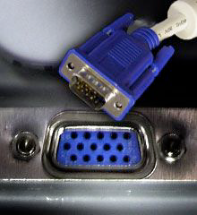
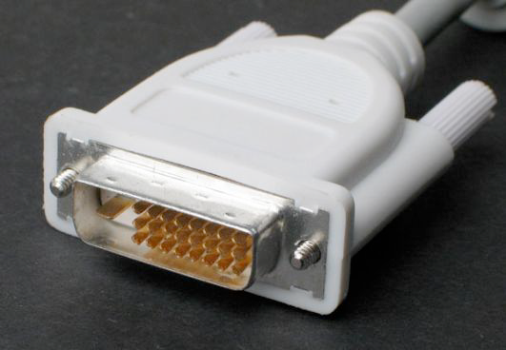
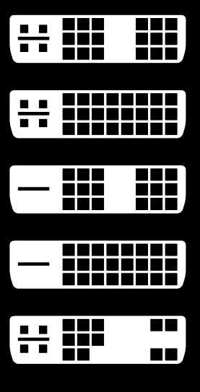
Peripheral Device Interfacing
Peripheral device interfacing refers to connecting a peripheral device to a computer via ports using cables or via wireless connectivity.
A port is an electrical connection using multiple wires to send data typically between a computer and a device.
An interface is a standardized method of communicating data typically between a computer and a device.
I/O ports
Video Graphics
Adapter (VGA) plug (male
connector) on a cable
above and a 15-pin VGA
receptacle (female
connector)
DVI plug (male
connector) on cable
Digital Visual
Interface (DVI)

Slide 171


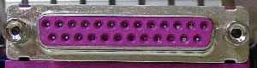




Audio (speakers or
headphones) output on
left;
microphone input on right.
25-pin D-shell receptacle. Connects: printer, scanner, magnetic tape
Male 9-pin D-shell
RS232C serial connector
on a PC.
Connects: modem,
printer,
keyboard
Universal Serial Bus
(USB 1.1 or USB 2.0) Type A receptacle on a computer host or a hub
PS/2 mouse or keyboard
connector on a PC,
typically with an icon for
a mouse (cyan) or for a
keyboard (magenta)
Type A plug to a host or hub

Slide 172





Bluetooth wireless
Enhanced Integrated
Device Electronics
(EIDE) female connector on a ribbon cable. They connect internal floppy or hard or optical disk
FireWire 4-pin mini
receptacle on a computer
FireWire 4-pin mini plug
(left, to the computer) and
FireWire 6-pin standard
plug (right, to the device). used for streaming video from digital cameras
Serial Advanced
Technology Attachment (SATA) The SATA serial port was designed to replace the slower EIDE parallel port

Slide 173





Small Computer
System Interface
(SCSI-1 or SCSI-2);
50-pin SCSI-2 connector on an interface card (SCSI-1 uses 25 pins; Wide SCSI uses 68 pins)
Centronics 50-pin SCSI-2
connector on a cable
Ethernet
Cable with an 8-wire
RJ45 plug (male connector) on each end
RJ45 receptacle (8-pin female connector) with its Ethernet icon at the left

Slide 174

Assignment:
=Make brief notes on power supply and device interfacing. Page 65-69.
=Draw the table on symbols and ports page 69. table 2.2

Slide 175
What is Hot swapping/hot plugging?
Refers to the connection or replacing some computer components without shutting down the computer system.
Once the appropriate software is installed in the computer, a user can plug and unplug the component without rebooting.
A Universal Serial Bus (USB) port is an example of a functionality that allows a user to add or remove a peripheral device such as mouse, keyboard or printer.
Computer components are usually referred to as cold pluggable if the computer system must be switched off in order to add or remove them.

Slide 176
What is Plug and Play (PnP)?
It refers to a technology that provides a combination of hardware and software support that enables the Windows operating system to detect and configure hardware with little or no user involvement.
Some bus types such as Peripheral Component Interconnect (PCI) and the Universal Serial Bus (USB), take full advantage of plug and play.
Plug and Play devices are capable of identifying themselves and declaring their services and resource requirements to the Operating System. This enables the operating system to determine and set a working configuration, then load the appropriate device drivers without the users intervention.

Slide 177
What is a Device Driver?
A Driver is a computer program that operates or controls a particular type of device that is attached to a computer.
A driver provides a software interface to hardware devices enabling the operating system and other programs to access the hardware functions.
What is a Disk Drive?
A disk drive is a device that allows a computer to read from or write to computer disks or other storage media. They include the hard disk drive, floppy disk drive, optical disk drives, flash and memory stick drives.

Slide 178
A computer student was attempting to print a publication he had prepared. The printer did not respond to the print command. Explain FOUR possible causes for the anomaly.
He had not selected the printer type in the printer dialog box.
The data cable between the printer and the computer was loose or unplugged.
He had not powered/switched on the printer.
The toner or cartridge on the printer had been removed.
The printer was out of paper.
The printer drivers had not been installed in the computer system or they had been disabled.

Slide 179
Why does the Hard Disk light flash/blink when the computer is not being used?
Windows could be running some of its applications on the background such as: scheduled Antivirus scans, backups, automatic updates, file indexing, defragmentation etc.
Open applications running in the background such as a Word processor.
Possibility of there being a malware.
Possibility of a download taking place.
An audio application could be running.
Logged on to another user account.
The End

