Slide 1
COMPUTER STUDIES
FORM 2
COURSE WORK
INTERNET AND E-MAIL
REF: KLB LOG ON BK 2, COMPUTER STUDIES-ONUNGA BK 2, LONGHORN COMPUTER STUDIES BK 2, KLB TOP MARK, INTERNET

Slide 2
INTERNET AND E-MAIL
CHAPTER OBJECTIVES:
By the end of the topic, the learners should be able to:
Define Internet.
Explain the development and importance of Internet.
Describe Internet connectivity.
Identify Internet services.
Access the Internet.
Use E-mail facilities
State the moral, social and spiritual issues that may immerge through access to the Internet.

Slide 3
Definition:
The Internet is a global network of computers providing a variety of resources and data to the people who use it.
It is a large set of computer networks that communicate with each other either through telephone lines, fiber optic cables or wireless connectivity.
Internet can be broken down into two words, inter and net which implies that it is an interconnection of networks.
Individual networks may be owned by private individuals, research institutions, universities and colleges, government organisations, business corporations etc.
Being part of the network means that you can access, share and exchange information.
Because of its large size and the vast information that passes through it, the Internet can also be referred to as Information superhighway.

Slide 4
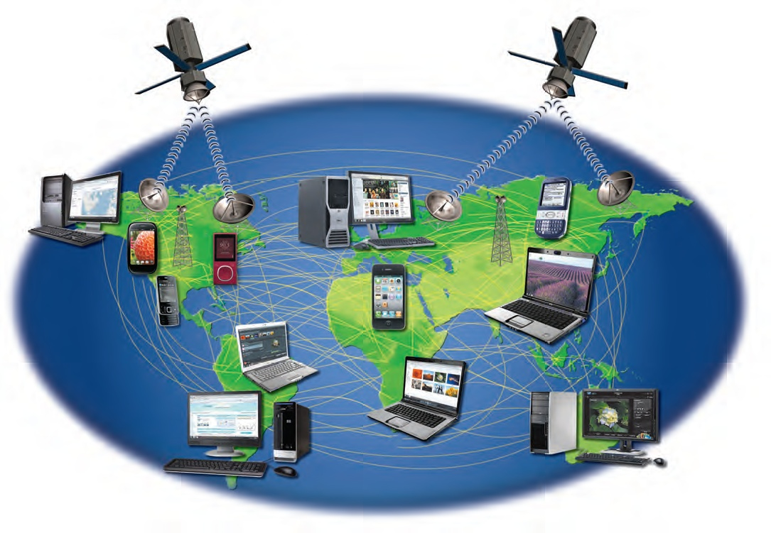
The Internet is the largest computer network, connecting millions of computers and devices around the world.

Slide 5
Who owns the Internet?
The Internet does not have a central authority. There are organisations which develop technical aspects of the network and set standards for creating applications on it, but no one governing body or government is in control.
The internet therefore has very few rules and answers to no single organisation. It consists of independently maintained and administered networks. Each network on the Internet is responsible for formulating its own policies, procedures and rules.
The Internet backbone, through which data traffic flows is owned by private companies.

Slide 6
Development of The Internet
The internet began in 1969 as ARPAnet (Advanced Research Projects Agency), a United States Department of Defence project to create a nationwide computer network that would continue to function even if a large portion of it was destroyed in a nuclear war or natural disaster. The network was decentralised and originally consisted of four supercomputers.
ARPAnet was originally used by defence scientists and military researchers to log in and run programs from remote computers. In 1983, ARPAnet was split into two parts: MILnet, which was devoted entirely to the military, and ARPAnet, devoted to experimental research and development.

Slide 7
In 1986, the success of networking and computer technology led the US National Science Foundation (NSF) to establish NSFNET, which connected users together with five supercomputers. It was then expanded to include regional and state wide networks that connected universities and research organisations. The nature of the Internet changed in 1992, when the US government began offering Internet access to the general public.

Slide 8
Importance of the Internet
The internet has led to the emergence of information society, a society that regards information as a valuable commodity. Some of its importance include:
Speedy and inexpensive communication via electronic mail (e-mail), chat and conferencing.
Provides vast news and information.
Education through virtual learning or electronic learning (e-learning), online books and research.
Commerce and industry through electronic business (e-business), online shopping and electronic banking (e-banking).
Entertainment: through sports news, movies, music and chatrooms such as Facebook.
Job opportunities through job adverts.
Software downloading (free ware).

Slide 9
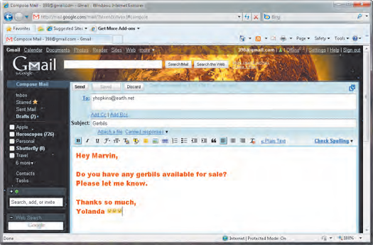
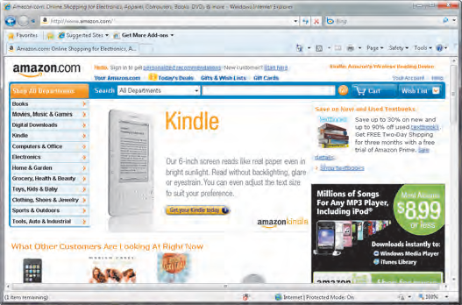
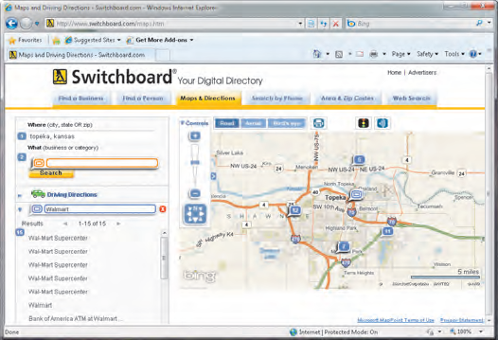
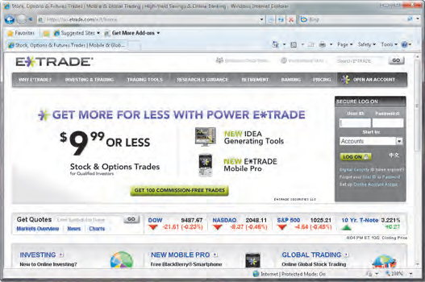
shop
communicate
Bank and invest
Research and access information

Slide 10
Problems of the Internet
Lots of incorrect information is available; there is no authority to check the accuracy of Internet documents.
Computer viruses can easily be downloaded without the user realising it through free ware.
Erosion of social culture; people no longer find time to socialize especially with the advent of mobile phone technology.
Moral decay through access to obscene sites.
Security of information may not be guaranteed in an organisation through various computer crimes such as hacking, cracking, eavesdropping and industrial espionage.
Excessive amount of information accessible to users can overwhelm them causing information overload (information fatigue syndrome).
Abuse of Copyright Law. Many users are plagiarising other peoples work.
Ethical issues such as intrusion of peoples privacy and malicious fabrication of stories, placing of doctored photographs and circulating them over the internet.

Slide 11
Internet connectivity requirements
To access the Internet, the following elements are required.
Computer system: this may include a Personal desktop computer, laptop or a handheld device such as a mobile phone or a Personal Digital Assistant (PDA).
Transmission media: this can either be telecommunication facilities such as telephone lines, exchange stations and satellite stations. Media can be physical or wireless pathways.
Modem: the term Modem refers to Modulator and Demodulator. This facility is able to convert digital signal to analog (modulation) for transmission through a media that handles analog data. It also reconverts the analog signal to digital form (demodulation) for the receiving computer.
Internet Service Providers (ISPs): these are companies that offer Internet services to the end users. In Kenya, the sole gateway to the Internet for a long time was Telkoms Jambonet. Due to heavy workload, they leased some of their lines to ISPs such as Swift Kenya and Africa Online. Demand for internet has led to the coming up of other ISPs such as Wananchi, Access Kenya, Airtel, Safaricom, Kenya Data Network (KDN) and Orange among others.

Slide 12
(v) Internet Software (web browser): special software which are required to facilitate access to the internet. They are also called protocols. A protocol is a set of rules that govern how computers send and receive information. An example is Transmission Control Protocol/Internet Protocol (TCP/IP).
Internet services
World Wide Web (WWW)
This is a set of Internet servers and computer systems that support specially formatted documents using a markup language called Hyper Text Markup Language (HTML). This language supports links to other documents, graphics, audio and video files. This helps to navigate from one file or section to another.
The WWW is made up of many websites that are able to link with one another hence putting a lot of information in different forms together.
Today, many organisations employ web designers to help in updating their websites.

Slide 13
Many people use the terms Internet and World Wide Web interchangeably. Though inter-related, the two terms are different.
The Internet is a massive network connecting millions of computers globally.
The WWW or the web is a way of accessing information in a web page over the Internet medium.
What makes up the web?
Web Pages: a web page is a single screen of information which may contain text, images, animation, sound and video. The web page is viewed via a web browser software.
Web Sites: a web site is a collection of web pages published as one interconnected entity.
Web portals: these are web pages that offer specialised services such as searching, e-mail, sports updates, news and links to selected web sites.
Blog: a web site that contains personal information which can easily be updated. Some blogs act as resumes, diaries and may be used for business, advocacy and campaign purposes.
hyperlinks: these are elements in a web site that connect a web page to other pages in a web site. They include Hypertext (coloured text) and Hypermedia(can be inform of graphics, sound or video).

Slide 14
Multimedia: sites that contain photos, movies, music, Web TV and Internet radio. They are meant for entertainment.
Accessing the Internet
To access the Internet, a web browser software is required. Common web browsers include:
Internet Explorer.
Netscape Navigator.
Mozilla Firefox.
Google Chrome.
Safari.
Konqueror.
Opera
Flock
AOL Explorer etc.
Assignment: draw table 5.1 pg 209 KLB Log On book 2 (functions of the commands of internet explorer window)

Slide 15
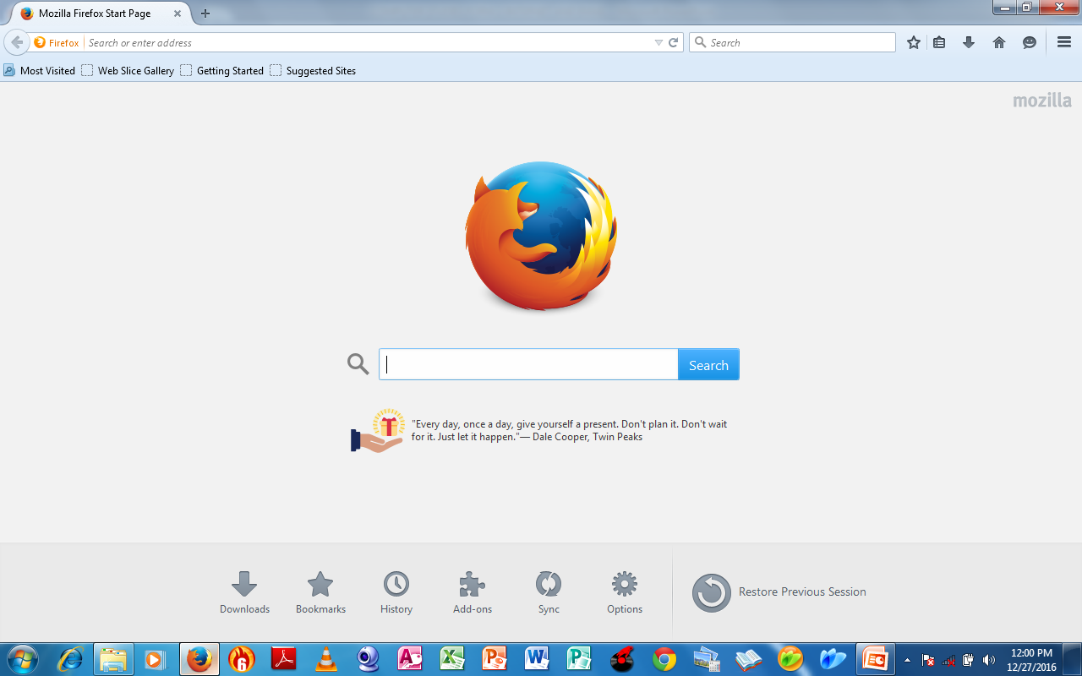
Mozilla Firefox browser window

Slide 16
Log-in/Sign-in: in order to be able to use some services in the Internet such as e-mail, one has to get authentication. It is the process through which an individual gains access to an internet resource by identifying and authenticating themselves. The user credentials are typically a ‘user name’ and a ‘password’.
Sign Up: this is a feature that enables a user to create an Internet account such as e-mail account, Facebook account and other work or service related accounts.
Sign Out: refers to exiting the account. Always sign out of the account once you are through with your activities.

Slide 17
(iv) Surf/Browse: refers to viewing, searching or accessing data from the internet using a search engine.
(v) Search engine: software that allow the user to type keywords that run against a database on the Internet when searching for some information. It is used when the Uniform Resource Locator (URL) is unknown. Examples of search engines: Google, Yahoo, Alta Vista, Excite, alltheweb and HotBot.
(vi) Uniform Resource Locator (URL): this is the Internet address of a particular web page or internet file.

Slide 18
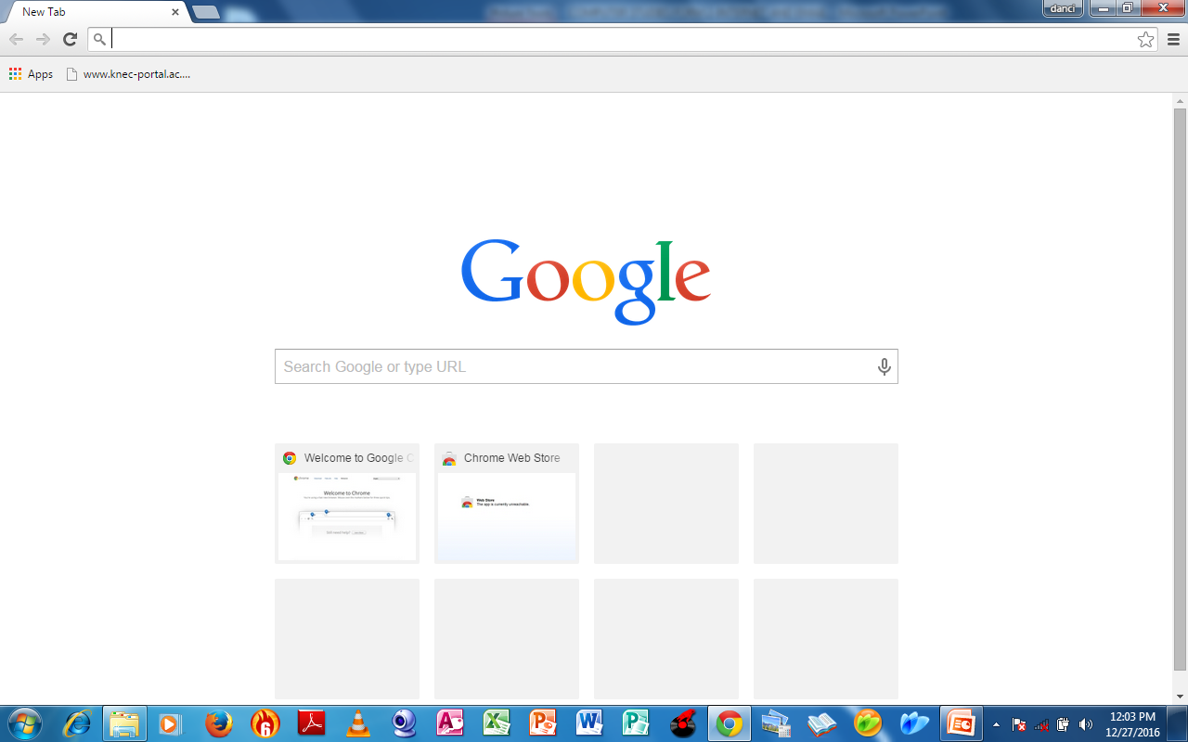
Google Chrome browser with Google search engine displayed

Slide 19
The Uniform Resource Locator is entered in the address field located at the top of the browser window just below the menu bar. It is made up of four parts as shown in the example below.
http://www.ascd.org/studyguides.doc
Protocol://server/path/filename
Protocol: the name of the internet protocol, usually http (Hyper Text Transfer Protocol), giving access to the site.
server (host name, e.g. www): the computer on which the document is located.
Path (directory hierarchy): the top level directory and any lower-level sub-directories (separated by ‘/’ characters) in which the required file is to be found.
Filename: the actual file name of the document being accessed.

Slide 20
The URL example above can be interpreted as follows:
Internet Protocol (IP) addresses
Each computer on the internet has a unique address that identifies it as a node so that information can be sent to it. This unique address is usually a number called IP address (Internet Protocol address). It consists of four sets of up to three digits each, separated by full stops, for example 196.361.232.4. The first part of the address specifies the network and the last two digits specifies the host computer.
URL part | Description
http:// | The transfer protocol to be used.
www | Name of the server computer.
.ascd | Sub-domain name.
.org | Top level domain name or type of organisation.
/ | A separator to indicate a change of directory in the servers’ storage medium.
Studyguides | Name of the document.

Slide 21
To allow users to refer hosts by names, the Domain Name System (DNS) was developed. This divides the Internet into a series of domains. The table below shows a list of top-level domains and their purpose.
Domain name | Purpose
.com or .co | Commercial organisation
.edu | Educational institution
.gov | Government bodies
.mil | Military institutions
.net | Computer networks
.org | Other types of organisations e.g. non-profit organisations.
.rec | Recreational organisations
.info | Distributors of information
.ac | Academic institutions

Slide 22
Uniform Resource Locator (URL)-simplified
http://www.asteron.co.uk/smith/index.html
Note:
The symbols (:) (//) (/) (.) are called delimiters and are used to separate different parts of the URL address.
Domain name
Country domain
protocol
Host/server name
Sub-domain name
Directory on the server
File name

Slide 23
Sometimes, a two letter extension is added after the domain name to show the country where the site is located e.g. http://knec-portal.ac.ke
.ke stands for Kenya.
.us stands for United States.
.ug stands for Uganda.
.uk stands for the United Kingdom.
.au stands for Australia.
.jp stands for Japan.
.za stands for South Africa.
.sa stands for Saudi Arabia etc.
(vi) Downloading: refers to the process of accessing, retrieving and saving information from the internet to a local computer.
(vii) Uploading: refers to the process of transferring information from a local computer to the internet.

Slide 24
Electronic Mail (e-mail)
E-mail is the most popular and widely used service on the internet today. Any kind of mail prepared and sent through electronic devices is e-mail.
E-mail enables users to send and receive electronic messages (text, sound, video and graphics) either locally or globally.
A powerful feature of the e-mail is the ability to send attachments (other documents annexed to the message).
In order to send and receive messages, each user must have an e-mail address. The address should be unique to each user. A typical e-mail address appears as follows:
Dancing@gmail.com

Slide 25
An e-mail address has the following sections:
The user name e.g. dancing
The @ ‘at’ sign: separates the user name form the rest of the address.
The host server name (the computer in which the e-mail account is hosted) e.g. gmail, yahoo etc.
The period “ . ” read as “dot”, also used to separate various parts of the address.
The domain name e.g. .com, .edu, .org among others
dancing@gmail.com
“at”
“dot”
Domain name
User name
Host/ server name

Slide 26
E-mail software
The commonly used e-mail software are:
Microsoft Outlook
Netscape Communicator
Eudora
However, e-mail facilities are found within many search engines. These includes Google, Yahoo and MSN among others.
Localised e-mail addresses are available for different firms. E-mail software allows the user to compose, view, send and receive e-mails. The e-mails are usually stored in separate folders as described below.
Inbox: stores all incoming e-mails.
Outbox: contains e-mails that are waiting to be sent.
Sent: contains e-mails that have already been sent.
Drafts: contains e-mails that are being worked on, and are not yet ready to be sent.
Deleted items: contains e-mails that have been deleted. You can recover a deleted mail as long as you have not emptied this folder.
Spam: also known as junk e-mail, is a folder where unsolicited messages are stored.

Slide 27
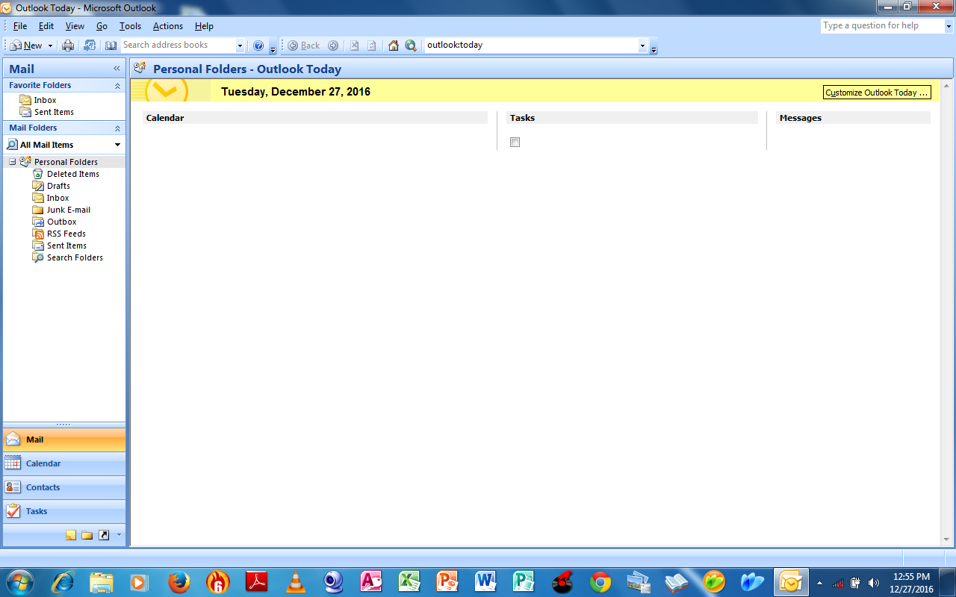
Microsoft Outlook e-mail window

Slide 28
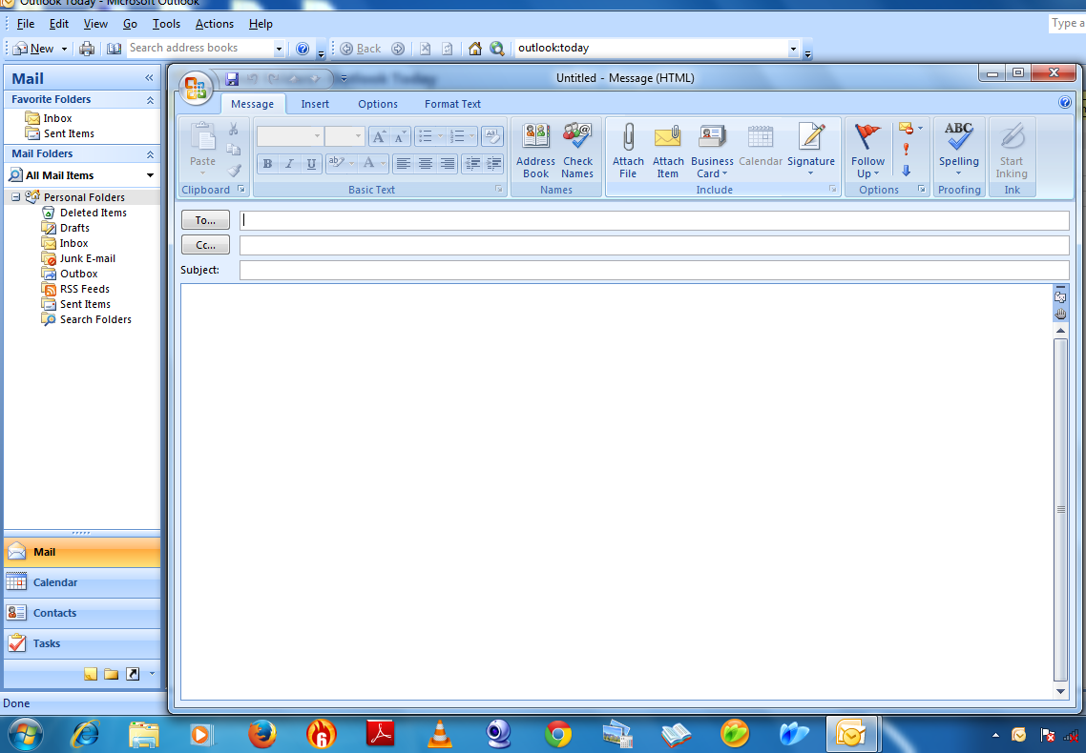
Microsoft Outlook New Mail window

Slide 29
Composing an E-mail
Before you send an e-mail, you need to create it first. This is done by logging-in or signing-in to your e-mail account. On opening the account, start with Compose Mail, Create Mail or New Mail message command.
The common header elements in the new e-mail window are:
To: this is where the e-mail address of the recipient(s) is entered.
From: this is where the e-mail software automatically enters the senders e-mail address.
Subject: should contain a few words outlining the nature of the message to be sent.
CC: stands for Carbon Copy, and is used to copy an e-mail to other recipients. The main recipient is able to see who the e-mail has been sent to.
BCC: stands for Blind Carbon Copy, meaning that a copy of the message has been sent to an extra address, without any indication of that action appearing on the main recipient’s copy of the message.

Slide 30
Date: the date and time the message is sent.
Send: this feature is used to dispatch the e-mails using the Send command.
Attachments: the name and location of any file you may be sending along with the e-mail. Attachments may include pictures, videos and program files. Most systems allow a maximum file size of 10 MB, hence any attachment greater than 10 MB needs to be compressed before it is sent. The receiving computer must have software for decompressing the attachment.
Forward: this feature allows one to pass on an e-mail that was in the Inbox folder to other recipients.

Slide 31
Advantages of E-mail over Traditional Mail
It is possible to send mail to many recipients at the same time.
It is more secure.
Information in different forms (audio, visual or textual) can be sent as attachments.
Relatively cheaper compared to posting letters.
provides a very high speed of transmitting the mail.
Disadvantages
The initial set up cost is high.
Through e-mails, viruses and worms can be transmitted which cause havoc to the computer system.
Hackers and crackers easily interfere with peoples privacy.
Only computer literate people are comfortable with use of e-mail.

Slide 32
~The End~

