Slide 1
SPREADSHEETS
FORM 2
COURSE WORK
REF: KLB LOG ON BK 2, COMPUTER STUDIES-ONUNGA BK 2, LONGHORN COMPUTER STUDIES BK 2, KLB TOP MARK, INTERNET

Slide 2
SPREADSHEETS:
Definition:
It is an application software used to calculate, organize and analyze numerical data.
It is also a productivity software package that enable users to develop tables and financial schedules.
Spreadsheets consist of rows and columns much like the manual paper ledgers.
A spreadsheet enables a user to store not only numerical data but also formulae to carry out operations on the data.

Slide 3
There are two types of spreadsheets i.e. manual and electronic spreadsheets.
A manual spreadsheet is prepared using pen and papers and is used by book keepers as a ledger book with many sheets of papers.
An electronic spreadsheet on the other hand is prepared using a computer program that enables users to enter data in rows and columns and manipulate it mathematically using a formulae.
Examples of electronic spreadsheets:
Microsoft Excel
OpenOffice Calc
Lotus 1-2-3
Corel Quattro Pro
MultiPlan
VP-Planner
VisiCalc

Slide 4
Advantages of electronic spreadsheets over manual spreadsheets
Electronic spreadsheets utilise the powerful aspects of the computer such as speed, accuracy and efficiency to enable the user quickly accomplish tasks
They offer a large virtual sheet for data entry and manipulation. A typical worksheet has 65,536 rows and 256 columns.
They utilise the large storage space on computer storage devices to save and retrieve documents.

Slide 5
iv. They enable the user to produce neat work because the traditional paper, pencil, pen, rubber and calculator are put aside.
v. Electronic spreadsheets have better formatting capabilities.
vi. They have inbuilt formulae called functions that enable users to quickly manipulate mathematical data.
vii. An electronic spreadsheets automatically adjusts the result of a formula if the values in a worksheet are changed (automatic recalculation).

Slide 6
COMPONENTS OF A SPREADSHEET
A spreadsheet has three components namely:
Worksheet
Database
Graphs
WORKSHEET:
This is the component in which data values are entered and it is made up of rows and columns. The intersection between a row and a column is called a cell.
A row is a horizontal arrangement of cells while a column is a vertical arrangement of cells.

Slide 7
Each row is labeled with a number (row header) and each column is labeled with a letter (column header). Each cell is referenced/addressed/named using the column header followed by the row header i.e. in the order ColumnRow.
A group of many worksheets make a workbook.

Slide 8
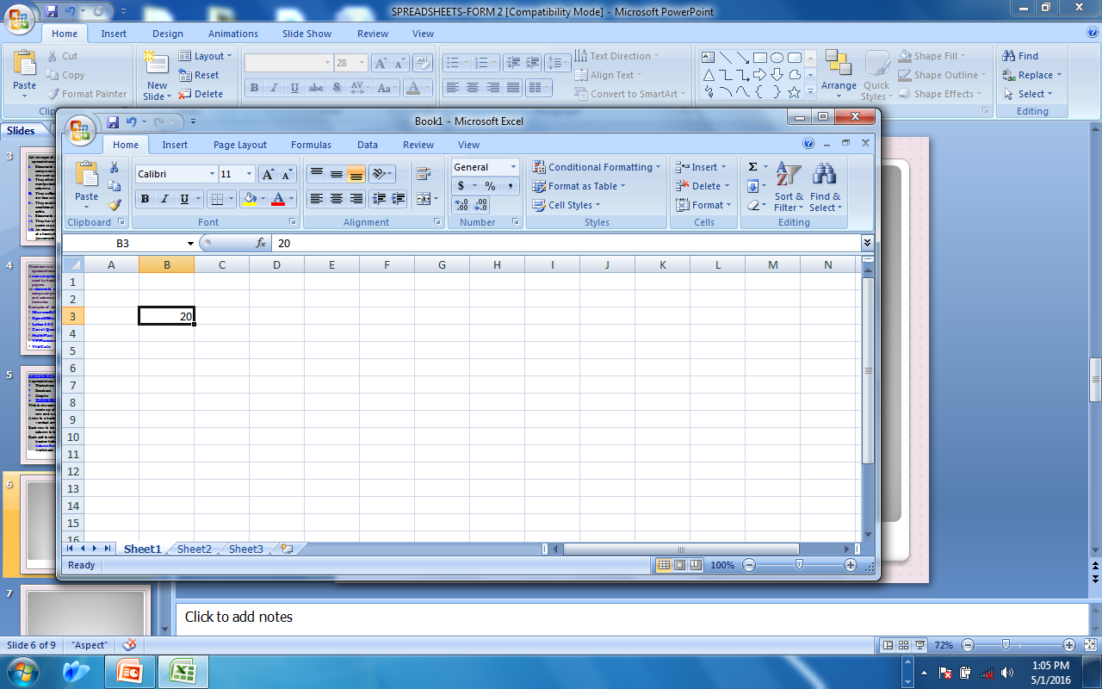
Row 3
Value 20 in cell B3
Column E
DATABASE:
A database is a collection of related data items organised in such a way as to provide a consistent and controlled access to items. In spreadsheets, a worksheet list may contain related data organised into rows that can be manipulated using database functions such as sorting, filtering, validation, subtotaling, pivot tables and consolidation.

Slide 9
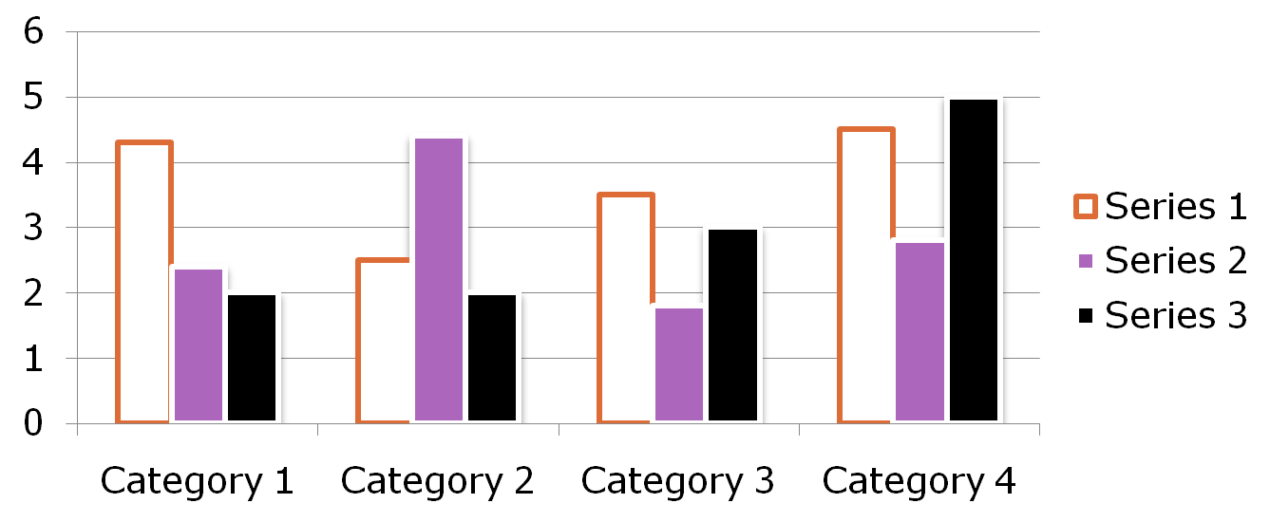
GRAPHS:
A graph is a pictorial representation of base data in a worksheet. Most spreadsheets refer to graphs as charts.
A chart enables the user to present complex data elements from a worksheet in a simple and easy to understand format. Examples of charts include pie charts, line charts and bar charts.

Slide 10
Application areas of spreadsheets:
Statistical analysis.
Accounting.
Mathematical and scientific applications.
Forecasting (‘what if’ analysis).
Data management.
Assignment:
Expound on application areas of spreadsheets. (longhorn bk 2 pg 52 and Onunga bk 2 pg 74-75, KLB Log on bk 2 pg 68-69)

Slide 11
CREATING WORKSHEETS/WORKBOOKS USING
MICROSOFT EXCEL 2007
Getting started:
Steps:
Click Start menu.
Click Programs/All Programs
Click Microsoft office folder
Click Microsoft Excel 2007
On following the above steps, a workbook made up of rows and columns appears. You can also start a spreadsheet from a template (specially preformatted spreadsheet document)

Slide 12
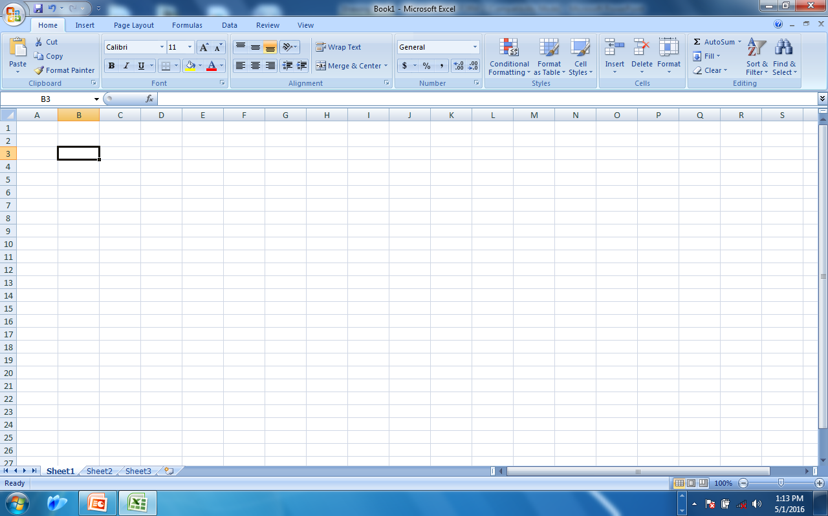
Cell name box
Formular bar
Active cell pointer
Column header
Row header
row
Worksheet tabs
column

Slide 13
Parts of Excel spreadsheet:
Column: a vertical arrangement of cells named alphabetically.
Row: a horizontal arrangement of cells named numerically.
Cell: the intersection between a row and a column. Each cell has an address named in the order, ColumnRow e.g. A1, B3, C15 and so on.

Slide 14
Active cell pointer: a cell that is ready to take in data. It always appears thicker than other cells.
Worksheet: a single sheet in a workbook made up of rows and columns where data is entered.
Workbook: a combination of 16 or more worksheets containing related data items.
Worksheet tabs: they are located at the bottom of the worksheet and show the number of worksheets in a workbook. By default, they are named sheet 1, sheet 2, sheet 3 and so on. They can be renamed depending on the users needs.

Slide 15
Chartsheet: a worksheet that contains a chart only.
Formula bar: this is where a cell entry or formula is displayed when being entered into the selected cell.
Cell/range name box: displays the name/address of the active cell or range of cells.
Worksheet browsers: located at the bottom left of the screen, these buttons are used for navigating through the worksheets.

Slide 16
Navigating a Worksheet:
The following keyboard keys can be used to navigate through cells in a worksheet.
Control keys | Function
Arrow keys | Moves the cell pointer to the left, right, up or down cells from the active cell respectively.
Tab key | Moves the cell pointer to the right of the active cell.

Slide 17
Enter | Moves the cell pointer to one cell down from the active cell.
Shift + Tab | Moves the cell pointer to one cell left from the active cell
Home | Moves the cell pointer to column A of the active Row.
Ctrl + Home | Moves the cell pointer to cell A1.
Ctrl + End | Moves the cell pointer to the last typed cell

Slide 18
Page Up | Moves the cell pointer to one screen width up.
Page down | Moves the cell pointer to one screen width down.
Alt + Page Up | Moves the cell pointer to one screen width to the left.
Alt + Page Down | Moves the cell pointer to one screen width to the right.
Ctrl + Page Up | Moves the cell pointer to the previous worksheet.
Ctrl + Page Down | Moves the cell pointer to the next worksheet.

Slide 19
Cell data types:
Entries into a worksheet can be classified into four categories namely:
Labels: refers to any text or alphanumerical characters entered in a cell that are not meant for calculations. They are always left aligned in a cell. Numerical values can also be formatted so as they can be used as labels.
Values: numerical data that are meant for calculations or that can be manipulated mathematically. They are always right aligned and include date, currency, numbers (0-9) or special symbols.

Slide 20
3. Formulae: mathematical expressions that create relationship between cells to return a new value. In Excel, a formula MUST start with an equal (=) sign. Excel formulae use cell addresses and arithmetic operators e.g. the formula =B3+D4 adds the contents of cell B3 and D4 and returns the sum value in the current cell.
4. Function: these are inbuilt predefined formulae that can automatically calculate results based on data provided in the worksheet.

Slide 21
OPERATORS
These are symbols used to specify the type of calculation to be done on an element of a formula.
Types of operators:
Arithmetic operators.
Comparison operators.
Text operators.
Reference operators.
Arithmetic operators
They define the type of mathematical operation to be done on an element of a formula. They follow the concept of BODMAS.

Slide 22
Operator | Meaning | Example in use
+ (plus) | Addition | =A1+B1
- (minus) | Subtraction | =A1-B1
/ (forward slash) | Division | =A1/B1
* (asterisk) | Multiplication | =A1*B1
^ (caret) | exponentiation | =3^3 (raised to power)

Slide 23
Comparison operators:
They compare two or more values in a cell and display the logical result; true or false. These operators must be chosen correctly to achieve correct results.
Text operator:
Used to join two or more text together to form one text:
Operator | Meaning | Example in use
< | Less than | =A1<B1
> | Greater than | =A1>B1
<= | Less than or equal to | =A1<=B1
>= | Greater than or equal to | =A1>=B1
<> | Not equal to | =A1<>B1
Operator | Meaning | Example in use
& (ampersand) | Join text | =“north”& “wind” Produces northwind

Slide 24
Reference operators:
Used to give cell address for operators and in identifying cells that are to be used in performing arithmetic operations.
Operator | Meaning | Example in use
: (colon) | Known as range operator. It defines a group of cells starting with the one before the colon through the one after the colon. | =Sum(A1:A10)
, (comma) | Union operator, combines two ranges of cells for calculation. | =Sum(A1:A10,C1:C10)

Slide 25
Calculation order
Formulas calculate values in a specific order. A formula in Excel always begins with an equal sign (=). The equal sign tells Excel that the succeeding characters constitute a formula. Following the equal sign are the elements to be calculated (the operands), which are separated by calculation operators. Excel calculates the formula from left to right, according to a specific order for each operator in the formula.

Slide 26
Use of parentheses ()
To change the order of evaluation, enclose in parentheses the part of the formula to be calculated first. For example, the following formula produces 11 because Excel calculates multiplication before addition. The formula multiplies 2 by 3 and then adds 5 to the result.
=5+2*3

Slide 27
In contrast, if you use parentheses to change the syntax, Excel adds 5 and 2 together and then multiplies the result by 3 to produce 21.
=(5+2)*3
In the example below, the parentheses around the first part of the formula force Excel to calculate B4+25 first and then divide the result by the sum of the values in the range of cells D5 to F5.
=(B4+25)/SUM(D5:F5)

Slide 28
Cell referencing
Refers to naming or addressing cells. When working with formulae, the following cell references are used.
By default, Microsoft Excel uses A1 reference style. R1C1 reference style can also be used where both row and column are numbered. R1C1 style is useful in computing the row and column positions in Macros.

Slide 29
Relative cell reference: it is the default reference. This is a method of indicating cell addresses in a formula such that the cell address can change freely during autofilling. E.g. =SUM(A1:A4), when this formula is filled across columns, it will change to =SUM(B1:B4), =SUM(C1:C4) as shown below.

Slide 30
 | A | B | C | D
1 | 45 | 67 | 89 | 21
2 | 23 | 42 | 76 | 64
3 | 56 | 32 | 57 | 30
4 | 76 | 21 | 48 | 80
5 | =SUM(A1:A4) | =SUM(B1:B4) | =SUM(C1:C4) | =SUM(D1:D4)
Direction of fill

Slide 31
2. Absolute cell reference:
This is a method of indicating cell addresses that are not meant to change during auto-filling.
Such entries are called constants and the Dollar ($) sign is used to activate these reference e.g. in =C2*$B$2, when the formula is auto-filled across rows, it changes to =D2*$B$2, =E2*$B$2…….
3. Mixed cell reference
This is a method of indicating cell addresses by making part of the cell address relative and the other one absolute i.e. a relative column and absolute row or an absolute column and a relative row e.g. C$7 where ‘C’ is relative and ‘$7’ is absolute or $C7 where ‘$C’ is absolute and ‘7’ is relative. When a mixed reference formula is copied to another cell, only the relative part of the formula is adjusted.

Slide 32
Overview of formulae and functions
Formulas are equations that perform calculations on values in a worksheet. A formula starts with an equal sign (=). For example, the following formula multiplies 2 by 3 and then adds 5 to the result.
=5+2*3
A formula can also contain any or all of the following: functions, references, operators and constants (constant: A value that is not calculated and, therefore, does not change).
Parts of a formula:
=PI() * A2^2
Functions: The PI() function returns the value of pi: 3.142...
References: A2 returns the value in cell A2.
Constants: Numbers or text values entered directly into a formula, such as 2.
Operators: The ^ (caret) operator raises a number to a power, and the * (asterisk) operator multiplies.
4
1
2
3

Slide 33
Using in-built functions:
Mathematical functions
=SUM ( ): Adds all the values in the selected range of cells e.g. =SUM(A3:F3).
=SUMIF( ): Conditionally adds the specified cells according to the set criteria e.g. =SUMIF(A3:A10, “>=1000”), returns a value if, and only if, the sum is greater than or equal to 1000.
=PRODUCT( ): Multiplies the values in the argument. E.g. =PRODUCT(A1:A10).
=ROUND( ): Rounds a number to a specified number of digits.

Slide 34
Statistical functions
=AVERAGE( ): returns the arithmetic mean of its arguments. E.g. =AVERAGE(A1:A10), returns the mean in the range A1 to A10.
=COUNT( ): counts the number of cells that contains values within a range. E.g. COUNT(A1:A10).
=COUNTIF( ): conditionally counts the number of cells within a range that meets a given condition. E.g. =COUNTIF(A1:A10,“>100”), counts the number of cells with values greater than 100.
=MAX( ): returns the largest value in a set of values within a range. E.g. =MAX(A1:A10).
=MIN( ): returns the smallest value in a set of values within a range.
=RANK( ): returns the position of a number from a range of values.
Syntax of rank: =RANK(A2,$A$1:$A$10,1)

Slide 35
Logical functions:
The most commonly used logical function is the IF function.
IF( ): It returns a value or label if a condition specified is evaluated to TRUE and another is evaluated to FALSE.
For example, if cells A3, B3, C3, D3 and E3 contain a set of marks 35, 50, 80, 60 and 45 respectively, grades are to be awarded as follows:
80 to 100 = A
60 to 79 = B
40 t0 59 = C
Below 40 = FAIL
To assign a grade, the following syntax is used;
=IF(A3>=80, “A” , IF(A3>=60, “B”,IF(A3>=40, “C”, “FAIL”)))
Cell A3 is used to reference all the other cells and during autofilling, the formula will change relatively returning true or false depending on the values in cells A3 to E3.
Function name
Resultant true or false
condition

Slide 36
4. Date and time functions
TODAY( ): returns a number that represents today’s date.
NOW( ): returns the current date and time.
DATE( ):returns a serial number that represents a particular date.
HOUR( ), MINUTE( ) or SECOND( )functions returns the current hour as 0 to 23, minute from 0 to 59 and seconds from 0 to 59 respectively.
Interpreting Formula error messages:
Error | Description
###### | Means that the column is not wide enough to display the value entered. Resize the column to the desired width.
#N/A | The formula refers to a cell that contains no value. This error warns that not all the data referenced by a formula is available.
#NAME? | Excel does not recognise a function, range, name or text entered in formula. Check the spelling of the function or verify whether the name exists.

Slide 37
Error | Description
#VALUE! | The formula contains the wrong type of argument or operator. Check for the correct syntax of the formula.
#DIV/0! | The formula is attempting to divide by zero. Check the values of the cell in the formula. (blanks or zeros)
#NULL! | The formula refers to an invalid range. Check to see whether you entered the cell or range reference correctly.
#REF! | A cell reference in the formula is incorrect. Check for changes to cell reference caused by deleting cells, rows or columns referenced by the formula.
#NUM! | There is a problem with a number used in the formula. Check for correct use of function arguments.
CIRCULAR | The formula is referencing itself i.e. the formula either directly or indirectly refers to the same cell in which the formula is being typed e.g. typing =A3*C3 in cell A3.

Slide 38
Formatting and editing worksheets:
Deleting worksheets.
Copying and moving worksheets.
Inserting and deleting rows and columns.
Inserting and deleting worksheets.
Merging cells.
Text orientation
Changing worksheet appearance.
Borders and shading.
Colors and patterns.
Wrap text
FORMATTING NUMBERS/NUMBER FORMATS:
General: This is the default number format that Excel applies when you type a number. For the most part, numbers that are formatted with the General format are displayed just the way you type them. However, if the cell is not wide enough to show the entire number, the General format rounds the numbers with decimals.

Slide 39
Number: This format is used for the general display of numbers. You can specify the number of decimal places that you want to use, whether you want to use a thousands separator, and how you want to display negative numbers.
Currency: This format is used for general monetary values and displays the default currency symbol with numbers. You can specify the number of decimal places that you want to use.
Accounting: This format is also used for monetary values, but it aligns the currency symbols and decimal points of numbers in a column.
Date: This format displays date and time serial numbers as date values, according to the type and locale (location) that you specify.

Slide 40
Time: This format displays date and time serial numbers as time values, according to the type and locale (location) that you specify.
Percentage: This format multiplies the cell value by 100 and displays the result with a percent symbol. You can specify the number of decimal places that you want to use.
Fraction: This format display a number as a fraction, according to the type of fraction that you specify.
Text: This format treats the content of a cell as text and displays the content exactly as you type it, even when numbers are typed.
Custom: This format allows you to modify a copy of an existing number format code. This creates a custom number format that is added to the list of number format codes.

Slide 41
Worksheet data management:
Data management features available in spreadsheets helps a user to manage large amounts of related data. Some database operations that can be performed on a worksheet list include data entry forms, sorting, filtering, Subtotaling and input validation.
Data entry using forms:
A data form lets the user display and enter records into a worksheet database.
Sorting:
These is the arrangement of records according to a specified field in ascending or descending order.
Filtering data:
Filters are used to display ONLY data that meet certain criteria. This is useful when you have a large worksheet and you are only interested in a small portion.

Slide 42
Subtotals and grand totals:
Subtotals function is used to summarise a worksheet list to display grouped subtotals and grand totals. The list is grouped using a preferred field.
Input validation:
These feature ensures that the user does not enter wrong or invalid data. Whenever a validation criteria set by the user is violated, an error message is displayed.
Note:
Data management tools are found under the Data tab in Excel 2007.

Slide 43
Generating charts/graphs:
Ac chart or graph, is a visually appealing diagram generated from numerical data in a worksheet.
It is a pictorial representation of base data in a worksheet.
A chart is linked to the worksheet data. After its creation, it is updated automatically whenever the data on the worksheet is modified. Charts make data easier to interpret.
Types of charts:
Line chart
Column chart
Bar chart
Burble chart
Pie chart
Scatter chart etc.
(assignment: expound on types of charts Longhorn bk 2 pg 77 and Onunga bk 2 pg 112)

Slide 44
Chart elements:
Axis: the vertical and horizontal lines against which data is plotted. The X-axis is referred to as category axis and the Y-axis is referred to as the value axis.
Data range: the data selected from the worksheet to create the chart.
Series: the row or column headings that make up the range of values from the worksheet to the chart.
Titles: there are three titles; for the chart, category axis and value axis. They are lines of text used to describe the chart elements.
Gridlines: incremental lines that may appear along each axis; they help the user to read values from the graph more easily.
Legend (key): a cross-reference showing how each series is represented in the chart.

Slide 45
Printing worksheets:

