Slide 1
Chapter 1
Introduction to networking and data communication
1
1

Slide 2
Computer network
It’s a collection of computers linked together using transmission media for the purpose of communication and resource sharing.
2

Slide 3
Data communication
Refers to the process of transmitting data signals from one point to another through the network
3

Slide 4
Terms used in data communication
Bandwidth – it’s the maximum amount of data that a transmission medium can carry at any one time.
Base band signal – it’s a digital generated and applied to the transmission medium directly without modulation.
Broadband transmission – refers to sending analog signal over transmission medium using a particular frequency.
4

Slide 5
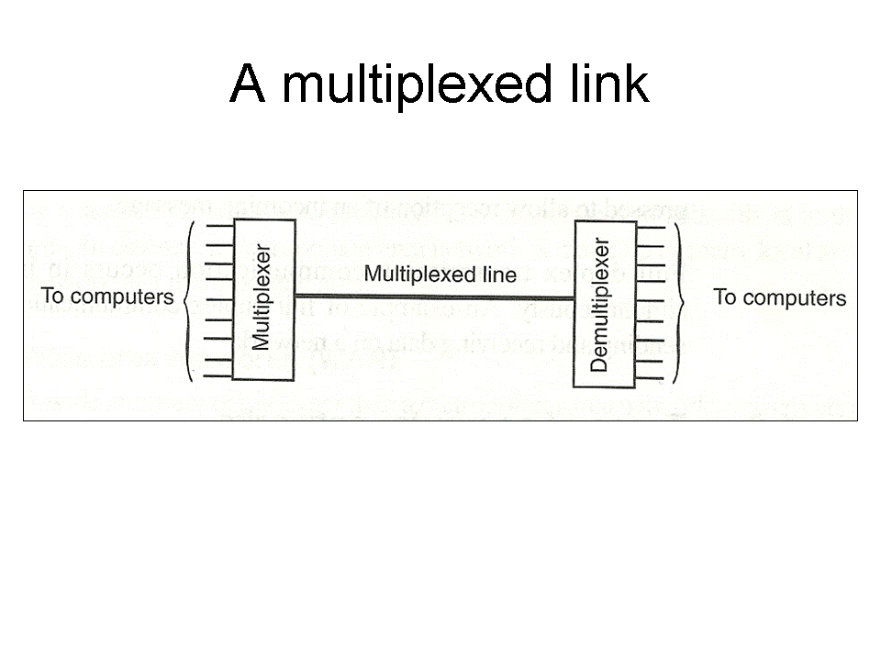
Terms used in data communication 2
Multiplexing – it’s a process of sending multiple data signal over the same medium while demultiplexing is the process of separating the multiplexed signals at the receiving end.
5

Slide 6
Modes of data communication
Simplex transmission – refers to communication in only one direction e.g. radio transmission.
Half duplex – refers to communication in both directions but one direction at a time e.g. police walkie talkie.
Full duplex – in this transmission communication occurs in both directions simultaneously e.g. computers connected in network.
6

Slide 7
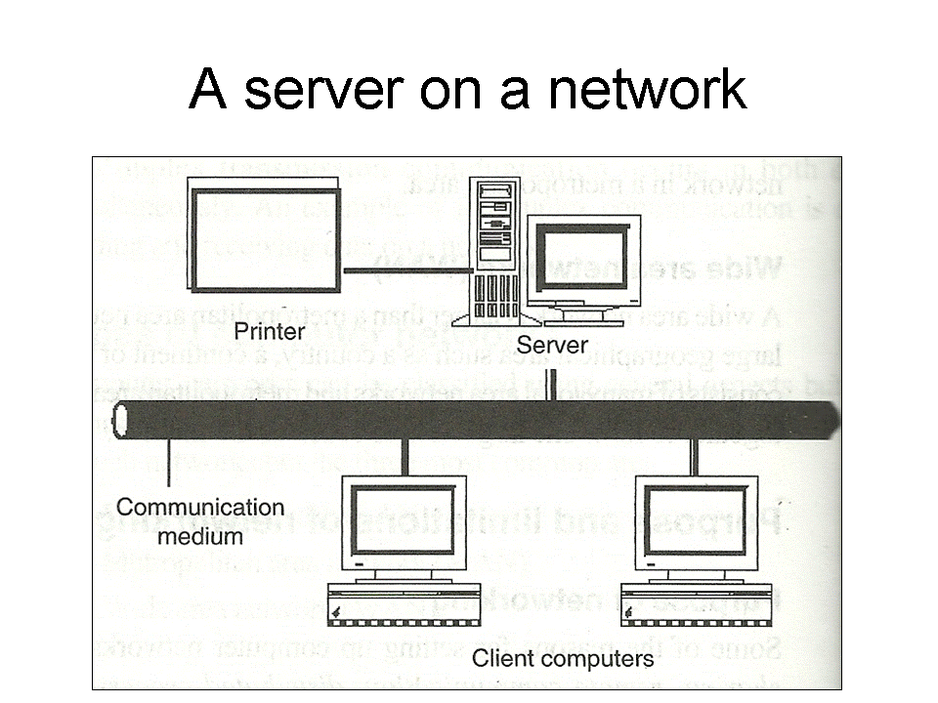
Purpose of networking 1
Resource sharing – different computers are connected to each other hence a user at one site may be able to use the resource available at another site e.g. printers, programs etc.
7

Slide 8
Purpose of networking 2
Remote communication – this involves transmission of data signals between two communication devices located at different geographical location. Through remote communication, people can be able to share ideas and pass messages over the network.
Cost effectiveness – reduction of resources in networking lead to reduction in costs. Example instead of purchasing many computers resources, one buys one which can be shared hence reducing the costs.
Distributed processing – if a particular process can be sub-divided into several sub-process then each sub-process can be processed at different sites co-currently hence speeding up the entire process.
Reliability – if one site fails in a computer network, the remaining site can potentially continue operating.
8

Slide 9
Limitation of networking
Cost – it’s expensive to acquire networking equipments, train network administrators and users and maintenance of network. The cost are high.
Data security – data and information held on a network is prone to more illegal access, danger of data theft and also tapping by unauthorised people during transmission.
Network failure – there is a danger of failure which may paralyze the operational of an organisation besides damaging files and programs.
Moral and cultural effects – large networks like Internet have chat rooms and messaging services that may enable underage children to meet peers and adults on the net some of whom have bad intentions. Access to pornographic and other negative materials is also a problem.
Over-reliance on networks – most organisations have done away with manual operations. This means that all business process and society depend on computer networks. The disadvantage of over-reliance is that if the network fails then many systems will stop operating.
9

Slide 10
Elements of networking
Data communication media – a data communication is a channel through which data is transmitted between computers and other devices. Data communication media are categorised into two:
  Communication with cables (bounded media)
    Two wire open lines cables
    Twisted pair cable
    Coaxial cable
    Fibre optic cables
  Wireless communication (unbounded media)
    Microwave
    Satellite
    Radio transmission
    Infrared transmission
10

Slide 11
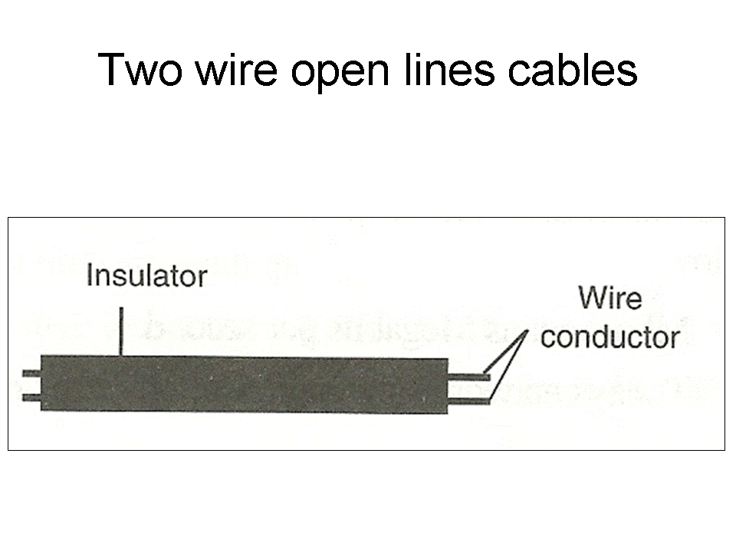
Two wire open line cables
Are made up of two parallel copper wires separated by a plastic insulator as shown figure right. They are used in telecommunication network to transmit voice signal.
11

Slide 12
Twisted pair cable
This consists of two insulated copper wires twisted in a spiral pattern to minimize electromagnetic interference. It’s the cheapest media used for both analogue and digital signals. Mainly used in telephone system. There are two types of twisted pair
  Unshielded Twisted Pair (UTP)
  Shielded Twisted Pair (STP)
12

Slide 13
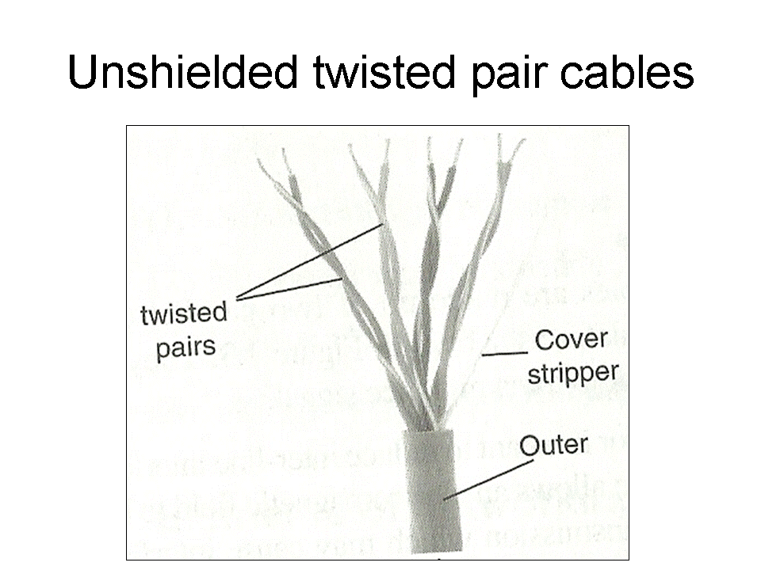
Unshielded Twisted Pair (UTP)
They do not have a shield the prevents electromagnetic interference hence they are susceptible to noise and signal interference.
13

Slide 14
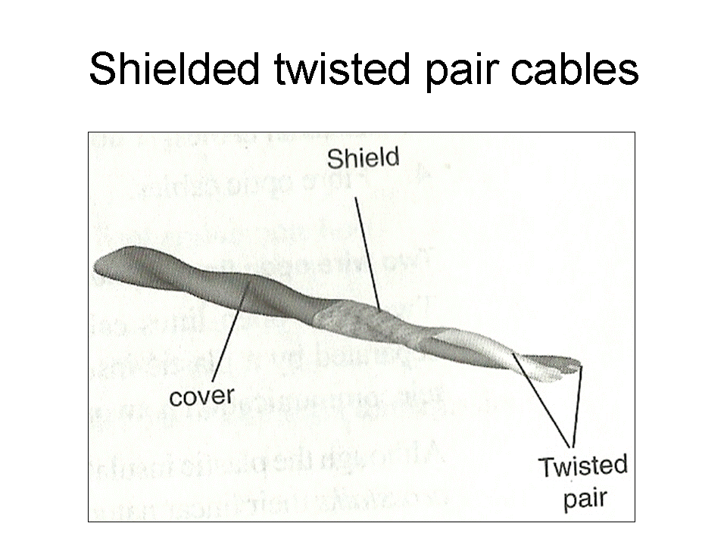
Shielded Twisted Pair (STP)
They have a braid wrapped around the wires to shield or protect them from noise.
14

Slide 15
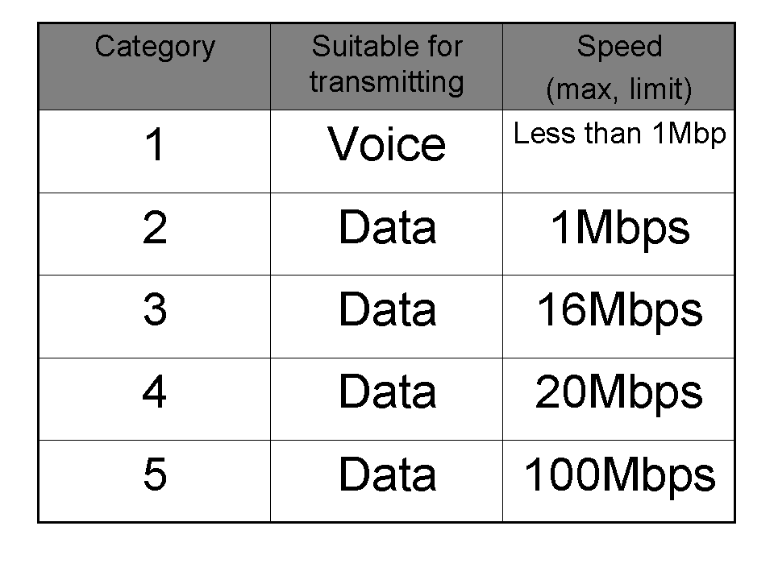
Category of twist pair cables
Twisted pair cables are categorised into five groups according to the type of data transmitted and maximum rate of transmission, as shown in table right.
15

Slide 16
Advantages and disadvantages of twisted pair cable
Advantages
  Easy to install
  Very cheap
Disadvantages
  Has low data transmission rates.
  It’s sensitive to electromagnetic interference.
  Suffers high attenuation.
16

Slide 17
Coaxial cable
This cable has a central copper core which may be solid or stranded wires surrounded by an insulator. The insulator is then surrounded by a hollow mesh conductor covered by a shield to prevent electromagnetic interference. The diameter of the centre core or conductor determines the attenuation rate. There are two types of coaxial cables:
  Thin coaxial cable (thinnet) which has one dialectric insulator.
  Thick coaxial cable (thicket) has two dialectric insulator around the core and is thicker than thinnet.
17

Slide 18
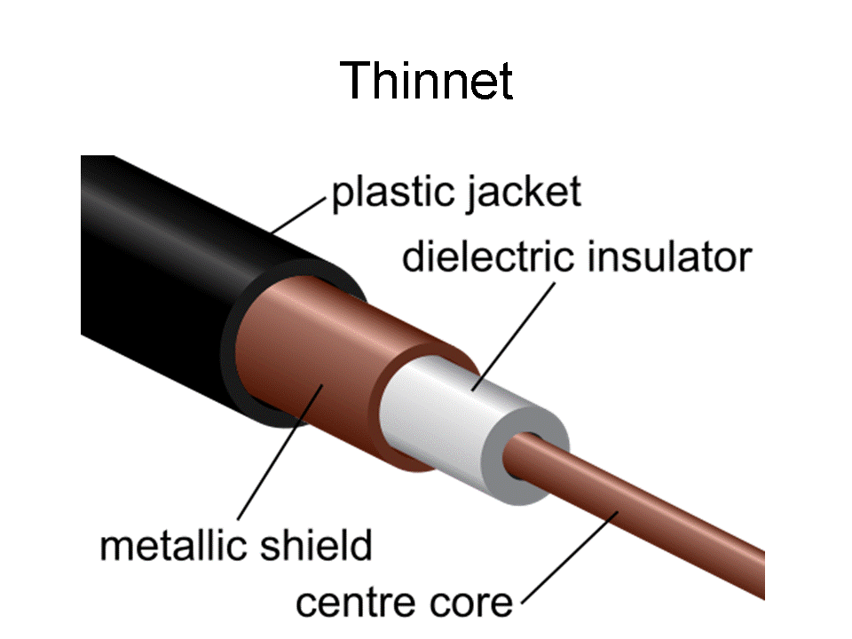
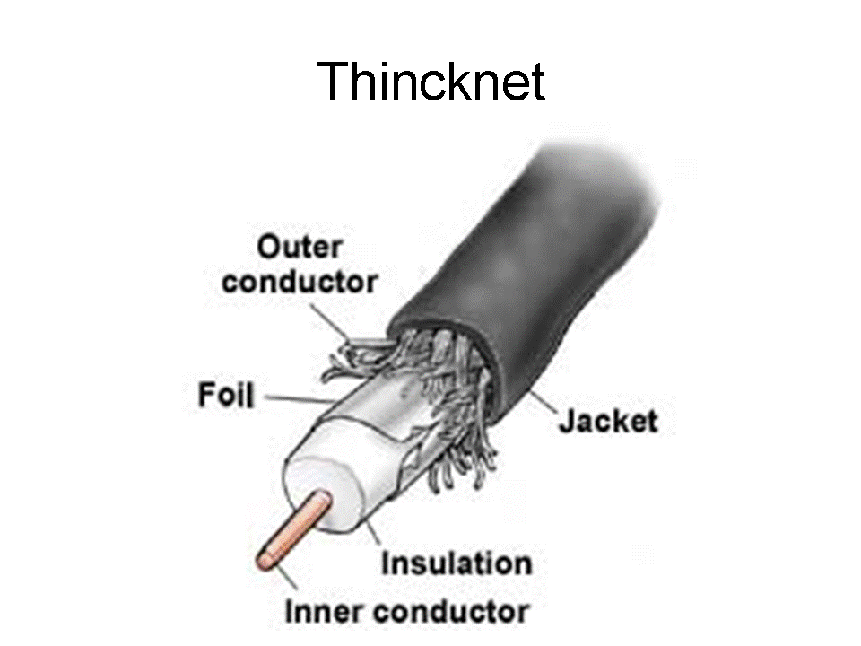
Samples of coaxial cables
18

Slide 19
Advantages and disadvantages of coaxial cables
Advantages
They are immune to external electrical interference because of insulation.
High data transmission rate.
Has capability of carrying more signals (Bandwidth).
They are very stable even under high loads.
Disadvantages
Lack of security due to illegal taps.
They are relatively expensive to buy.
It’s bulky therefore difficult to work with i.e. install.
19

Slide 20
Fibre optic cables
These are made of glass fibres and transmit information in light form. The cable is made up of:
  The core – the central part of the cable which is made of transparent plastic or glass.
  Cladding – it’s a single protective layer surrounding the core, and has some light bending characteristic inside it.
  Buffer – it surrounds the cladding and its function it to strengthen the cable.
  Jacket – outer covering of the cable.
20

Slide 21
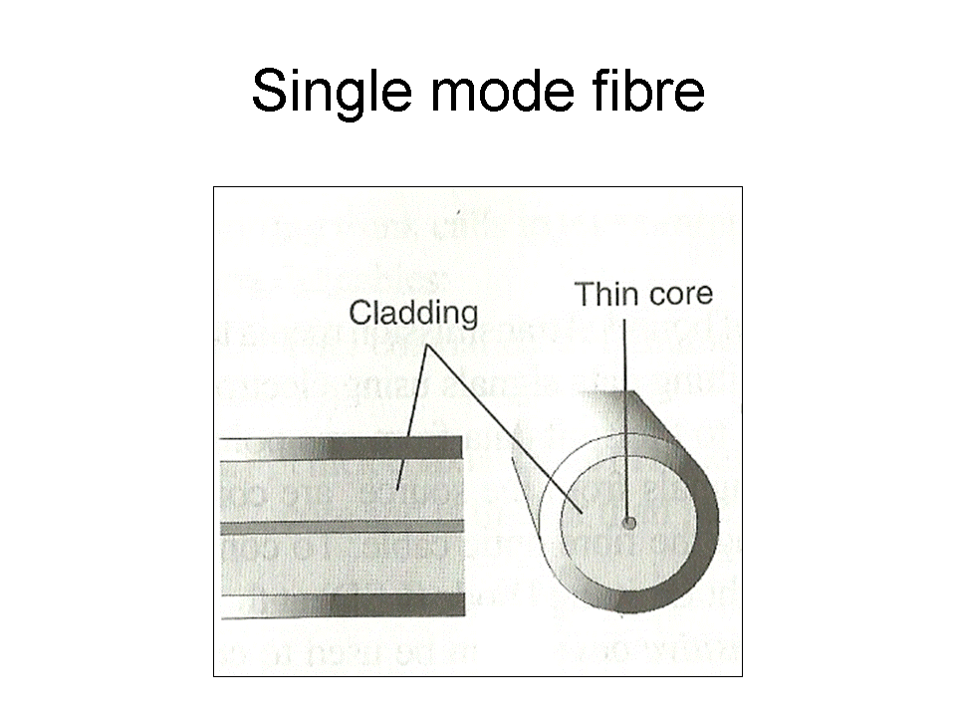
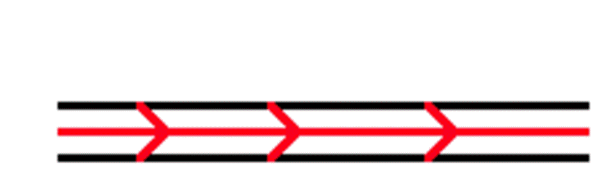
Types of fibre optic cables
Single mode fibre – it has a very narrow centre core. The light in the cable therefore take only one path through it making it to have a low attenuation rate.
21

Slide 22
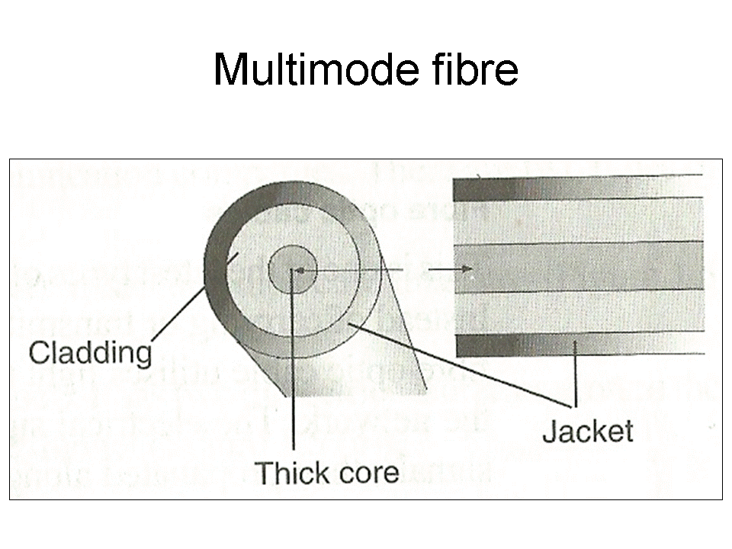
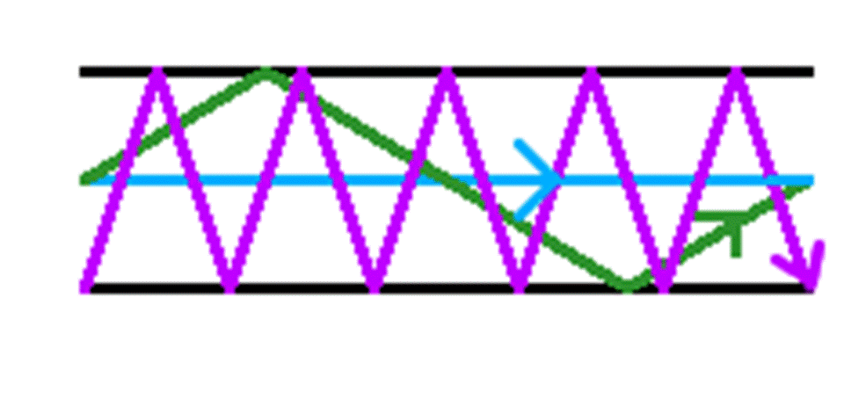
Multimode fibre – it has a thicker core and allows several light rays to be fed in the cable. they have a high attenuation rate and are mainly used for shorter distance transmission. The light is bent back into the core hence propagates along the length of the cable as shown in the diagram.
22

Slide 23
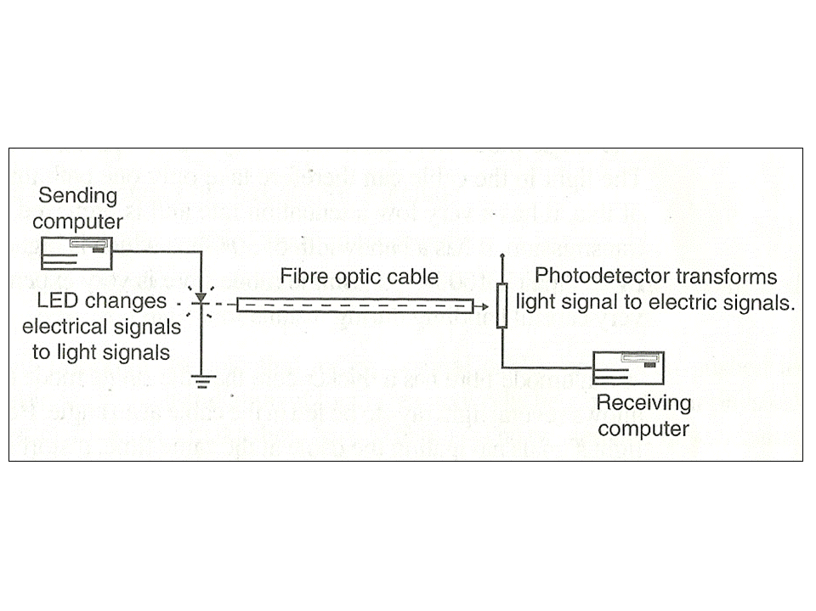
Fibre based network data transmission diagram:
23

Slide 24
Advantages
Has high bandwidth hence high carrying capacity.
It’s immune to electromagnetic interference.
Covers large distances because of low attenuation.
Very secured because they are un-tappable.
Disadvantages
Very expensive
Installation is difficult.
It’s complex to configure
Broken cable is difficult and expensive to repair
24

Slide 25
Wireless communication (unbounded media)
This type of communication media transmits data from one point to another without physical connections. Example of wireless transmission includes:
  Microwave
  Satellite
  Radio transmission
  Infrared transmission
25

Slide 26
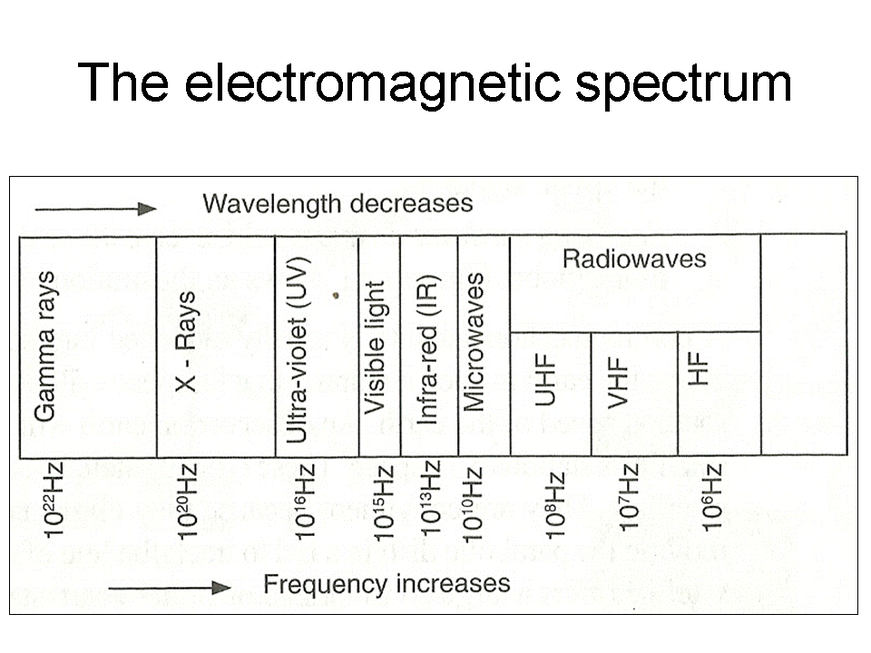
The electromagnetic spectrum
The figure is a representation of an electromagnetic spectrum. All these waves travel at the speed of light. For our concern here, we will only deal with microwaves radiowaves and infrared waves.
26

Slide 27
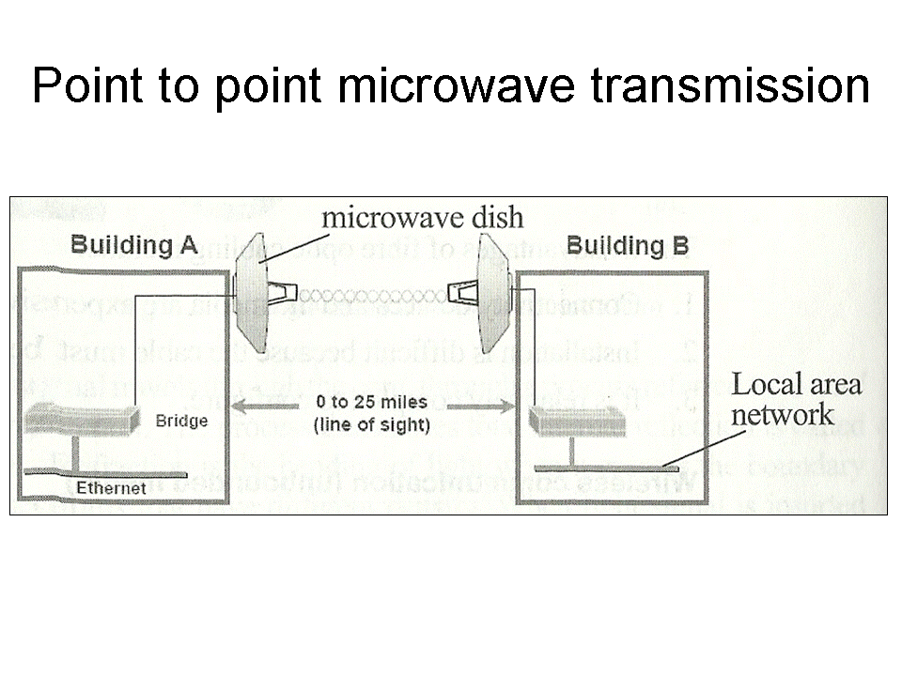
Microwave transmission
In microwave transmission signals travel in a straight line and therefore the transmitter and receiver must be in a direct line of sight of each other.
27

Slide 28
Advantages
They operate at a high speed.
It’s less prone to transmission errors unlike twisted wire pair.
Are capable of operating in digital or analog data.
Disadvantages
Signal is affected by atmospheric conductor like lightning.
Additional number of repeaters are added after every few kilometres.
28

Slide 29
Satellite Transmission
In this transmission microwave radio signal is transmitted from antennae from the ground to a satellite on the orbit around the earth. The microwave radio signal is beamed to the satellite on a specific frequency called uplink frequency where it is received, amplified and then rebroadcasted on a different frequency called downlink. The satellite transmit the signal to many earth stations to form a point to multipoint transmissions.
29

Slide 30
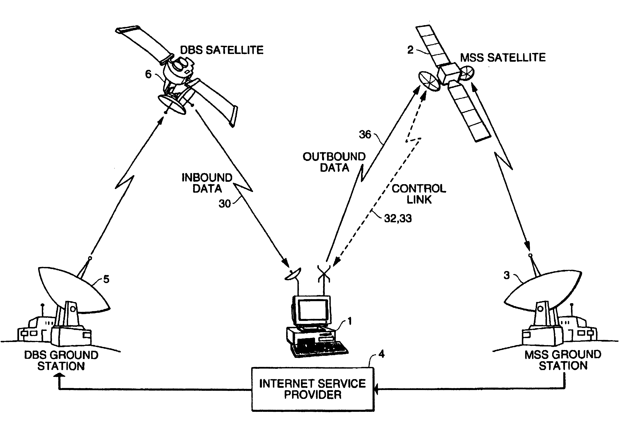
Satellite transmission system
30

Slide 31
Advantages of satellite transmission
The cost is not dependent on distance.
Has the second highest bandwidth after optical cable.
Earth station can be installed on a customer property than layering extensive cables.
Disadvantages of satellite transmission
Any station can receive the signals.
It’s expensive to install and configure ground and orbit stations.
Heavy rains or bad weather will increase loss of signals
31

Slide 32
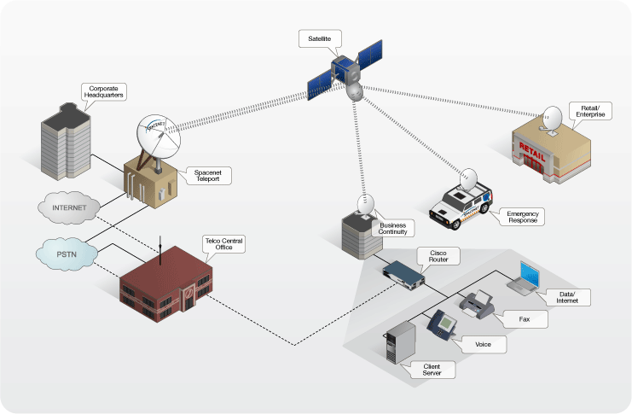
VSAT technology
The new trends in microwave transmission have seen the use of Very Small Aperture Terminal (VSAT) technology. This refers to a very small satellite dish used both in data, radio and TV communication.
Many businesses are adopting this new technology because it enables direct access to satellite communication instead of having to go through the state owned satellite gateway.
32

Slide 33
Radio communication
Radio waves travel just like surface water waves, i.e. they are omnidirectional. This means that they start from a central point and spread outwards in all directions.
As they travel outwards, their energy spreads outwards over the covered area.
The waves are radiated into the atmosphere by a radio frequency antenna at constant velocity. Radio waves are not visible to the human eye.
33

Slide 34
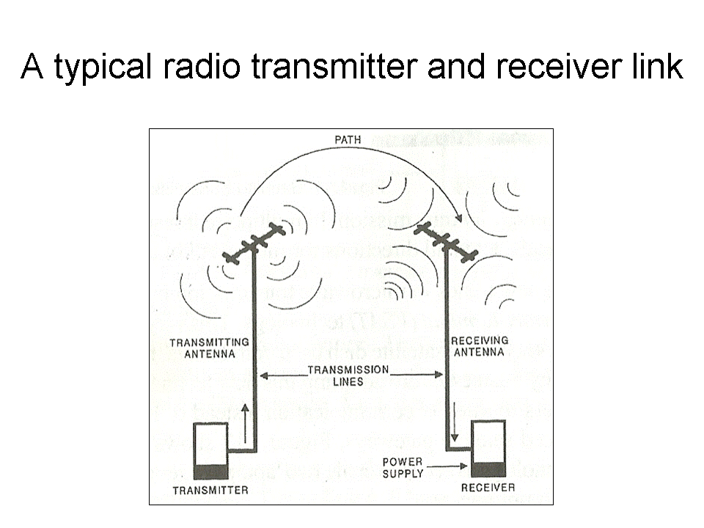
34

Slide 35
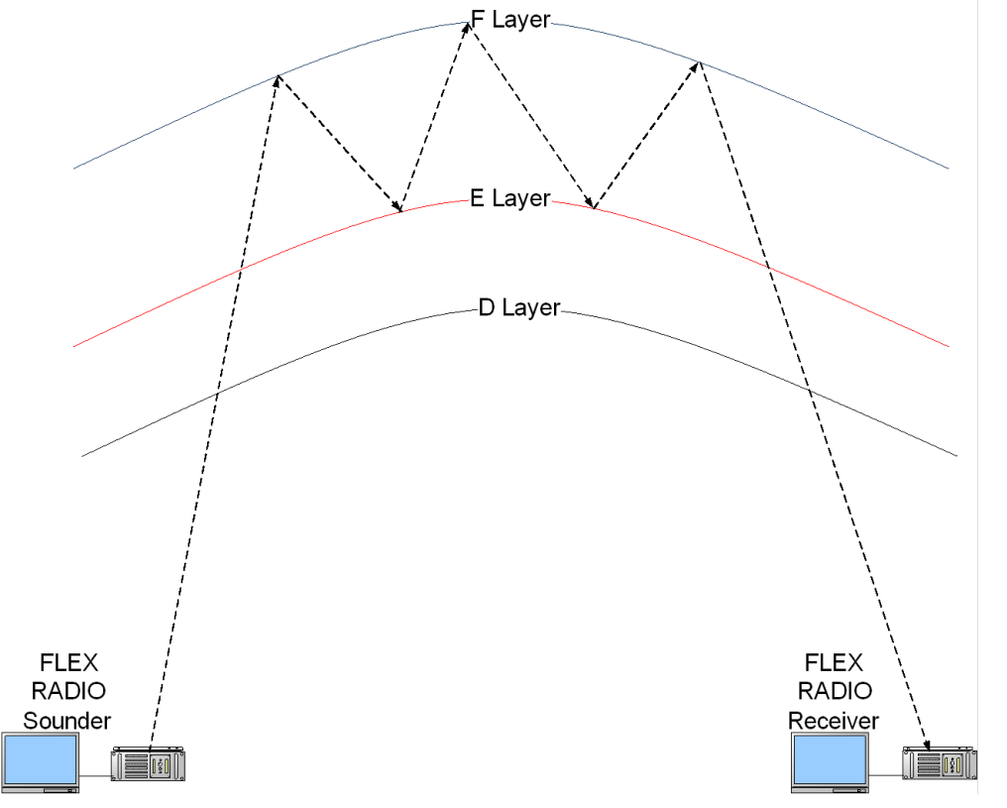
Radio transmission
Data can be transmitted over radio waves communication. The radio waves can be High Frequency (HF), Very High Frequency (VHF) or Ultra-High Frequency (UHF). The high frequency radio waves signal is transmitted by directing it to ionosphere of the earth. The ionosphere will reflect it back to the earth’s surface and the receiver will pick the signal. Very high frequency radio waves are transmitted along the earth’s surface. Ultra high frequency radio waves use the line of sight principle thus there should be no barrier between the sending and receiving devices.
35

Slide 36
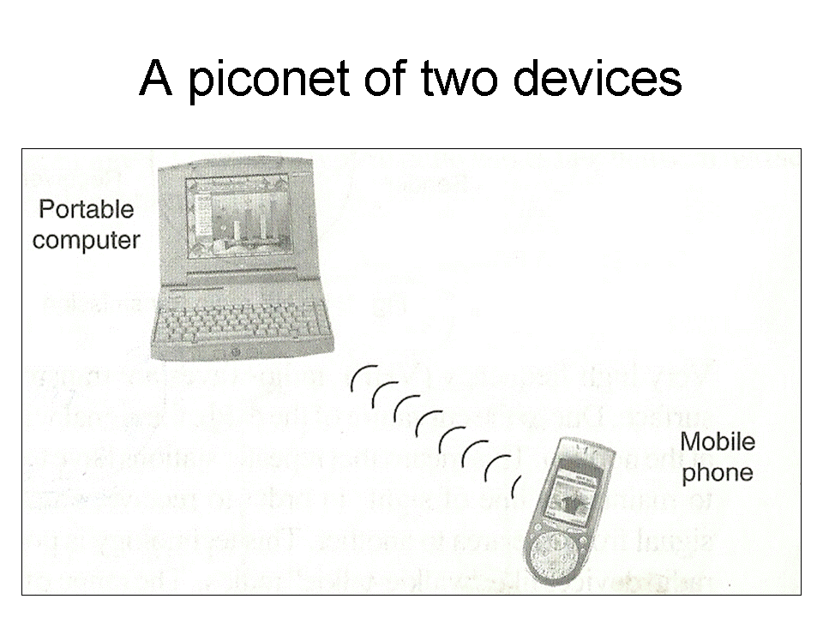
Blue tooth technology
This is a new short range radio transmission technology that enable people to use hand held communication devices like mobile phones and personal digital assistant (PDA) to access a network.
It enhances communication through wireless technology.
36

Slide 37
Infrared transmission
Communication through this medium is achieved by having infrared transmitters and receivers.
The transmitter and receiver of infrared signals must be within a line of sight in the same room.
They do not penetrate walls or solid objects hence security and interference problems are not encountered. The technology is used in TV and other devices remote controls
37

Slide 38
Advantages of wireless communication
They can cover larger geographical area easily.
They allow users of a network to roam without losing access to the network.
Allows communication in remote areas where laying of cables is not feasible.
Easy to add and remove nodes/work stations.
Disadvantages of wireless communication
Initial cost is very high.
Relatively difficult to establish or configure.
Vulnerable to tapping hence security of information can be compromised.
They can suffer high attenuation in case there are obstacles along the transmission lines.
38

Slide 39
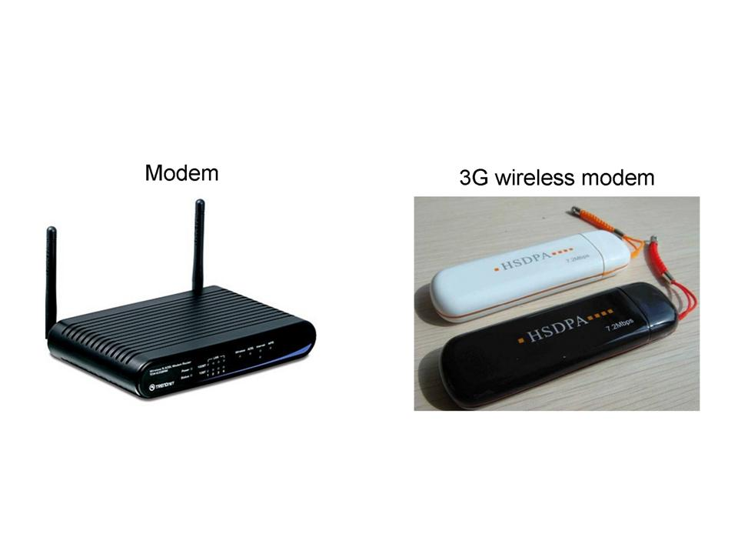
Communication devices
Modem – this is a device used to convert digital signals to analog form and then analog signals back to digital form.
A modem is an example of a CoDec (Coder-Decoder). A CoDec is any device that converts data from one form to another, then changes the data to its original form.
39

Slide 40
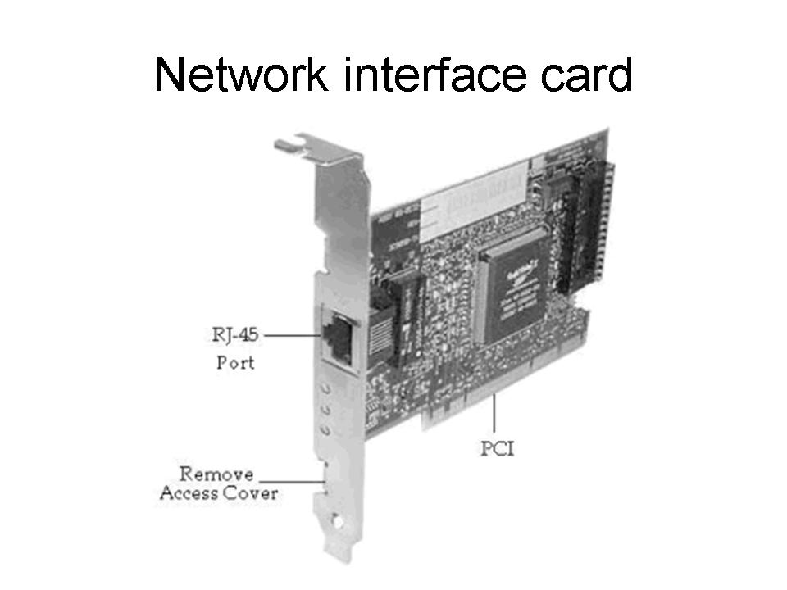
Network Interface Card (NIC) –
It is a circuit board that fits inside an expansion slot of a workstation and creates a physical link between the computer and the transmission media.
40

Slide 41
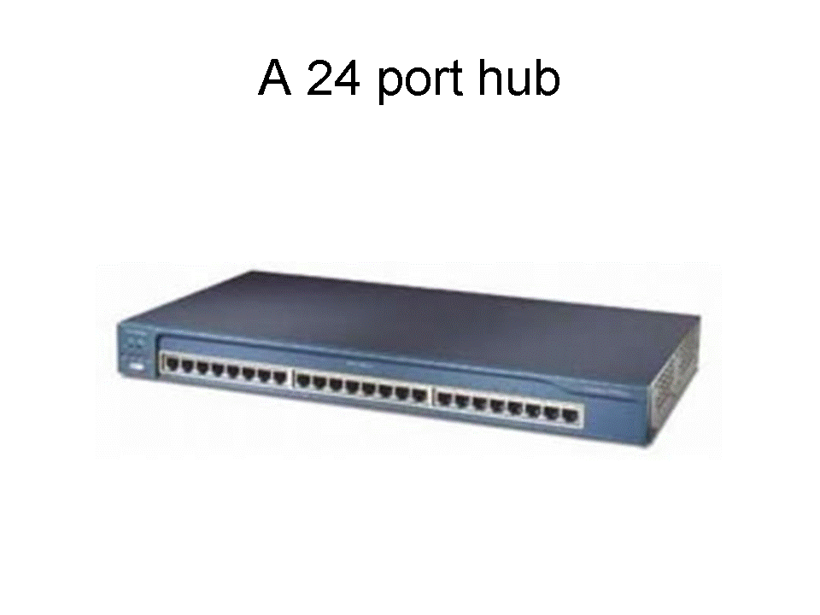
Hub: it is a component that connects computers on a network and is able to relay signals from one computer to another on the same network.
It usually connects networks of the same architecture i.e. One that has the same set of protocols.
It transfers signals from one node to another on the network through broadcasting. However, only the node whose address matches the one in the signal gets access to the message.
A 24 port hub
41

Slide 42
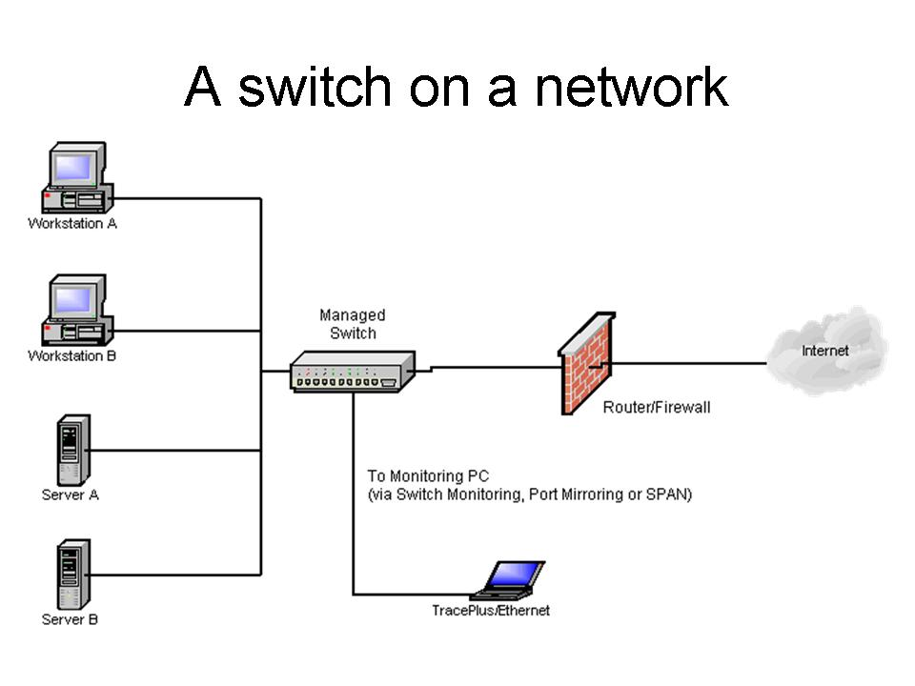
Switches – unlike the hub, the switch forwards a packet of data directly to the address mode without broadcasting. It transmits the packet using a point to point transmission.
42

Slide 43
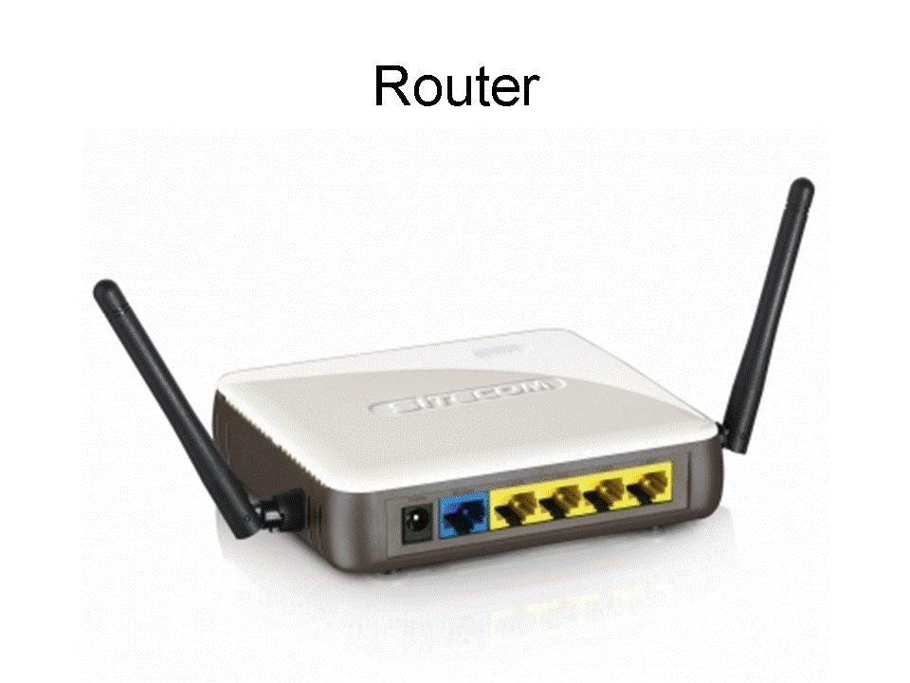
Repeater – a device that receives a signal from one segment of a network, cleans it to remove any distortion, boosts it and then sends it to another segment.
Routers – a device that interconnects different networks and directs the transfer of data packets from source to destination. It selects the best path to route a message based on the destination address and the source.
The router is intelligent enough to know when to direct signal traffic along a shorter path or a longer path to prevent head-on data interference or congestion.
A Router
43

Slide 44
Bridge – it’s a communication device that connects one network segment to another that uses the same protocol.
It selectively determines the appropriate network segment for which a message is meant for delivery through address filtering.
It makes sure that data packets that are not meant for a particular segment are not broadcast in that segment.
44

Slide 45
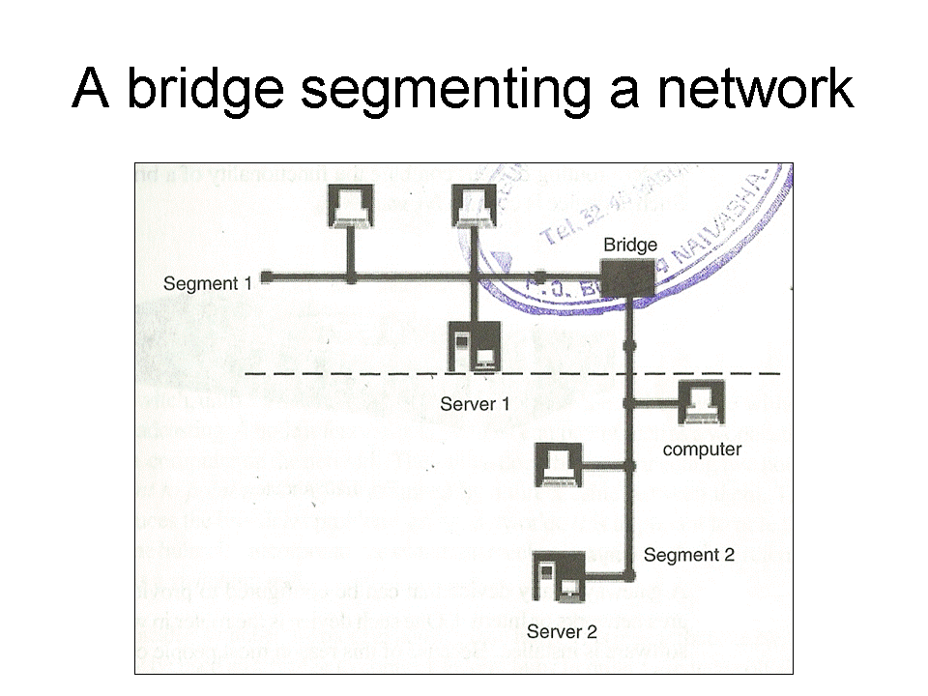
45

Slide 46
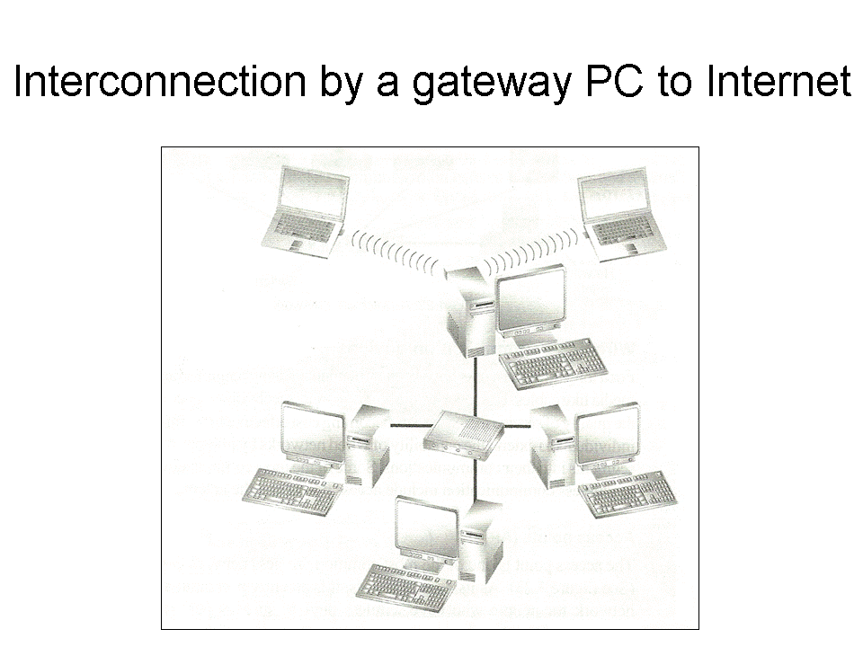
Gateway – it’s a device that can be configured to provide access to wide area network or Internet.
It enables communication between different network architecture that do not use the same protocol or data formatting structures.
46

Slide 47
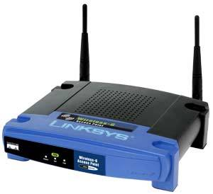
Wireless Communication Devices
Access points (AP) – It is the most common wireless network device.
It is mainly used for wireless devices such as personal digital assistants, laptops and computers with wireless links.
These devices need to have antennas in order to detect signals in the surrounding.
47

Slide 48
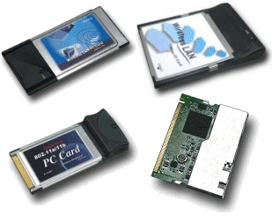
Personal Computer Memory Card International Association (PCMCIA) – the PCMCIA is an add on card inserted into a device such as personal digital assistants or a laptop in order to enable wireless communication between the devices and a wired network server.
48

Slide 49
3. Network software
These are programmes that enhance and manage communication on a network. They are classified into two main groups:
  Network operating system
  Network Protocols
49

Slide 50
Network operating system
These are operating systems specifically designed to optimise the networked computers ability to respond to service requests.
It’s performs the following network related functions:
  Making sharing of resources possible.
  Transmitting data around network.
  Respond to requests from application programs running on the networks.
  Enables nodes on the network to communicate with each other more efficiently.
  Implementing network security features.
50

Slide 51
In most cases, network operating systems are designed as multi-user operating systems that run the network server programs.
Once installed and configured, the operating system provides network management tools to do the following:
Secure the network against unauthorized access.
Track network usage and keep log of all people who have accessed the network.
Ensure there is proper internal operations between various systems on the network.
Monitor performance to ensure maximum throughput on the network.
51

Slide 52
Examples Of Network Operating Systems
Windows NT/2000/2003/XP/07/Vista etc
Unix
Linux
Novell Netware
52

Slide 53
Network Protocols
The data transmission process over the network has to be broken down into discrete systematic steps.
At each step, a certain action takes place. Each step has its own rules and procedures as defined by the network protocols.
The work of these protocols must be co-ordinated so that there are no conflicts or incomplete operations.
This co-ordination is achieved through protocol layering.
Network protocols are designed after the Open System Interconnection (OSI) model. The open systems interconnection model is not a protocol as such but is meant to help designers to come up with high quality layered protocols. It has seven layers, each performing distinct functions.
53

Slide 54
 | LAYER | FUNCTION | DEVICES | PROTOCOLS
7 | Application Layer | Identifies communication nodes and determines the available resources. | Servers/hosts, personal computers, mobile phones | File Transfer Protocol (FTP) Simple Mail Transfer Protocol (SMTP) Hyper Text Transfer Protocol (HTTP)
6 | Presentation layer | Compresses, encrypts and translates data. It protects data from interception by hackers. | Encryption devices | SSL (Secure Socket Layer) MIME (Multi-purpose Internet Mail Extension)
54

Slide 55
5 | Session layer | Sets up transmission sessions between communication channels. |  | TCP (Transmission Control Protocol)
4 | Transport layer | Manages data transfer over the network and ensures accuracy and reliability of data. |  | TCP (Transmission Control Protocol) UDP (User Datagram Protocol)
3 | Network layer | Adds address to the data/information. Routes the data to the intended destination | Router | IP (Internet Protocol) Appletalk.
2 | Data Link layer | Adds error checking information to the data and prepares the data for transmission. (data is packed into frames so that they can be transmitted over a network) | Switch, Bridges, NIC (Network Interface Card) | Frame relay IEEE (Institute of Electrical and Electronic Engineers)
55

Slide 56
1 | Physical layer | Provides hardware connection and transmits data via Network Interface Card to the transmission medium. | NIC, Hub, Wi-Fi, bluetooth, Cables Bounded and unbounded medium) | IEEE (Institute of Electrical and Electronic Engineers) EIA (Electronic Industries Alliance)
56

Slide 57
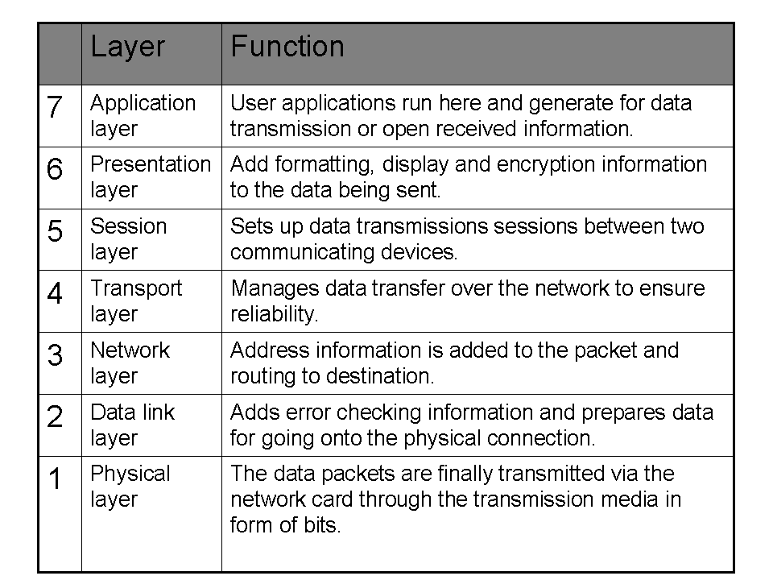
57

Slide 58
Examples of protocols
Transmission Control Protocol / Internet Protocol (TCP/IP) – TCP is responsible for delivery of sequenced data over network. The IP handles the address scheme i.e. it does packet forwarding and routing.
File Transfer Protocol (FTP) – allows the user to connect to remote system, to sent and receives files from that system.
58

Slide 59
Network topologies
This refers to the way in which computers and other devices have been arranged or how data is passed from one computer to another in the network.
They are viewed in two ways namely logical and physical topology.
59

Slide 60
  Logical topology – also known as signal topology. It deals with the way data passes from one device to the next on a network. There are two kinds of logical topology:
  Ethernet topology: in this topology, all computers listen to the network media and can only send data when none of the others is sending.
  Token ring topology: in this topology, a special package of data called a token goes around the network and only the computer whose address is on the data will take the token, read the data and release the token.
  The token can then be captured by another computer which needs to transmit data.
60

Slide 61
Examples of logical topologies
Ethernet topology – in this topology, all computers listen to the networks media and can only send data when none of the others is sending.
Token ring topology – in this topology the token (data packed) goes around the network and only the computer whose address is on the data held in the token will take up the token to read the data then release the token.
61

Slide 62
  Physical topology – refers to the physical layout or arrangement of components on the network. They include the following:
  Star topology.
  Ring topology.
  Bus topology
  Mesh topology.
  Tree/hierarchical topology
62

Slide 63
Star topology –
In this topology, all devices are connected to a central hub. Workstations communicates across the network by passing data through the hub.
When the hub receives data from a transmitting computer, it broadcasts the message to all the other workstations on the network.
63

Slide 64
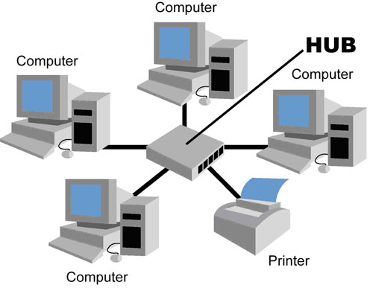
64

Slide 65
Advantages of star topology
Easy to configure.
It’s easily expanded.
If one workstation fail it does not affect the others.
Allows centralization of key networking resources e.g. server.
Disadvantages of star topology
If the central hub fails, the entire network will be down.
Requires more cables to install hence more expensive.
65

Slide 66
2. Ring topology
In this topology all the components are connected to a single cable forming a ring.
The data flows in only one direction and the signal is actively retransmitted by each node to its neighbour if its not addressed to it.
66

Slide 67
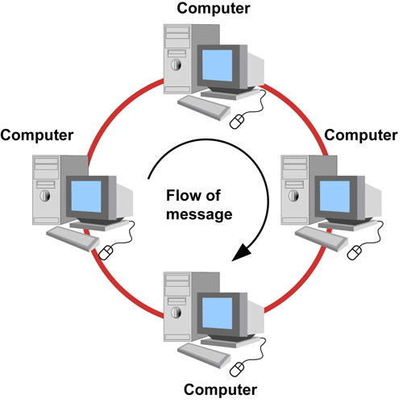
67

Slide 68
Advantages of ring topology
It’s simple to install.
Data transmission is very fast.
Use a short length cable hence cheap.
Disadvantages of ring topology
If one node fails it affects all the other nodes.
Troubleshooting can be difficult.
Modification may be difficult because adding or removing a device can disrupt the entire network.
68

Slide 69
3. Mesh topology
This topology uses separate cables to connect each device to every other devices on the network providing a straight communication path.
Advantages of mesh topology
Has many alternative ways of delivering a packet(routes)
If one workstation fail it does not affect the others.
Disadvantage of mesh topology
Costly to provide the redundant cables.
Difficult to install and maintain.
Easy to troubleshoot
69

Slide 70
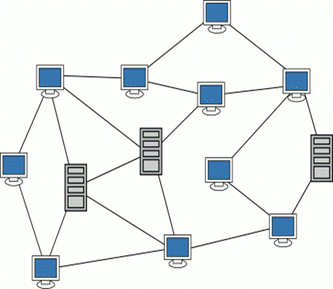
70

Slide 71
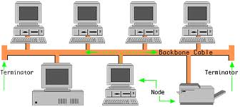
4. Bus topology
All devices are connected to a central transmission cable called the bus or backbone and terminated at both ends. It uses Ethernet logical topology during data transmission.
The terminator is attached to each end of the cable to prevent signals from bouncing back and forth causing signal distortion.
71

Slide 72
Advantages of bus topology
It’s easy to install and extend the bus
It’s less expensive to set up since it requires minimum cabling.
Failure or malfunction of one node does not affect the nodes.
Disadvantages of bus topology
The failure of the cable will bring the whole network down.
Only one node can transmit message at a time hence considerably slow in transmission.
Difficult to troubleshoot and diagnose problems.
72

Slide 73
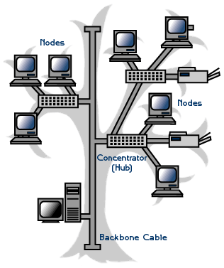
5. Tree/Hierarchical topology
It combines the characteristics of a star and bus topology.
Groups of star configured nodes are connected to a bus backbone cable.
The branches in turn can have more sub-branches. Branches are connected to each other by means of devices called hubs.
73

Slide 74
Advantage
Failure in a network segment does not bring the entire network down.
It is easier to add new nodes to the network.
Disadvantages
If the backbone breaks or malfunctions the entire network goes down.
Installation is expensive and complex to configure.
Assignment: make notes on daisy chain topology. Page 35 KLB Log On Bk 4.
74

Slide 75
Types of computer networks
Local Area Network (LAN)
This network is formed whenever computers are connected together in a small geographical area e.g. In a building, a school etc within a radius of 10m up to 3km.
2. Metropolitan Area Network (MAN)
This network covers a metropolitan area such as a town or city within a radius of between 5 and 50km. They are data rates of 100Mbps and above and are more expensive than LANS.
3. Wide Area Network (WAN)
This covers unlimited geographical area e.g. across states, entire country or entire world. They are expensive to build and have high data transmission rates and higher speed (over 100Mbps or higher).
75

Slide 76
Review questions 1
List four network systems that are not computer-based networks.
Define the term computer network.
Define the term communication.
Differentiate between a baseband and broadband signal.
State four advantages of networking.
Give two disadvantages of networking.
Differentiate between a network server and a workstation.
Explain the concept of distributed processing in networking.
Why is a network more reliable than stand alone computers?
Explain the three most common types of computer networks in use today.
Differentiate between remote client and remote host.
Explain the term bandwidth.
What is a “resource” in networking?
Differentiate between half duplex and full duplex transmission.
76

Slide 77
Answer of review questions 1-1
Road networks, telephone networks, nervous system and railway network
A computer network can be defined as a collection of computers connected together using transmission media for the purpose of communication and resource sharing.
Data communication is the process of transmitting data from one location to another through a transmission media.
Baseband refers to a digital signal that is generated and applied to the transmission medium directly without modulation while broadband transmission refers to a process where analog signal is sent over the transmission medium using a particular frequency.
Advantages of networking
  Sharing of resources
  Efficient communication
  The running cost is low
  Reliable and error free
77

Slide 78
Answer of review questions 1-2
Disadvantages of networking
  High initial installation cost
  Security threats
  Moral and cultural effects
A network server is a computer dedicated to servicing requests from other computers on the Internet while a workstation is a computer connected to a network on which users do their work.
Distributed processing is a configuration in which terminals with processing power are located in a wide geographical area.
If one of the computers breaks down information can still be accessed from the server using another computer on the network.
78

Slide 79
Answer of review questions 1-3
Common types of computer networks
  Local Area Network (LAN)
  Metropolitan Area Network (MAN)
  Wide Area Network (WAN)
The computer mailing a remote request is called a remote client while the computer that is being accessed is called a remote host.
Bandwidth is the maximum amount of data that a transmission medium can carry at any one time.
A resource is anything that can be shared on a network.
Half duplex refers to communication in both directions but one at a time while full duplex transmission refers to communication in both directions simultaneously.
79

Slide 80
Review questions 2-1
Define the term transmission media.
Differentiate between a router and a gateway.
Why is a switch preferred to a hub on the network?
Compare and contrast a brouter and a router.
Describe an electromagnetic spectrum?
Describe at least five devices used in data communications.
What is the function of a repeater on a network?
Give one disadvantage of a hub on a network.
Give one application area of infrared transmission.
80

Slide 81
Answer of review questions 2-1-1
A transmission medium is a pathway used for carrying data and information from one station to another.
A router is a device used to interconnect different networks and direct the transfer of data packets from source to destination. On the other hand a gateway is any device that can be configured to provide access to WAN or Internet. This means that a gateway may not necessarily be a router.
Unlike a hub, a switch directs a packet directly to the addressed node without broadcasting.
A router connects logical networks while a brouter has both functionalities of a router and a bridge.
81

Slide 82
Answer of review questions 2-1-2
Electromagnetic spectrum is a diagrammatic representation of carious electromagnetic wave frequencies. It consists of radiowaves, microwaves, infrared radiation, visible light, ultraviolet rays, X-rays, Gamma rays and cosmic rays.
Network Interface Card (NIC’s), modems, hubs, bridges, repeaters, routers, switches and brouters.
A repeater receives a weak signal on the network, cleans it and amplifies it for transmission over the next portion of the network. Signals become weak due to attenuation.
A hub may cause broadcast problems.
Communication in wireless devices.
82

Slide 83
Review questions 2-2
Explain the importance of a gateway on a network.
State two advantages of satellite communication.
Give two advantages of fibre optic media.
Define the term pitch as used in twisted pair cabling.
Give two advantages of coaxial cables.
Differentiate between single mode and multimode fibre.
Describe the VSAT technology.
Explain the concept of a geostationary satellite.
Explain the importance of the wire braid in coaxial cable.
Explain the line of sight principle in wireless transmission.
83

Slide 84
Answer of review questions 2-2-1
Gateway provide access to the wide area networks and Internet.
Advantages of satellite communication:
  Covers a wide area.
  As opposed to earth-to-earth microwaves, it overcomes line of sight problem.
Advantages of fibre optic media:
  Allows faster communication.
  Transmits data over longer distances compared to other cables.
  It is immune to interference and eavesdropping.
  Supports high bandwidth.
Pitch refers to the twists per foot of each pair of the UTP cable.
Advantages of coaxial cables:
  Supports higher bandwidth compared to twisted pair cables.
  It’s installation is relatively simple.
  It can carry voice, data and videos on the network.
  It is more resistant to radio and electromagnetic interference than twisted pair cables.
84

Slide 85
Answer of review questions 2-2-2
Single mode fibre has a very narrow centre core compared of multimode.
VSAT refers to a very small satellite dish used both for data and radio communication. It enables direct access to satellite transmission instead of having to go through the state owned satellite gateway.
Geostationary satellite’s speed in its orbit is relatively equal to the rotation of the earth hence, an observer on earth will see as if the satellite is stationary in space.
The braid protects the carrier wire from radio frequency interference and electromagnetic interference.
In line of sight principle, a signal is directed through a focused beam from the transmitter station to receiver station without obstructions in between them.
85

Slide 86
Review questions 3
List two types of network software.
Give three examples of protocols used in networking.
Outline the seven Open Systems Interconnection (OSI) reference model layers.
Define the term network topology.
Distinguish between logical and physical network topology.
Explain the importance logical and physical network topology.
List four examples of network operating system.
Outline the functions of network operating system.
86

Slide 87
Answer of review questions 3-1
Types of network software
  Network operating systems.
  Network protocols.
Examples of protocols used in networking:
  Transmission control protocol / Internet protocol (TCP/IP). It is the main internetworking protocol that has enabled the setting up of the Internet.
  OSPF – it stands for Open Shortest Path First. This protocol is used by routers to forward the packages on the network through the path that is not only shortest but has least load.
  NetBEUI – a local area network protocol and is limited to Microsoft and IBM networks.
  IPX/SPX – is an internetworking protocol like TCP/IP. It also routes packets. However, duplication of network addresses is the main.
OSI model layers – application layer, presentation layer, session layer, transport layer, network layer, data link layer, physical layer.
Network topology refers to the layout of the computers, printers, and other equipment connected on the network.
87

Slide 88
Answer of review questions 3-2
Logical topology also called signal topology deals with the way that data passes from one device to the next on the network. Physical topology on the other hand refers to the physical layout or arrangement on the network.
Does the actual sending of data on the transmission medium in binary form.
Microsoft Windows NT/2000/2003, UNIX, Novell Netware, Linux.
Functions of network operating systems:
  Provides access to network resources e.g. printers and folders.
  Enables nodes on the network to communicate with each other.
  Supports inter-process communication i.e. enables the various processes on the network to communicate with one another.
  Responds to requests from application programs running on the network.
  Supporting network services like network card drivers and protocols.
88

Slide 89
Revision questions
Determine the type of a network characterised by:
  Connection between computers, printers and other resources using UTP cables.
  Over 180 stand alones in an office building.
  Over 254 computers connected to share resources in a city.
Explain the function of a NIC in networking.
The computer that is dedicated to serving requests from other computers in a network is called a ( ) while the computer that sends requests is called ( ).
Distinguish between thinnet and thicknet coaxial cables.
Distinguish between radio and microwave transmission.
The layer that surrounds the core of a fibre optic cable is called ( ).
Describe any three types of physical network topologies used in LAN.
The device that connects workstations and the server to a central point is called a ( ).
Define the term protocol.
89

Slide 90
Answer of revision questions 1
A). Unshielded twisted pair cabling – LAN.
B). Stand alones – None.
C). Over 254 computers in a city – MAN.
Network interface card creates a physical link between the computer and the transmission media.
Server, Client.
A thicknet is thicker than the thinnet and has two insulators around the core.
Microwave transmission is point-to-point while in radio transmission the signals are Omni directional i.e. they originate from a central point and then spread outward.
90

Slide 91
Answer of revision questions 2
Cladding.
Types of physical network topologies used in LAN:
  Star topology.
  Bus topology.
  Ring topology.
  Mesh topology.
  Tree topology.
Hub.
A protocol is a special set of rules that enable computers on a network to communicate.
91

Slide 92
Practical exercise
92
92

Slide 93
Setting up a peer-to-peer local area network
This practical activity is a step by step guide on how to set up a simple local area network. The following are some of the requirements you need.
  Hardware requirements.
  Tools
  Installing a network card
  Installing the drivers manually
  Adding protocols
  Identifying your computer in a workgroup
  Configuring transport control protocol/Internet protocol (TCP/IP)
  Media preparation and connection
  Connecting the computers to hub/switch
93

Slide 94
Hardware requirements
A computer running on any version of Microsoft Windows especially Windows 9x/2000/ME/windows XP.
Network interface card. Some computers may have it already installed onboard so that you do not have to purchase one.
A hub or a switch.
Transmission media preferably unshielded twisted pair category 5.
RJ45 connectors.
94

Slide 95
Installing a network card
The network interface card acts as the physical interface or connection between the computer and a properly terminated transmission cable. As mentioned earlier, come motherboards come with on-board network interface cards hence you may not need to plug in a separate add-on card.
95

Slide 96
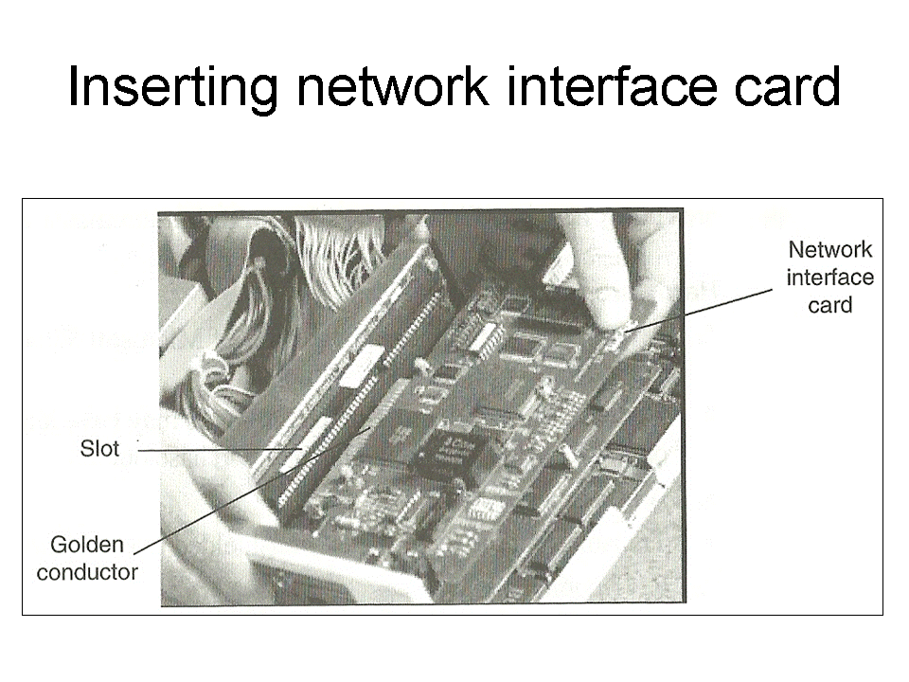
Steps of physically install an add-on card 1
Disconnect the computer from the power source.
Open te system unit and identify an empty expansion slot on the motherboard.
Insert the card as shown in figure right and screw it into place. Some little force may be needed to push the card into place squarely. Make sure that all the conductor points of the card sink into the expansion slot. Avoid touching the golden conductor points and chip on the card with your bare hands.
96

Slide 97
Steps of physically install an add-on card 2
Replace the casing then connect the computer to the power supply and boot it up. If you are using Microsoft Windows 9x and above, the computer will detect the new hardware because of the plug and play feature found in the operating system. It may install the protocols and device software needed for the proper operation of the network interface card automatically. If there is a problem of the card being detected, you may have to configure the card manually using a disk that comes with the card.
NB: some cards are slotted into Industry Standard Architecture (ISA) slots while others for Peripheral Components Interconnect (PCI) slots. Make sure you install in the right slot and then screw into place.
97

Slide 98
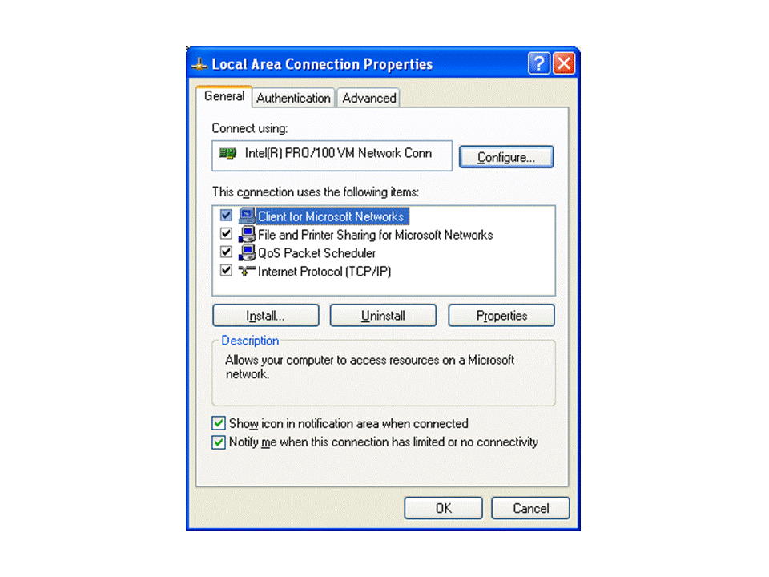
Installing the drivers manually 1
Click “Start”, “Settings” then “Control Panel”. In the “Control Panel” window double click the “Network/Network Connection” icon. A dialog box such as the one shown in figure right will be displayed. (In some Windows versions you may have to double click the “Network and Dial-up Connection” icon found in the “Control Panel” then double click the “Local Area Connection” icon.)
Click the “Configure” button.
Click “Adapter/drivers” and then click “Add”. Follow the on screen instructions screen.
98

Slide 99
Adding protocols
Make sure the “Network” dialog box is open.
Click “Add” then “protocols”.
Click “Microsoft”, select “TCP/IP” and “NetBEUI” from the network protocols list then “OK”.
Click “Apply”.
99

Slide 100
Identifying your computer in a workgroup
A workgroup is a collection of computers that are on the same network. To specify your computer and the name of the workgroup:
  If you are using Windows 9x, click the “Identification: tab from the :Network dialog box. If you are using Windows Me, 2000 or XP. Identification (computer Name) tab is located in system properties dialog box. Right click “My computer”, click “Properties” then click the computer name tab.
  Type your computer name and the workgroup name. the computer name you give must be unique.
100

Slide 101
Configuring TCP/IP 1
In order to communicate with other computers, you need to install and configure a protocol. In our case let us use TCP/IP. To configure TCP/IP,
  Select the TCP/IP Ethernet adapter from the list titled. the following network components are installed / This connection uses the following items.
  Click the “Properties” button then the “Specify and IP address” option.
101

Slide 102
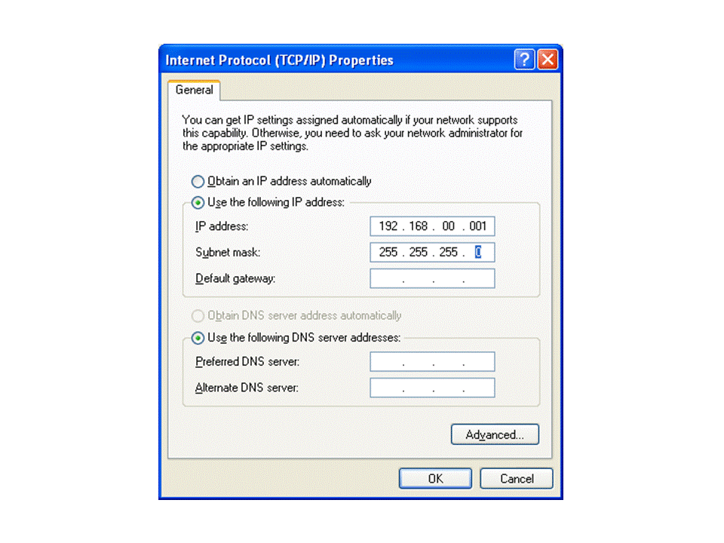
Configuring TCP/IP 2
Type in the IP address such as 192.168.00.001. Each computer should have unique IP address. Figure right shows a TCP/IP properties dialog box in Microsoft Windows XP.
102

Slide 103
Configuring TCP/IP 3
  Specify the subnet mask. Subnet masks are values that allow the router to distinguish the network ID from host ID portions of the IP address. If the IP address is examined by the subnet mask and found to be identical, the message is destined to a host on the same network otherwise it is routed to another network. Typically, subnet masks use the format 255.x.x.x. In our case let us use a subnet mask such as 255.255.255.0.
  Click “Apply” then “OK”. The computer will prompt you to restart in order for the changes to be effected.
  Restart the computer.
103

Slide 104
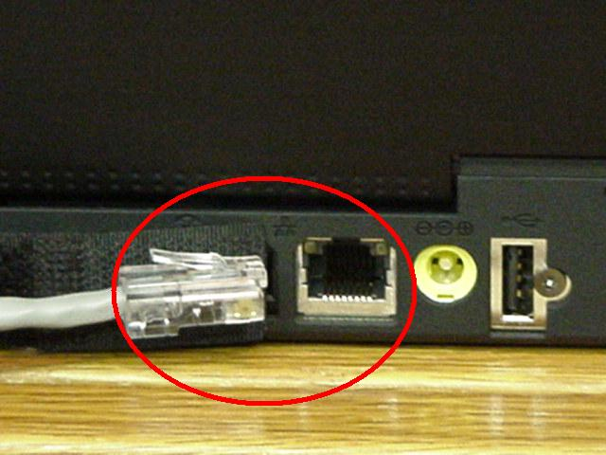
Media preparation and connection
In this practical exercise, we are going to use twisted pair cabling technique because it has become almost the default method. This type of media uses a connector known as RJ45 to terminate the cable. Figure right shows illustration of RJ45 port and RJ45 terminated cable. RJ45t is attached to a UTP cable using crimping tool.
104

Slide 105
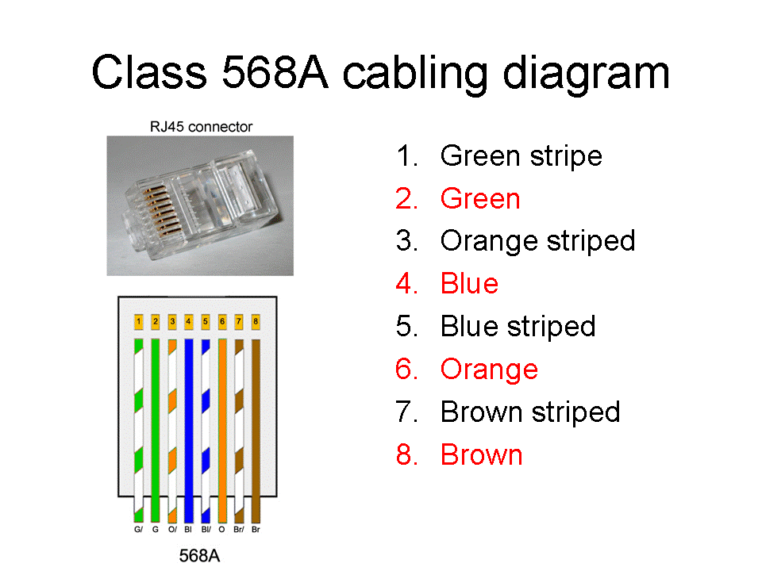
Steps of attach an RJ45 connector to a UTP cable 1
Cut a piece of cable of suitable length approximately 3 metres.
Strip off approximately a dimension centimetres of the cable sheath on both ends to expose the inner pairs.
Untwist the pairs.
Using the wiring diagram shown in figure right, place the wires in the correct order and trim the edges to make them even.
105

Slide 106
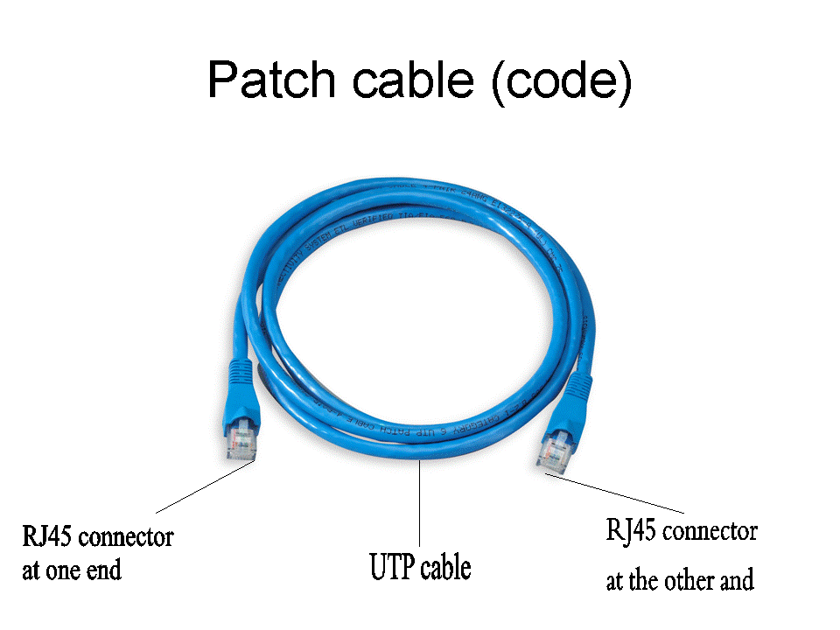
Steps of attach an RJ45 connector to a UTP cable 2
Insert the wires into the RJ45 connector, plug it in their correct order and then push it into the crimping tool.
Squeeze the handles of the tool to make sure the wires are pierced and held tightly in the connector.
Repeat steps 5 and 6 at the other end of the cable. Your cable should now be terminated on both ends and should be like the one shown in figure right.
You can then test the media for continuity and correct termination using the cable tester.
106

Slide 107
Connecting the computers to the hub/switch
It is now time to connect the computers together through the hub. To connect the computer do the following:
  Connect one end of the cable to the RJ45 port of the network card and the other end to one port in the hub. If the hub is powered, a LED will indicate the connection. Repeat all this process for all other computers that you wish to connect on the network.
  To see if the networking is successful, right click the Network Neighbourhood / My Network Places on the desktop. If all the connected computers in the same workgroup can “see” one another then you have succeeded setting up a peer-to-peer network.
  If not, you may decide to test the connection using the PING command to test connection. For example if you have two computers with the IP addresses 192.168.001.001 and 192.168.001.002.
107

Slide 108
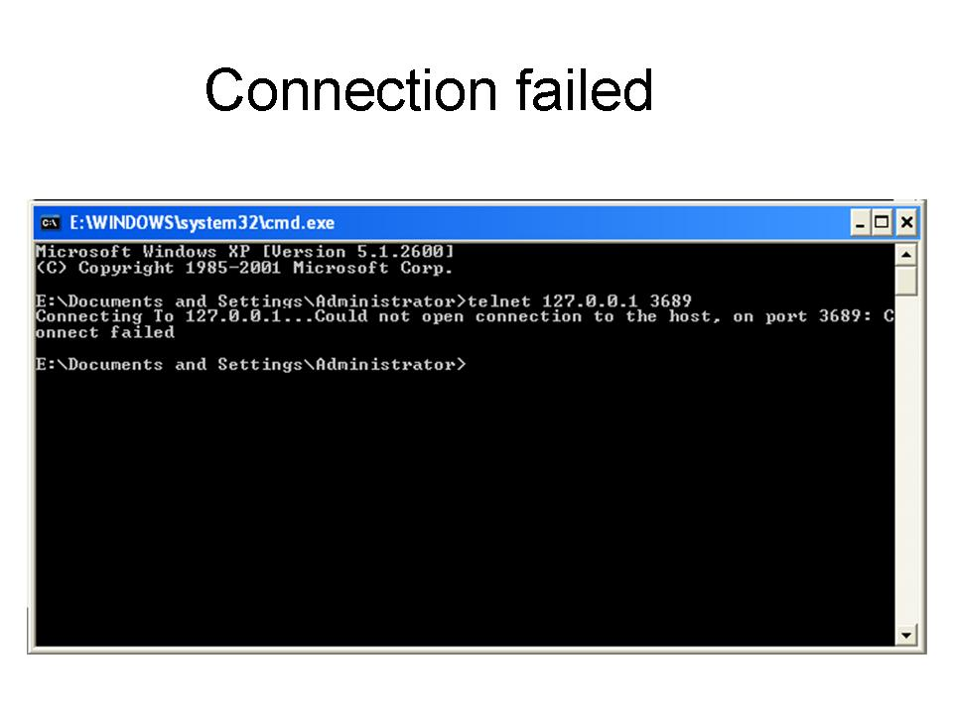
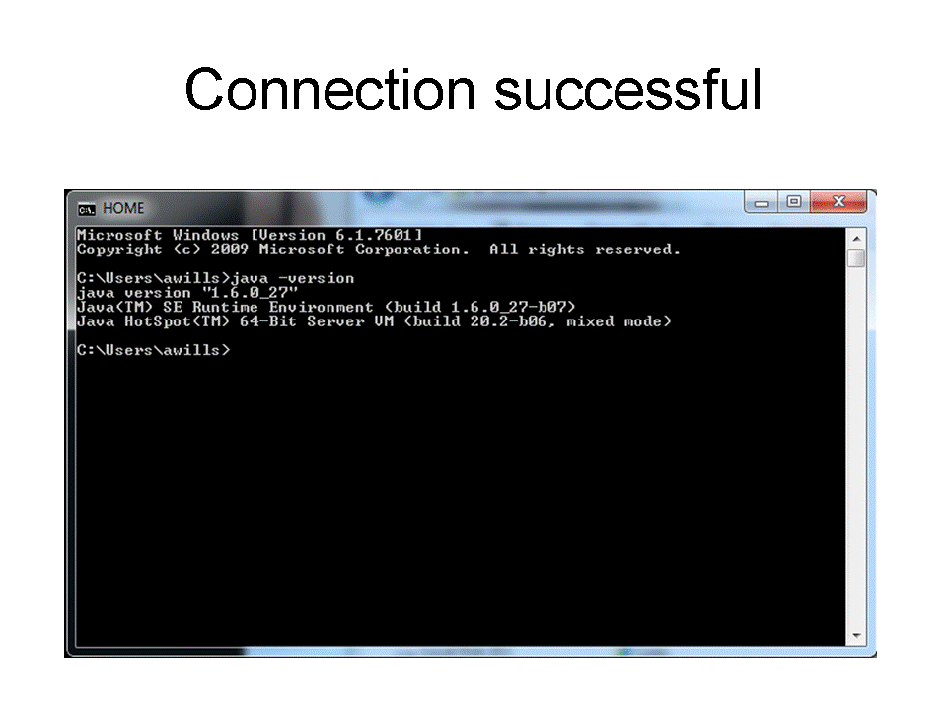
Steps of test the connection between the two
From the “Start” menu of the computer with IP address 192.168.001.001, choose the “Run” menu and type the command [PING 192.168.001.002].
Click “OK”
A connection failure will be displayed on the screen as shown in figure right above while a successful network is shown on figure right below.
108

Slide 109
Sharing network resources
If you have successfully installed the network, you can then start enjoying the benefits of networking by enabling resource sharing. For example if you are using Windows XP, you can share resources by enabling sharing and security as follows:
  Open “Windows Explorer”
  From the explorer window, right click the drive folder or file you wish others on the network then select sharing and security.
  Click the “Sharing” tab then enable “share this folder”.
  Type in the share name and set other options as required.
  Click “OK”.
109

