Slide 1

Chapter 3
Elementary programming principles
1

Slide 2
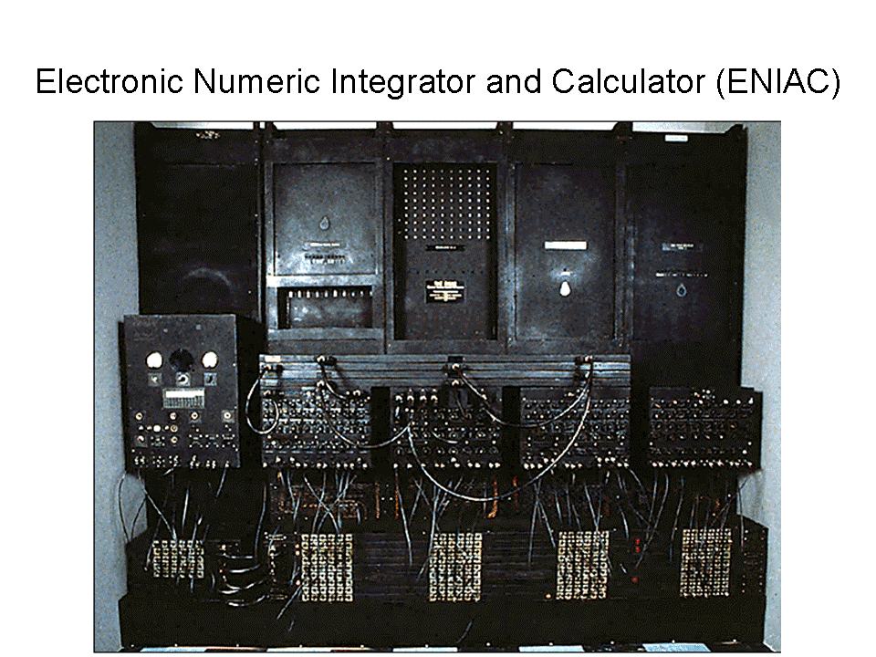
Introduction
Human beings have evolved from the stone age to a highly sophisticated and advanced society by inventing things like the wheel, fire, transistors and today’s ultra modern devices like computers. The idea of computers started way back in the nineteenth century. The first generation computers called Electronic Numeric Integrator And Calculator (ENIAC 1) were operated by plugging wires into a control panel that resembles the old telephone switchboards.

Slide 3
Computer programming
A program.
is an organised list of statements (instructions) that when executed, causes the computer to behave in a predetermined manner or carry out a defined task
Programming
refers to the process of developing computer (instructions) programs used to solve a particular task.
A computer program
is designed using a particular programming language. Each language has a special sequence or order of writing characters usually referred to as syntax

Slide 4
Terms used in programming
Source program
Object code
Translator
Assembler
Interpreter
Compiler

Slide 5
Source program
This refers to the program code that the programmer enters in the program editor window that is not yet translated into machine-readable form.

Slide 6
Object code
This refers to the program code that is in machine-readable. i.e. a source code that has been translated into machine language.

Slide 7
Translator
These are programs that translates/convert the source program into object code. E.g. assemblers, compilers, interpreters etc.

Slide 8
Assembler
An assembler translates a program written in assembly language into machine language,

Slide 9
Interpreter
This translates the source program line-by-line, allowing the CPU to execute one line before translating the next. The translated line is not stored in the computer memory, hence every time the program is executed, it has to be translated.

Slide 10
Complier
This translates the entire source program into object code. The compiler translates each high-level instruction into several machine code instructions in a process called COMPILATION and produces a complete independent program that can be run by the computer as often as required without the original source program being present.

Slide 11
Difference between the interpreters and compilers
Interpreters | Compilers
Translates the source program one statement at a time. | Translates the entire source code at once before execution.
Translates the program each time it is run hence slower than compiling. | Compiled program (object code) can be saved on a storage media and run as required, hence executes faster than interpreted programs.
Interpreted object code takes less memory compared to compiled program. | Compiled programs require more memory as the object file are larger.

Slide 12
Level of programming languages
There are 2 major levels namely;
  Low-level languages.
  High-level languages.

Slide 13
Low-level languages
These languages are classified as low because they can be easily understood by the computer directly or they require little effort to translate into computer understandable form. These languages are hardware oriented and therefore they are not portable. i.e. a program written for one computer cannot be installed and used on another.

Slide 14
High-level languages
These languages are very close to the human language (English-like) and they can be read and understood even by people who are not experts in programming.
These languages are machine independent. This means that a programmer concentrates on problem solving during a programming session rather than how a machine operates.

Slide 15
Types of low level languages
Machine language (First generation languages).
Assembly languages (Second generation languages)

Slide 16
Machine language
(First generation languages)
In this language, instructions are written using binary logic. Given that data and instructions are in binary form, many lines of codes are needed to accomplish even a simple task like adding two numbers i.e. a program written in this language look like this.
  11100110 00000011 19999991
  00001111 10001101
  10001111 11111111 10000011
The program code is hard for human to understand but it’s easily understood by computers.

Slide 17
Assembly languages
(Second generation languages)
This language is close to the machines vocabulary rather than human beings vocabulary. It was developed in order to overcome the difficulties of understanding and using machine language. This language helps the programmers to write programs as a set of symbolic operation codes called Mnemonics. Mnemonics are basically shortened two or three letter words. A sample program written in Assembly language.
MOV AX, 15 (move 15 to register Ax)
SUB AX, 10 (Subtract 10 from the value Ax)
Programs written in this language require an assembler to convert them into machine language.

Slide 18
Classes of high level languages
Third generation languages (3GLS)
Forth generation languages (5GLs)
Fifth generation languages (5GL’s)
Object Oriented Programming Language (OOP)
Web scripting languages

Slide 19
Third generation languages (3GLS)
This generation languages is also called structured or procedural languages. A procedural language makes it possible to break a program into components called modules. Each performing a particular task. Structured programming has advantages because its flexible, easier to read and modify.

Slide 20
Examples of third generation programming language
Pascal – was developed to help in the teaching and learning of structured programming.
Fotran – was developed for mathematics, scientists of programs with mathematical expressions.
Cobol – was designed for developing programs that solve business problems.
Basic – developed to enable students to easily learn programming.
C – used for developing system software e.g. the operation systems. Its very powerful high level language because of its ability to provide programmer with powerful aspects/features of low level.
Ada – this language is suitable for developing military, industrial and real – time systems.

Slide 21
Forth generation languages (4GLs)
This generation make programming an even easier task than the third generation language because they present the programmer with more programming tools.
Examples of such tools are command buttons, forms etc. the 4 GLs are easy to learn and understand because they are user based.
The languages syntax (grammar) is natural, near English language and use menus to prompts to guide a non-specialist or retrieve data with ease.

Slide 22
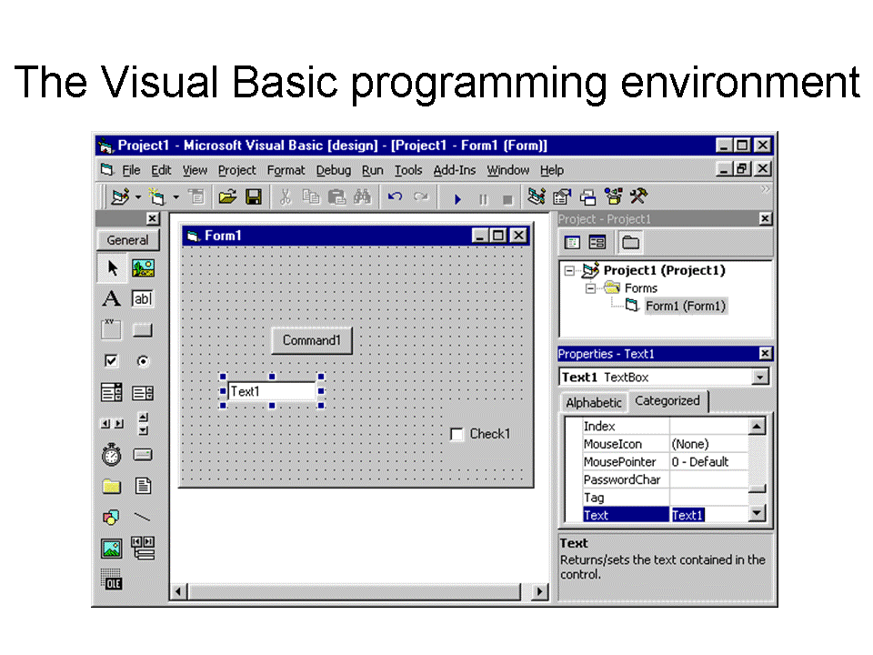
Examples of 4GLs
Visual Basic
Delphi Pascal
Visual Cobol
C++

Slide 23
Fifth generation languages (5GL’s)
These languages are designed around the concept of solving problems by enabling the computer to depict human like intelligence. These programs are designed to make the computer solve the problem for the programmer rather than programmer spending a lot of time to come up with the solution.

Slide 24
Examples of 5GL’s
PROLOG
MERCURY
LISP
OCCAM

Slide 25
Object Oriented Programming Language (OOP)
The concept behind OOP languages is to look at a program as having various objects interacting to make up a whole. Each object has a specific data values that are unique to it (called state) and a set of the things it can accomplish called (functions or behaviour). This process of having data and functions that operate on the data within an object is called Encapsulation. Several objects can then be linked together to form a complete program. OOP has greatly contributed to development of Graphical user interface operation system and application programs.

Slide 26
Examples of OOP
Java
Simula
Small talk

Slide 27
Web scripting languages
These languages are used to develop or add functionalities on web pages. Web pages are hypertext documents created in a language called HyperText Markup Language (HTML). The languages consist of markup tags that tell the Internet browser that the file contains HTML-code information and is distinguished by a file extension of HTML. The markup tags define the various components of a World Wide Web document such as heading, tables, paragraphs, lists etc. HTML does not have the declaration part and control structures, hence it’s not considered as a true programming language. Due to its simplicity, it has many limitations and cannot be used alone when developing functional websites. Some special blocks of codes called Scripts may be inserted in HTML pages using scripting languages like JavaScript, VBScript etc in order to add functionality to HTML pages.

Slide 28
Examples of HTML tags and their meanings
Tag | Meaning
<HTML> </HTML> | Marks the beginning and end of a HTML document. All other tags and text fall between these two tags.
<HEAD></HEAD> | Marks the header part of the document.
<TITLE> </TITLE> | Gives title of the web page. Text between this tags appears in the title bar when the page is browsed.
<BODY></BODY> | Marks the body part of the document.
<CENTER></CENTER> | Centres text and objects on the web page.
<B></B> | Bolds the text on the web page.
<I></I> | Italicise the text.
<H1> </H1> | Sets size of text on the web page with H6 displaying the smallest and H1 the largest size.

Slide 29
Creating a script using Javascript 1
Javascript is a popular scripting language. Before writing your HTML program with a script inserted, make sure that you have the latest browser software installed on your computer. Older browsers may not have support for Javascript. If you are using Internet Explorer, it should be version 5.0 and above.

Slide 30
Creating a script using Javascript 2
Open Notepad and key in the following program. Do not write the numbers to the left of each line of code.
  <HTML>
  <HEAD>
  <TITLE>Scripting Example</TITLE>
  </HEAD>
  <BODY>
  <H1><CENTER><B>we are the world</B></CENTER><H1>
  <SCRIPT LANGUAGE=‘JavaScript’>
  document.write(‘My name is strongman’);
  alert(‘congratulations for succeeding to run this script’);
  </SCRIPT>
  </BODY></HTML>

Slide 31
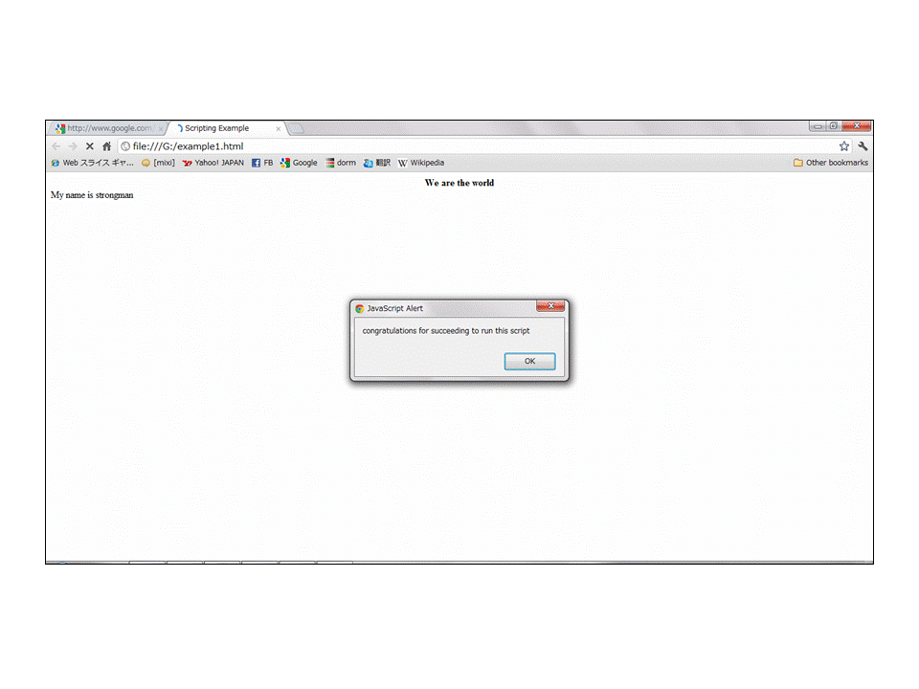
Creating a script using Javascript 3
After typing the entire program, save your file on the desktop as Example.html and then close the notepad. Notice that the icon to your file on the desktop look like that of the default web browser in your computer.
To view the web page, double click the icon of the file Example.html on the desktop. Figure right shows as open webpage.

Slide 32
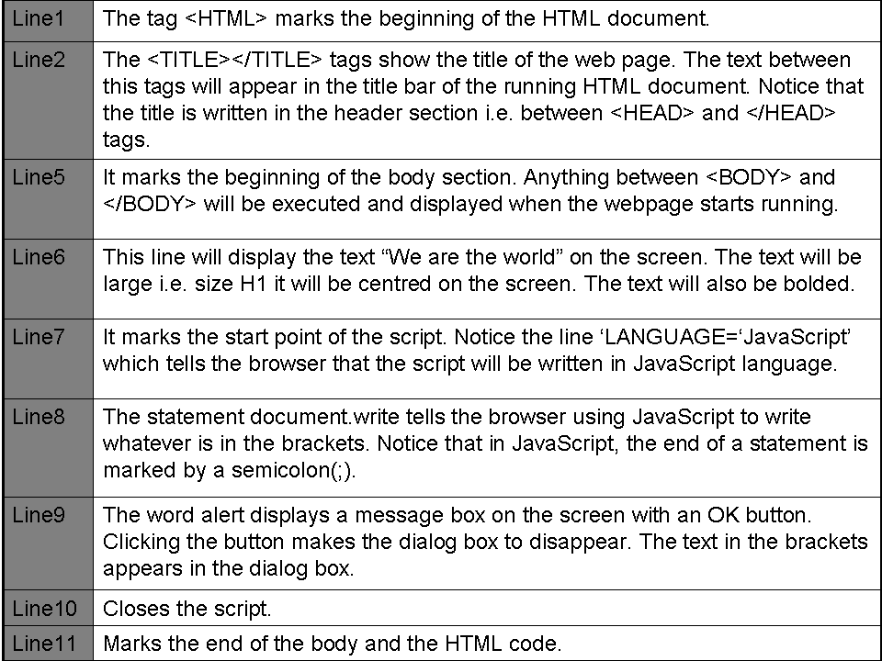
Explanations of JavaScript

Slide 33
Advantages of low-level languages
The CPU understands machine language directly without translation.
They are stable and hardly crash or breakdown once written.
Running a program is fast, no compilation is needed.
They are economical in terms of the amount of memory they use.

Slide 34
Disadvantages of low-level languages
They are difficult and cumbersome to use and learn.
Require highly trained experts to both develop and maintain programs.
Debugging programs is difficult.
They are machine dependent.
The programs are long.

Slide 35
Advantages of high-level languages
The programs are portable (not machine dependent).
They are user friendly and easy to use and learn.
They are more flexible.
They are easy to debug.
They provide better documentation.
Require less time to code.

Slide 36
Disadvantages of high-level languages
Program executed more slowly.
Require larger CPU storage capacity for compilation.
They have to be translated to machine readable form before

Slide 37
Program development
There are six stages of program development. They include:
Problem recognition
Documentation
Problem definition
Program design
Program coding
Program testing
Program implemetation

Slide 38
Problem recognition
This refers to the understanding and interpretation of a particular problem. To understand a problem one has to look for key words such as compute, evaluate, compare etc. a programmer identifies problems in the environment and seeks to solve them by writing a computer program that would provide the solution.

Slide 39
Circumstances that can cause the programmer to identify a problem
Opportunity to improve the current program.
A new directive given by the management requiring a change in the status quo.
Problems or undesirable situations that prevent an individual or organisation from achieving their purpose.

Slide 40
Problem definition
At this stage the programmer tries to determine or define the likely input, processing and expected output using the keywords outlined at the problem recognition stage. The boundaries of the expected program are established and if several methods to solve the same problem are identified the best alternatives should be chosen. At the end of the stage requirement documentation for the new program is written.

Slide 41
Program design
This is the actual development of the program’s processing or problem solving logic called algorithm. (A limited number of logical steps that a program follows in order to solve a problem). The programmer comes up with an algorithm after analysing the requirements specifications. Some of the programs are made up of one large block code. i.e. they are Monolithic while others are made of several units called modules which work together to from the whole program. In modular programming, each module performs a specific task. This approach makes a program flexible, easier to read and debug. This phase enable the programmer to come up with models of the expected program. The model show the flow of events and data throughout the entire program from input of a program.

Slide 42
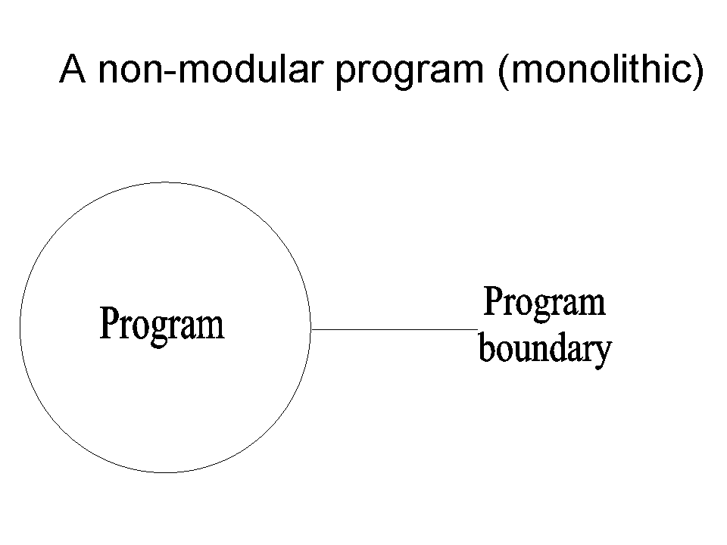
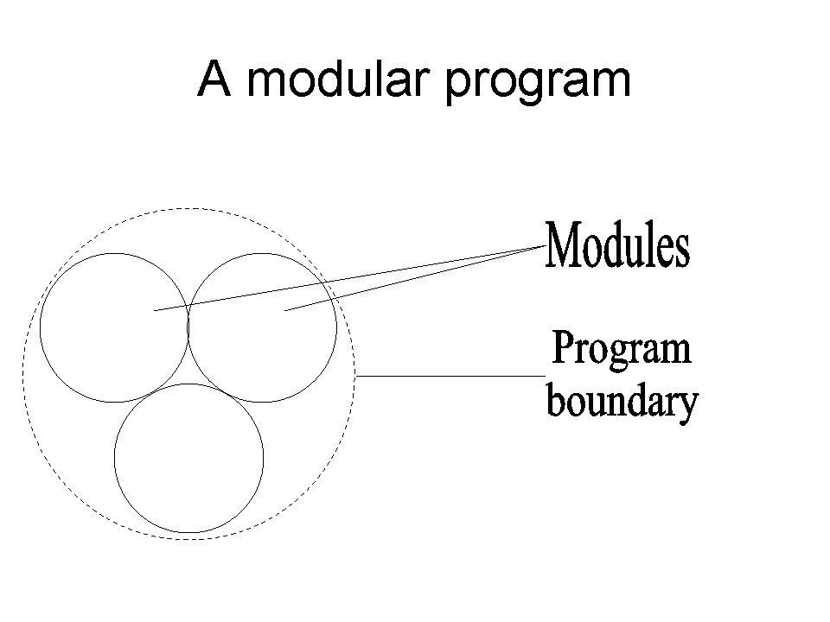
Monolithic and modular program

Slide 43
Program coding
This is the actual process of converting a design model into its equivalent program. This is done by creating the program using a particular programming language. The end result of this stage is a source program that can be translated into machine readable form for the computer to execute and solve the target problem.

Slide 44
Program in Pascal and C++
Program in Pascal | Program in C++
Program AreaCircle (input, output); Const Pi = 22/7; Var Radius, Area: real; Begin WriteIn (‘Enter the radius’); ReadIn (radius); Area: = Pi *Radius *Radius; WriteIn (‘The area is’, Area) End. | #include<iostream.h> double radius, area; double pi = 22/7; main () { cout<<‘Enter the radius’; cin>>radius; area = pi *radius *radius cout<<‘The area is’, area; return 0; }

Slide 45
Explain the program codes 1
Pascal code | C++ code | Explanation
Program Areacircle (input, output); | #include<iostream.h> | The header of the programs. The statements in () and <> shows that the user inputs data via the keyboard and the program display information on the screen.
Const Pi = 3.142; | double pi = 3.142; | A constant has been declared with a name pi and value 3.142.
Var Radius, area:real | double area, radius; | Real variables with fractional part have been declared.

Slide 46
Explain the program codes 2
Pascal code | C++ code | Explanation
Begin | { | Marks the beginning of the program body or executable statements.
WtiteIn | cout<<’Enter radius’: | Display on the screen the string between inverted commas.
ReadIn (Radius) | cin>>radius; | Displays a blinking cursor that tells the user that an input is needed before the program can continue.

Slide 47
Explain the program codes 3
Pascal code | C++ code | Explanation
Area: = Pi * Radius * Radius | area = pi * radius * radius; | Calculates the area. Notice the assignment statement in Pascal is : = while in C++ it is =
WriteIn (‘The area is’, Area); | cout<<”The area is’, Area<<”∖n”; | Display the value stored in the variable Area.
End. | return 0; } | Marks the end of the program

Slide 48
Program Testing and Debugging
After coding the program has to be tested and the errors detected and corrected. Debugging refers to detection and correction of errors that may exist in the program. Program testing involves creating test data designed to produce predictable output. They are two types of errors (bugs) that can be encountered when testing.

Slide 49
Types of errors (bugs)
Syntax errors – they occur as a result of improper use of language rules. E.g. grammar mistakes, punctuation, improper naming of variables etc. these errors are detectable by translator and must be corrected before the program runs.
Logical errors – they are not detectable by the translator. The program rules but gives wrong out put or halts during execution.

Slide 50
Methods of errors detection
Desk checking / dry – run.
Using Debugging utilities.
Using Test Data.
Implementation and maintenance Implementation.
Review and maintenance.
Program documentation.

Slide 51
Desk checking / dry – run
It involves going through the program while still on paper before entering it in the program editor.

Slide 52
Using Debugging utilities
In the program editor, you can run the debugging utilities during translation to detect syntax errors.

Slide 53
Using Test Data
The programmer carries out trial runs of the new program. At each run he enters various data variations and extremes including data with errors to test whether the system will grid to a halt. A good program should not crash due to incorrect data entry but should inform the user about the anomaly.

Slide 54
Implementation and maintenance implementation
This is the actual delivery and installation of the new program ready for use, creating data files and train people to use the system. The new system will change the way things are done hence it should be reviewed and maintained.

Slide 55
Review and maintenance
This stage is important because of the errors that may be encountered after implementation. A program may fail due to poor use, hence proper training and post implementation support of users will reduce chances of having them entering invalid data that crash the program.

Slide 56
Program documentation
This is writing of support materials explaining how the program can be used by users, installed by operators or modified by other programmers. All stages of program development should be documented in order to help during future modification of the program.

Slide 57
Types of documentation
User oriented documentation – these type enables the user to learn how to use the program as quickly as possible and with little help from programmer.
Operator oriented documentation – meant for computer operators. E.g. Technician. It helps them to install and maintain the program.
Programmer oriented documentation – written for skilled programmers. It provides necessary technician information to help in future modification of program.

Slide 58
Development of algorithms
Algorithms – refers to a limited number of logical steps that a program follows in order to solve a problem.
Pseudocode – refers to a set of statements written in a readable language (English – like) but expressing the processing logic of a program.

Slide 59
Guidelines for designing a good pseudocode
The statements must be short, clear and readable.
Pseudocode lines should be clearly outlined and indented clearly.
It should show clearly the start and stop of executable statements and control structures.
Statements must not have more than one meaning.

Slide 60
Examples of Pseudo code
Solution
START
Print “Enter two numbers”
Input x,y
Sum – x + y
Average = sum / 2
PRINT sum
PRINT Average
STOP
Write of Pseudo code that can be used to prompt the user to enter two numbers, calculate the sum and average of the two numbers and then display the output on the screen

Slide 61
Program flowcharts
A flowchart is a diagrammatic representation of a program in algorithms. It uses statements and symbols that have specific meaning. The symbols are of different standard shapes linked to show the order of processing. Each shape contains note stating what the operation is.

Slide 62
Most common program flowcharts
Start/Stop
Ellipse: denotes the beginning and end of the program algorithm.
Parallelogram: used to denote an input or output operation. For example, READ A,B, PRINT SUM =A+B
Rectangle: indicates that a processing or data transformation is taking place. For example SUM =A+B.
Rhombus: used to specify a condition. A condition must evaluate to a boolean value (True or false) for the program to execute the next instructions.
Connector: used as a connecting point or interface for arrows coming from different directions.
Arrow: used to indicate the direction of flow of the program logic.
Input/output
Process
Decision
Connector

Slide 63
Guidelines for drawing a flowchart
There should be only one entry and one exit point of a program algorithm.
Use correct symbol at each stage in the flowchart.
Avoid crossed flow lines.
Be as neat and tidy in drawing as possible.
General direction of flow in any flowchart is from top to bottom, left to right.

Slide 64
Examples of flowchart
Solution
Draw a flowchart for a program used to prompt the user to enter two numbers. The program should find the sum, and average then display the output.
START
Input
X,Y
Sum = X + Y
Average = Z + y/2
Print
Sum,
Average
STOP

Slide 65
Types of flowchart
System flowchart – it’s a chart that depicts the systems as a whole with only subsystems or major elements shown,
Program flowchart – this chart shows the sequence of operations as carried out by a computer program.

Slide 66
Advantages of flowchart
Gives programmer good visual reference of what the program will do.
Serves as a program or system documentation.
It’s easy to trace through from the start to find the action resulting from a set of condition.
Allows programmers to test alternative solutions to a problem without over coding the program.

Slide 67
Disadvantages of flowchart
There are so many different ways to draw them.
it’s difficult to remain neat and uncluttered if the logic is complex.
Constructing a flowchart is time consuming.
They take up considerable space.
They are difficult to amend without redrawing.

Slide 68
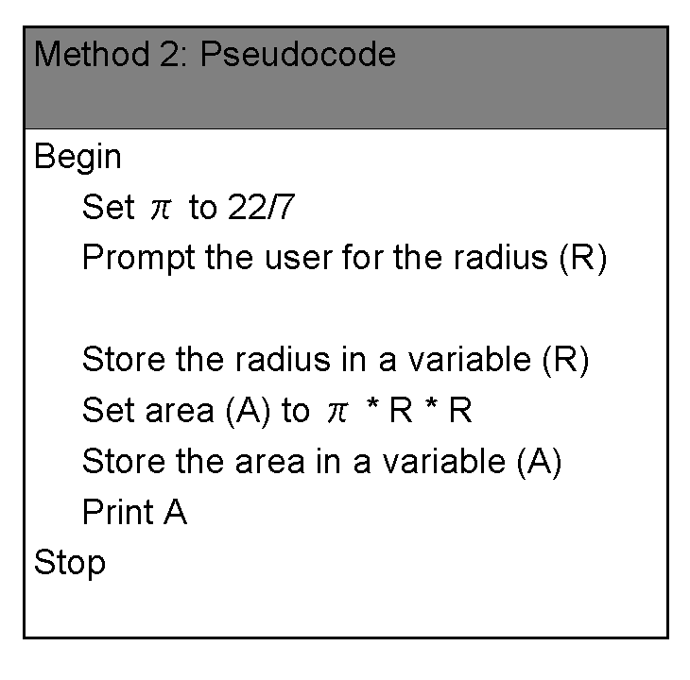
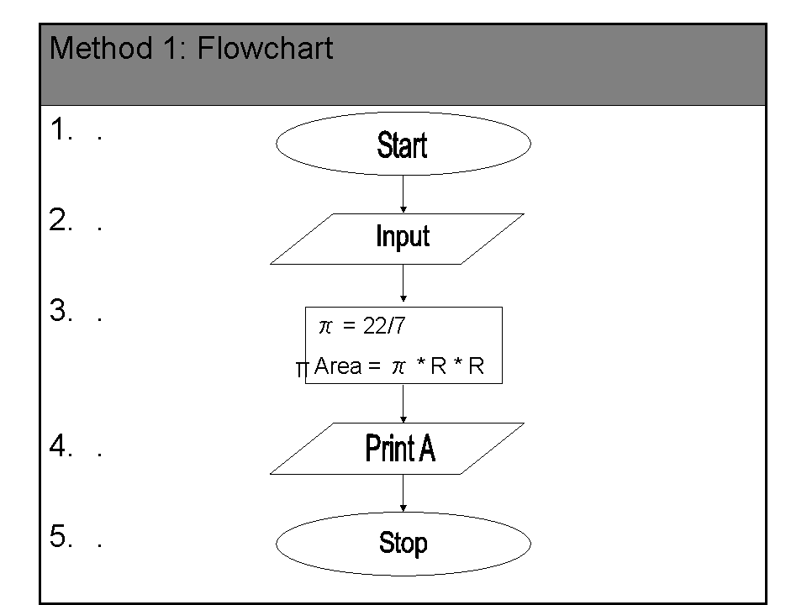
Comparison between a pseudocode and a flowchart

Slide 69
Program control structures
They are blocks of statements that determine how statements are to be executed. There are three control structures namely.
  Sequence
  Selection decision
  Iteration (looping) repetition

Slide 70
Sequence
In this control structure, the computer reads instructions from a program file starting from the first top line and proceeding downwards one by one to the end. Hence sequential program execution enables the computer to perform tasks that are arranged consecutively one after another in the code.

Slide 71
Example of how a sequential programs code execute
The
program file
reader
reads
Begin {Procedure name} sequentially
Action 1 statement
Action 2 by
Action n statements
End {Procedure name} to the end
of the file

Slide 72
Selection/decision
This structure is used to branch, depending on whether the condition returns a value of True of False (Yes or No).
For example
  IF < Condition >
  Then Action 1
  Else Action 2
  Endif.
There are 4 types of selection controls used in high-level programming.
  IF……….THEN
  IF……THEN……ELSE
  Nested IF
  CASE SELECTION

Slide 73
IF……….THEN
General format
IF < condition > Then
Statement:
EndIf
If Mark > = 80 then
Print “Reward”
EndIf
This is used if only one option is available. All other options are ignored. For example if a school wants to reward only the students who have mean mark of 80 and above, it will be reward only those students who have attained 80% and above and ignore the rest.

Slide 74
IF……….THEN……….ELSE
General Format
  IF < Condition > THEN
  Statements 1
  ELSE
  Statements 2
  EndIf
The algorithem will be:-
  IF fault = Serious THEN
  Print “RED CARD”
  ELSE
  Print “yellow Card”
  EndIf
Used when there are two available options. For example in a football match a player is given a RED CARD if he does a very serious mistake otherwise he is given a Yellow Card.

Slide 75
Nested IF
This is used where two or more options have to be considered to make a selection. For example, to award grades according to the marks as follows
  80 marks Grade A
  60 marks Grade B
  50 marks Grade C
  40 marks Grade D

Slide 76
General format of Nested IF
General Format
IF <Conditions> Then
Statement
ELSE
IF <Condition> Then
Statement
ELSE
IF <Condition>Then
Statement
Endif
Endif
End
The pseudo code segment will be:-
If Marks = 80 THEN
Grade = “A”
ELSE
If Marks = 60 THEN
Grade = “B”
ELSE
If marks = 50 THEN
Grade = “D”
Endif
Endif
Endif
Endif
End

Slide 77
CASE SELECTION
General format
CASE x of
Label 1 : Statement1
Label 2 : Statement2
Label n : Statement n-1
ELSE
Statement n
End case
Example:-
CASE average OF
80…100: Grade=“A”
70…79: Grade=“B”
60…69: Grade=“C”
40…49: Grade=“E”
ELSE
Grade=“F”
End Case
It’s an alternative to the nested IF. This selection is preferred to the Nested if in order to reduce the many line s of codes. Case selection can only be expressed using integers and alphabetic characters only. The Boolean expression should be CASE integer OF or CASW char OF

Slide 78
Iteration (looping) repetition
This is designed to execute the same block of code again and again until a certain condition is fulfilled. Iteration is important in situations where the same operation has to be carried out on a set of data many times. There are three main looping controls.
  THE-WHILE-DO LOOP
  REPEAT……….UNTIL LOOP
  The FOR LOOP

Slide 79
THE-WHILE-DO LOOP
This repetitive structure tests the condition first before executing the successful code if and only if the Boolean expression returns a true value.
Example
To withdraw money using an ATM a customer must have a balance in his/her account.

Slide 80
General format of THE-WHILE DO LOOP
Flowchart
General format
While <condition> Do
Statement
End while
Pseudo code segment
While balance >0 do
Withdraw cash
Update account
End while
Withdraw cash
update account
Bai
>0?
Yes
No
End loop

Slide 81
REPEAT……….UNTIL LOOP
In this structure the code is executed before testing the condition. The repeat loop stops when the Boolean statement returns a value. For example in the case of ATM discussed above the client can withdraw money until balance is zero.
Example
Pseudo code segment.
REPEAT
Withdraw cash
Update account
Until balance <0;

Slide 82
General format of REPEAT…………UNTIL LOOP
Flow chart
General format
REPEAT
Statement
UNTIL <condition>
Withdraw cash
update account.
Bal >0?
Exit loop

Slide 83
The FOR LOOP
This structure is used where execution of the chosen statements has to be repeated a predetermined number of times. For example if a program is to calculate the sum of ten numbers provided by the user. The FOR LOOP can be used to prompt the user to enter the 10 numbers at most ten times. Once the numbers are entered the program calculates and displays the sum.

Slide 84
Pseudo code of the FOR LOOP
Pseudo code
FOR count = 1 to 10 DO
writeln “Enter a number (N)”
Readln N
Sum = sum + N
End FOR
Display Sum
The counter has to be set to a start value and sometimes to an end value.

Slide 85
General format of the FOR LOOP
General format
format for the FOR LOOP that counts from lower limit.
For loop variables = lower limit To upper limit Do
Statements
EndFor
Format for the ‘For’ loop that counts from upper limit down to lower limit
For loop variable = Upper limit Down To Lower Limit Do
Statements
EndFor

Slide 86
Flowchart for a For Loop that counts upward
Loop Variable = lower limit
Lower limit = Loop
variable + 1
Statement
No
Condition?
Yes

Slide 87
Flowchart for a For Loop that counts downwards
Loop Variable = Upper limit
Upper limit = Loop
variable - 1
Statement
No
Condition?
Yes

Slide 88
Examples of complex pseudo codes 1
Ushirika Society pays 5% interest on shares exceeding Kshs 10,000 and 3% on shares that do not meet this target. However no interest is paid on deposits in the member’s bank account. Design a pseudo code for a program that would:
  Prompt the user for shares and deposit of a particular member.
  Calculate the interest and total savings.
  Display the interest and total savings on the screen for a particular member.

Slide 89
Pseudo code of examples 1
Pseudo code
Start
Input Name, share, Deposit
If share > 10000 THEN
Interest = 0.05*shares
ELSE
Interest=0.03*shares
Endif
Total savings = deposits + Interest + shares
Print Name, Totalsaving, Interest
Stop

Slide 90
Flowchart of example 1
Start
Enter
Name, shares
deposit
Shares>
10000
No
Yes
Interest = 0.03 * shares
Interest = 0.05 * shares
Totalsavings = deposit + shares + interest
Print name, Totalsavings,
interest
Stop

Slide 91
Examples of complex pseudo codes 2
Botswana has a population of 3,000,000 but this is falling by 4% each year. The island of Reunion has a population of 95,000 but this is increasing by 9% each year.
  Draw a flowchart that predicts the year in which the population of reunion will be greater than that of Botswana if the trend continues.

Slide 92
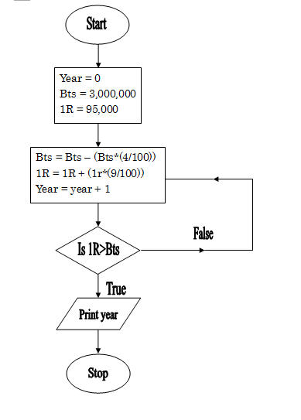
Solution of example 2

Slide 93
Pseudo code of example 2
Pseudo code
Start
Bts: = 3,000,000
1R: = 95,000
Year: = 0
REPEAT
Bts = Bts - (Bts * (4 / 100))
1R = 1R + (1R * (9 / 100))
Year = year + 1
UNTIL 1R > Bts
Print year
Stop

Slide 94
Examples of complex pseudo codes 3
Write a program that will allow the input of name of student marks obtained in 5 subjects (maths, English, Kiswahili, computer, biology). The program should calculate the total and average marks for each student and assign the grades depending on the average marks obtained as follows.
80 – 100 A
70 – 79 B
60 – 69 C
50 – 59 D
Below 50 E
The program should then display each student’s name, total marks and average grade.

Slide 95
Pseudo code of example 3
Pseudo code
START
REPEAT
Print “Enter name and subject marks”
Input Name, maths, English, Kiswahili, Computer, Biology
Sum =
Maths + English + Kiswahili + Computer + Biology
AVG = sum / 5
If (AVG>80) AND (AVG<100) THEN
Grade = ‘A’
If (AVG>70) AND (AVG<79) THEN
Grade = ‘B”
If (AVG>60) AND (AVG<69) THEN
Grade = ‘C’
If (AVG>50) AND (AVG<59) THEN
Grade = ‘D’
ELSE
Grade = ‘E”
Endif
Endif
Endif
Endif
Print Name, Sum, AVG, Grade
Until count = Number of students
Stop

Slide 96
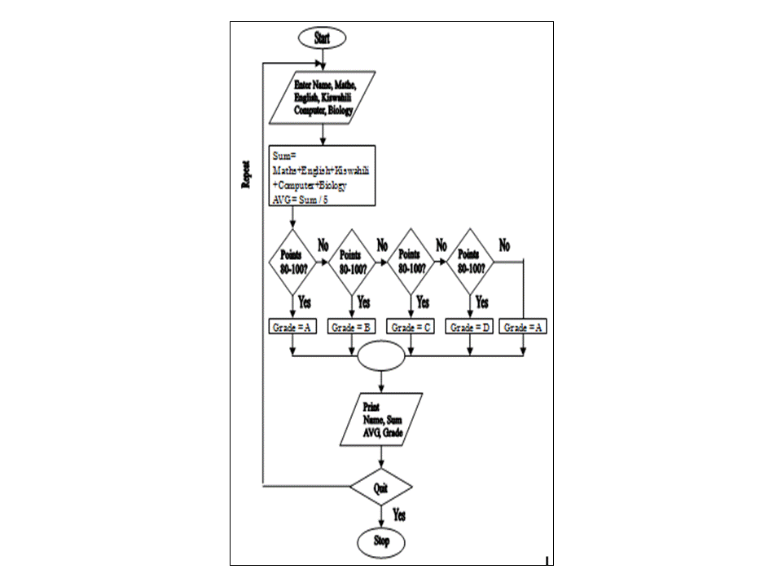
Flowchart of example 3

Slide 97
Practical activity 1-1
Open a text editor program on your computer like NotePad or WordPad.
Type the following program exactly the way it is in the editor.
  <HTML>
  <HEAD><TITLE>This is my first a webpage</TITLE></HEAD>
  <BODY bgcolor = “red”>
  <H1><CENTER><B>Hello World</B></CENTER></H1>
  </BODY>
  </HTML>
Save your work as webpage.html on the desktop. Make sure that the Save As Type box reads “All Files” before clicking the save button in order to avoid saving a text file with two extensions i.e. webpage.html.txt.

Slide 98
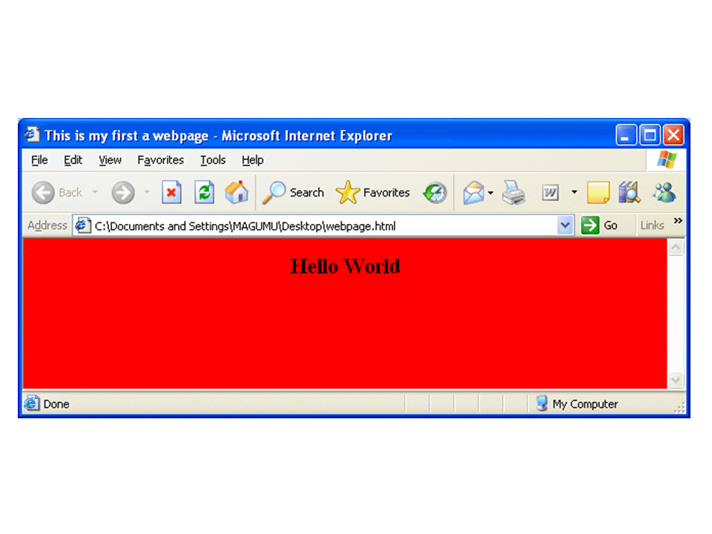
Practical activity 1-2
Close your text editor. Notice that your file on the desktop has the icon of the default web browser installed on your computer. Double click it to view the web page! Figure right shows a sample of the display expected when the file is loaded to the browser. If you have a colour monitor, it should look as below only that it will have black bold text on a red background!
Check your program and change your background to blue, save then click the refresh button. What happens?

Slide 99
Review questions 1
Define the term computer program.
What is programming?
State three advantages of high level languages over low level languages.
List four examples of languages and for each, state its most appropriate application area.
Why is an executable file unique when compared to any other file?
Differentiate between a compiler and an interpreter. Why did early computers work well with interpreters?
List the various examples of programming languages per generation.
State one advantage of machine language over the other languages.
Write the following in full
  HTML
  OOP
Distinguish between source program and object code in programming.
Define the term encapsulation as used in object oriented programming.

Slide 100
Answer of review questions 1-1
A computer program is a set of instructions that directs a computer on how to process a particular task.
Programming is the writing of computer programs.
A). Easier to learn and use.
B). Portable.
C). Flexible.
D). Easier to correct errors.
A). FORTRAN – used for developing business oriented programs.
B). COBOL – designed for developing business oriented programs.
C). Pascal – mostly used as a teaching tool in structured programming.
D). C – mostly used to create system software such as operating systems.
E). Ada – suitable for developing real-time and industrial systems.
It is the main file that is used to start the program.
A complier translates the entire source program into machine readable form while an interpreter translates the source program to machine language line-by-line. Interpreters were used on early computers due to memory limitations.

Slide 101
Answer of review questions 1-2
A). First generation – machine languages.
B). Second generation – assembly languages.
C). Third generation – Pascal, C, COBOL, BASIC, FOTRAN, Ada etc.
D). Fourth generation – Visual Basic, Delphi Pascal, Visual COBOL etc.
E). Fifth generation languages – PROLOG, Mercury, LISP, OCCAM etc.
A). The processor executes them faster.
B). They are more stable.
A). HTML – Hypertext Markup Language.
B). OOP – Object Oriented Programming language
Source program refers to a program that is not yet translated while object code refers to the program code that is in machine readable form.
Encapsulation refers to the process of joining data and instruction together to form an object.

Slide 102
Review questions 2
Give one advantage of compiling a program rather than interpreting it.
Outline at least six stages of program development in their respective order.
Highlight two advantages of monolithic programs.
State two advantages of modular programming.
In what stage of the development does program documentation fall? Justify your answer.
Differentiate between a flowchart and pseudocode.
What is a program bug?
Explain why it is important to test a program before implementing it.

Slide 103
Answer of review questions 2-1
A). Interpreters translate the source program one statement at a time while compilers translate the entire source code at once before execution.
B). Interpreters translate the program each time it runs hence slower than compiling. Compiled programs can be saved on a storage media. This means that it does not require any further transaction every time the program is run hence executes faster than interpreted programs.
C). Interpreters translation takes less memory while compiled programs require more memory as the object code files are larger.
A). Problem recognition.
B). Problem definition.
C). Program design.
D). Program coding.
E). Program testing and debugging.
F). Implementation.

Slide 104
Answer of review questions 2-1
A). They are difficult to test and debug.
B). They are difficult to modify or upgrade.
A). They are easy to test and debug.
B). They are easy to modify and upgrade.
Documentation is done at all stages of program development.
A flowchart is a graphical representation of step-by-step processing logic of a program while a pseudocode is a set of structured-English like statements that describe the step-by-step processing logic of a program.
Bugs refers to program errors.
To correct any syntax or logical errors.

Slide 105
Review questions 3
State the factors you would consider when
  Writing a pseudocode
  Drawing a flowchart
Using illustrations, explain at least six symbols used in flowchart design.
Give one advantage of pseudocodes over flowcharts.
Write a pseudocode for a program that would be used to solve the equation
E = MC²
Draw a flowchart that would be used to classify animals according to sex. If a letter M is input the program should display ‘Male’ otherwise it should display ‘Female’.

Slide 106
Answer of review questions 3-1
A). Pseudocode
1). Statements must be short and clear.
2). Statements should be unambiguous.
3). Should shoe start and stop.
4). Words used should be suggestive such as READ, PRINT, OUTPUT etc.
B). Flowchart
1). A flowchart should have one entry and one exit point.
2). Use correct symbols.
3). The flow should be clearly indicated using arrows.
Decision – used to represent a decision construct.
Connector – connects logic flows.
Process – indicates a transformation of data.
Input/output – shows program input/output.
Ellipse – indicates start/stop of algorithm.

Slide 107
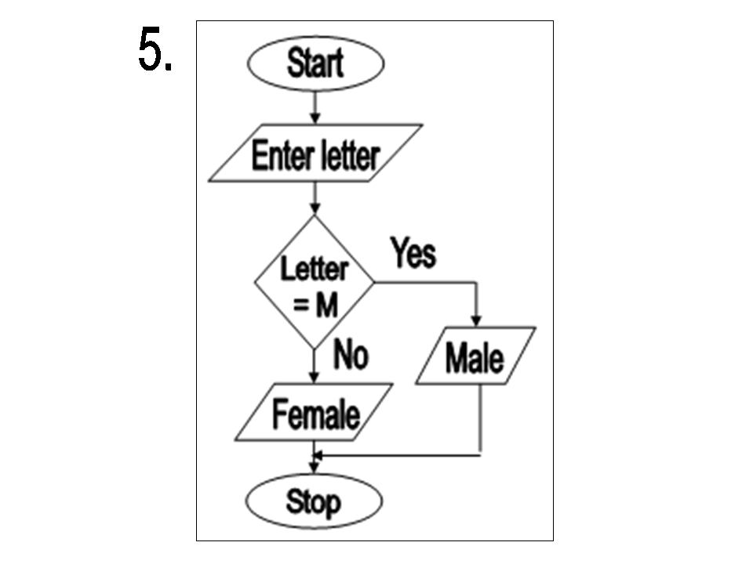
Answer of review questions 3-2
Pseudocodes are easier to write and understand.
Start
  Enter values form M and C
  E=M*C*C
  Display E
  Stop

Slide 108
Review questions 4
Define the term selection in relation to program control structures.
State three types of control structures used in programming.
Differentiate between looping and selection.
In what circumstance does looping depend on decision?
List four selection controls used in writing a program.

Slide 109
Answer of review questions 4
Selection refers to a situation where further program execution depend one making a decision from two more alternatives.
Sequence, decision and iteration.
Looping refers to a situation where the same block of code is executed repeatedly until a certain condition is fulfilled, while selection refers to a situation where further program execution depends on making a decision from two or more alternatives.
Looping may depend on decision if a condition has to be met before the looping terminates or continues.
A). IF…THEN
B). IF….THEN…ELSE
C). Nested IF
D). Case

Slide 110
Revision questions 1
State three reasons why high level languages are better than low level languages.
Explain why HTML is not true programming language.
List three examples of forth generation programming languages.
Describe the term structured programming.
Define the term structured programming.
A). State two reasons for documenting all the stages of program development.
B). Give three types of program documentation in reference to programming.
Write HTML code that would display a green background, with the words ‘Hello’ on the screen.
Draw a flowchart showing the general flow of the following:
  The nested IF selection.
  The FOR loop.
  REPEAT….UNTIL loop.

Slide 111
Answer of revision questions 1-1
A). They are portable
B). They are user friendly
C). They are more flexible
D). They are easier to debug
HTML is not a true programming language because it does not have a true format of a programming language. For example, it does not have a declaration part and control structures.
A). Visual Basic
B). Delphi Pascal
C). Visual COBOL
Fifth generation programming languages are designed in a way that enables programmers design programs that emulate human intelligence.
In structured programming, a program is broken down into components called modules each performing a particular task.

Slide 112
Answer of revision questions 1-2
A). Reasons for documenting
  There may rise a need to revise or modify it.
  Other people may think of ways of improving your program by studying at the documentation.
B). Types of documentation
  User-oriented.
  Operator-oriented.
  Programmer-oriented.
<HTML>
<HEAD><TITLE>Hello program </TITLE></HEAD>
<BODY bgcolour = “blue”>
<H3><CENTRE><B>Hello</B></CENTER></H3>
</BODY>
</HTML>

Slide 113
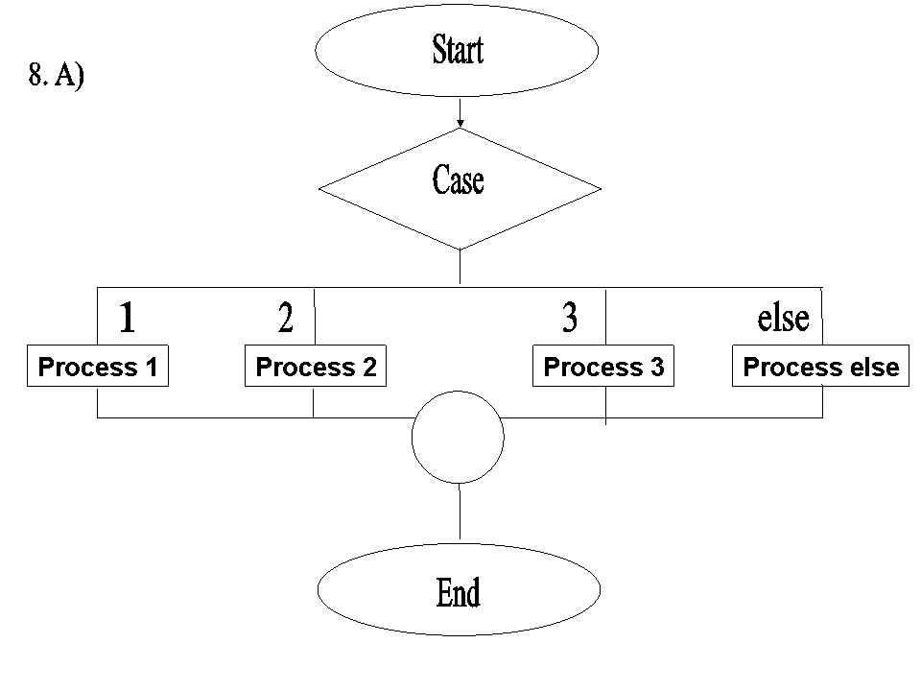
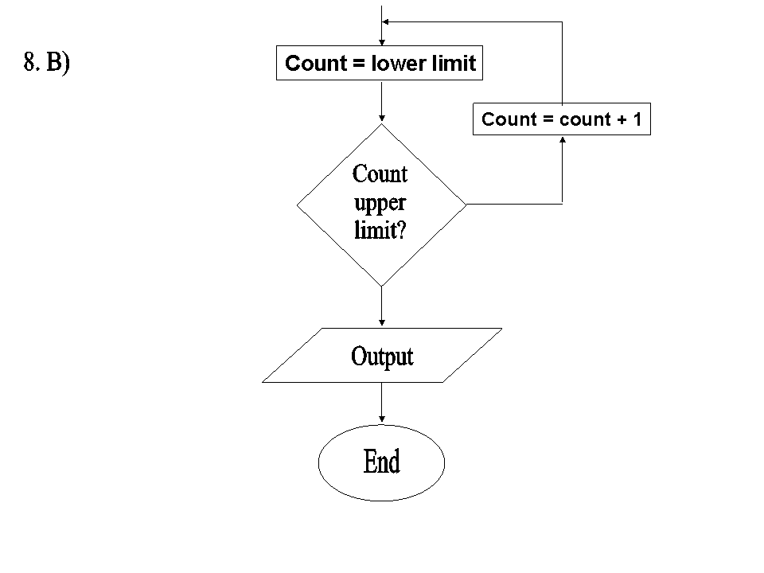
Answer of revision questions 1-3

Slide 114
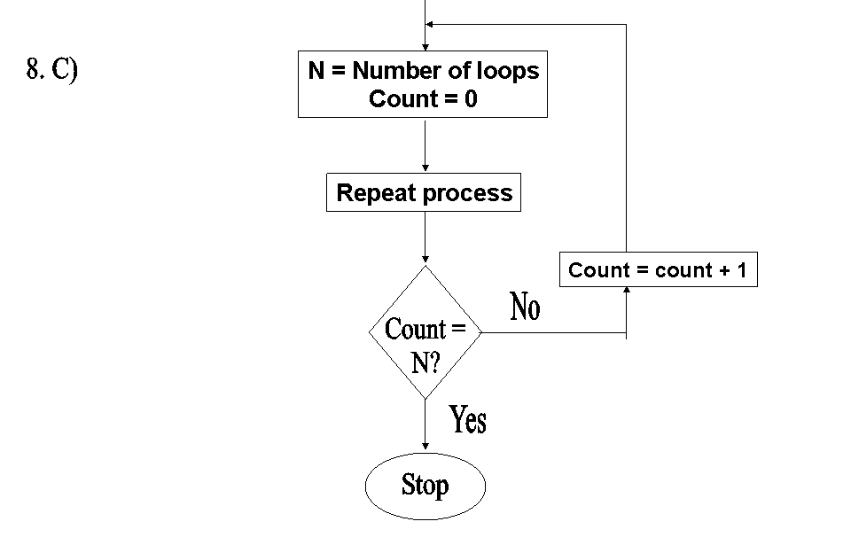
Answer of revision questions 1-4

Slide 115
Revision questions 2
Write a program algorithm that would enable the user to enter student marks. The program should then determine whether the mark entered is a pass or fail given that the pass mark is 50.
Draw a flowchart for a program that is to prompt for N numbers, accumulate the sum and then find the average. The output is the accumulated totals and the average.
Write a pseudocode that reads temperature for each day in a week, in degree Celsius, converts the Celsius into Fahrenheit's and then calculate the average weekly temperatures. The program should output the calculated average in degrees Fahrenheit's.

Slide 116
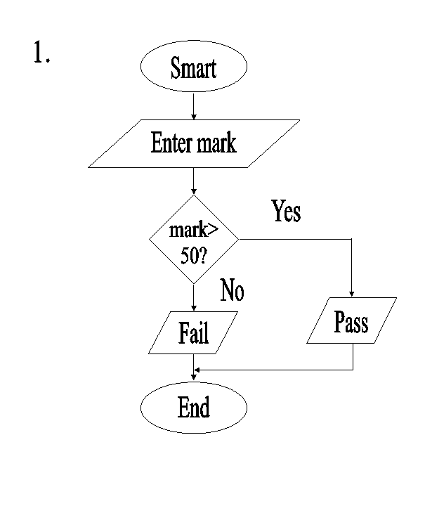
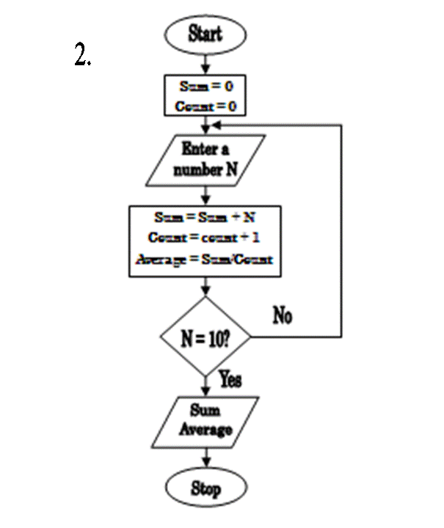
Answer of revision questions 2-1

Slide 117
Answer of revision questions 2-2
START
Input temperature in ℃
et initial day to 0
  WHILE initial day 6 DO
  Input temperature in ℃
  F=32+(9C/5)
  Initial day=initial day + 1
  Cummulative = cummulative + F
  END WHILE
  Average weekly temperature
  = cummulative/7
  Print Average
  STOP

Slide 118
Revision questions 3
A lady deposits 2,000 shillings in a Microfinance company at an interest rate of 20% per annum. At the end of each year, the interest earned is added to the deposit and the new amount becomes the deposit for that year. Write an algorithm for a program that would track the growth of the deposits over a period of seven years.
Mukumu took a loan of Ksh 400,000 from a local bank at an interest rate of 10% payable in four years. Assuming you wish to develop a computer program that will keep track of monthly repayments:
  Identify the input, processing and output requirements for such a program.
  Design the algorithm for the program using a simple flowchart and pseudocode.

Slide 119
Answer of revision questions 3-1
START
Input initial deposit
Input interest rate
Set deposit to initial deposit
Set year to 0
  WHILE year < 7 DO
  Interest = Deposit * interest rate
  Total = Deposit + interest
  Deposit = Total
  Year = Year + 1
  END WHILE
PRINT Deposit, Year
STOP

Slide 120
Answer of revision questions 3-2
A).
Inputs – initial amount borrowed
- Interest rate
- Number of years
Processing – the equation to calculate monthly repayments.
Output – monthly repayments calculated by the process

Slide 121
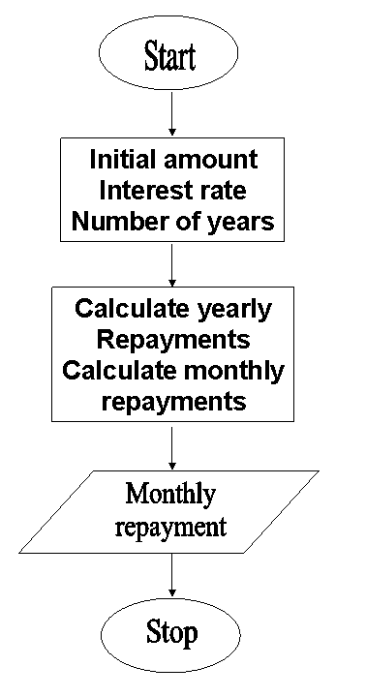
Answer of revision questions 3-3
B).
START
  Input initial loan borrowed
  Input interest rate
  Input number of years
  Calculate yearly repayments
  Monthly repayments
  = yearly repayments/12
  Display monthly repayments
STOP

