Slide 1
COMPUTER STUDIES:
FORM 2
COURSE WORK

Slide 2
COURSE OUTLINE
WORD PROCESSING
SPREADSHEETS
DATABASE
DESKTOP PUBLISHING
INTERNET AND E-MAIL
DATA SECURITY AND CONTROL

Slide 3
WORD PROCESSING
Chapter objectives:
By the end of the topic, the learners should be able to:
Define a word processor.
State the purpose of word processing.
Create, save and open a document.
Edit and format a document.
Create and edit a table.
Insert and edit pictures and objects
Perform mail-merge.
Print a document.

Slide 4
INTRODUCTION
Definition:
Word processing is the activity of manipulating text, characters, words and sentences in such a manner as to make the final document free of errors and attractive using a word processor.
It is also the art of creating, saving, editing, formatting and printing text and graphical documents using an electronic word processor.

Slide 5
A word processor can either be manual (using traditional typewriter's) or electronic (using a computer).
An electronic word processor is an application software package or program that allows a user to create, save, edit, format and print text and graphical documents.
Examples of common word processors include:
Microsoft Word
Corel WordPerfect
Lotus Word Pro
Apple Works
Open Office Writer
Word Star etc.

Slide 6
Advantages of electronic word processors over manual typewriters.
Documents can be stored for future use unlike in typewriting where the same document may require re-typing if required in future.
Typing is easier and more efficient due to automated features such as word wrap, autotext and autocomplete.
Most word processors have superior editing tools such as thesaurus, autocorrect, spelling and grammar checkers.
They provide predefined features for generating headers, footers, indexes, footnotes and references.

Slide 7
Word processors have superior document formatting features. Formatting in word processing refers to the art of making a document more attractive and appealing to the eye.
Most word processors have the ability to import tables, text and graphics from other programs.
With electronic word processors, it is possible to print multiple copies at once.

Slide 8
Common features in Word processors
Regardless of the version of word processor being used, the following features are common in almost all word processors:
They allow users to create, edit, save and open a file again and again for reuse.
They have editing tools.
They have predefined features.
They can be used to import text, tables and other graphical objects from other programs.

Slide 9
Creating documents using a word processor
Although there are many word processing packages available in the market today, Microsoft Word will be the standard application for this course.
Microsoft Word is a member of Microsoft Office suite that consists of several integrated programs. Other programs within Microsoft Office suite include Microsoft Excel, Microsoft Access, Microsoft PowerPoint, Microsoft Publisher, Microsoft Outlook etc.
Microsoft office versions include:
Microsoft Office 97, Microsoft Office 2000, Microsoft Office 2003, Microsoft Office 2007, Microsoft Office 2010, Microsoft Office 2013.

Slide 10
GUI based word processors have common application document layout although there is a slight change in modern applications. More common features include:
Text editing features
Paragraph editing features
Page editing features
Printing of documents
Creating and manipulating tables
Document templates
Working with graphics etc.

Slide 11
Microsoft Word also follows the same versions under the various Microsoft office suites.
While versions of Microsoft Word 97 to Microsoft Word 2003 looks alike and are compatible, Microsoft Word 2007 and newer versions deviates from these versions in ‘look and feel’.
Documents saved in Word 2007 format cannot be opened in the previous versions unless you save the file in compatibility mode.

Slide 12
Microsoft Word 2007
(File extension: doc, docx)
Getting started with Ms Word 2007:
STEPS
Click start menu
Click on Programs/All Programs
Click on Microsoft Office folder
Click on Microsoft Office Word 2007
Note that on following the above steps, a work area with a with a blank white sheet will appear.

Slide 13
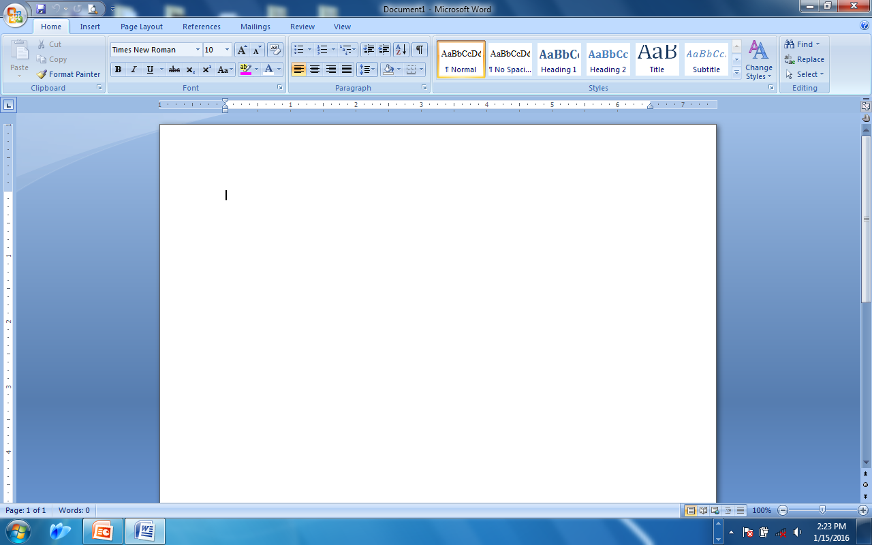
Ms Word 2007 screen/window layout
Office button
Title bar
Maximize/restore
Tabbed menu ribbon
minimize
close
ruler
Insertion point or Cursor
Vertical scroll bar
Active work area
Status bar
Page buttons

Slide 14
Key elements of the Ms Word 2007 Window
Element | Function
Title bar | Displays the document name, program name, quick access tool bar as well as the minimize, maximize/restore and close buttons
Office button | Located at the top left corner of the window. Click the button to open, save, create new document or print and to see everything else you can do to a document.
Tabbed menu ribbon | The Ribbon is designed to help you quickly find the commands that you need to complete a task. Commands are organized in logical groups, which are collected together under tabs. Each tab relates to a type of activity, such as writing or laying out a page. To reduce blocking the window, some tabs are shown only when needed. The tabs include Home, Insert, Page layout, References, mailings, review and view.

Slide 15
Ruler | Shows the margins, the tab settings and the indents
Insertion point or cursor | A blinking vertical line which indicates the position where the next character will be inserted.
Active work area | This is the plain area where the actual document is type beginning at the cursor position.
Scroll bars (vertical and horizontal) | They allow the user to move up, down, left, right and vice versa in a document
Page buttons | Allow the user to move up and down a document a page at a time
Status bar | Contains the page numbers , total number of pages and the view mode

Slide 16
Entering Text
Ms Word 2007 is a WYSIWYG (What-You-See-Is-What-You-Get) word processor. This means that what is displayed in the screen is exactly what will be printed.
Once Ms word 2007 has been started, a new document is automatically opened.
Start typing in the active work area at the cursor position or insertion point.
The document will be set up with default settings (a number of features that have been preset such as page size, margin size, line spacing, font style etc).
However, this default settings can be formatted or changed later depending on the users needs.
Word wrap: a default setting that allows text to move automatically to the next line without the user pressing the Enter key on the keyboard. When words reach the right margin and its too long to fit on the line, it automatically moves to the next.

Slide 17
Saving the document
Saving-refers to storing a document in a secondary storage device for future retrieval or use.
A document should be saved immediately after it has been created.
Saving a new document
STEPS
Click the Office Button
Select Save or Save As command
In the Save As dialog box that appears, do the following: select drive or folder to Save In, type a unique file name in the File Name box.
Click the Save button.
NB: the document will be saved and the file name will appear at the title bar.

Slide 18
Saving an existing document
In this case, an existing document is a document that had been created and saved earlier.
The purpose is to save a back-up copy or save it using a different file name for future editing.
The Save As command is used for this purpose.
STEPS
Click the Office Button
Select Save As command
In the Save As dialog box that appears, do the following: select drive or folder to Save In, type a unique file name in the File Name box.
Click the Save button.
NB: the document will be saved and the new file name will appear at the title bar.

Slide 19
Difference between Save and Save As.
Save : this command is used to save a new document or to save changes to an existing document after it has been edited.
Save As: this command is used when saving a new document or when saving an existing document using a different file name.
Protecting a document using a password
A password is a combination of characters that prevent others users from opening and modifying a document without permission.
Passwords should not be too obvious and mostly should be created in lower case characters (small letters).

Slide 20
Set a password for a document
Click the Office Button , and then click Save As.
Click Tools, and then click General Options.
Do one or both of the following:
  If you want reviewers to enter a password before they can view the document, type a password in the Password to open box.
  If you want reviewers to enter a password before they can save changes to the document, type a password in the Password to modify box.
If you don't want content reviewers to accidentally modify the file, select the Read-only recommended check box. When opening the file, reviewers are asked whether or not they want to open the file as read-only.
Click OK.
When prompted, retype your passwords to confirm them, and then click OK.
Click Save.
If prompted, click Yes to replace the existing document

Slide 21
Notes
  Password to open: By default, this feature uses advanced encryption. Encryption is a standard method used to help make your file more secure.
  Password to modify : This feature does not use any encryption method. It is designed so you can collaborate with content reviewers you trust. Is not designed to help make your file more secure.
  Both passwords : You can assign both passwords — one to access the file and one to provide specific reviewers with permission to modify its content. Make sure each password is different from the other.

Slide 22
Remove a password
Do one or both of the following:
  Open the file using your open password and as read/write.
  Open the file using your modify password and as read/write.
Click the Office Button , and then click Save As.
Click Tools, and then click General Options.
Select the password, and then press DELETE.
Click OK.
Click Save.
If prompted, click Yes to replace the existing file.

Slide 23
Editing Word documents
Editing: refers to making the necessary changes to an existing document. Ms Word provides users with inbuilt tools to help in editing. They include:
Blocking /highlighting or selecting text: the purpose of selecting text is to enable the user to manipulate the selected block of text through editing or formatting. The following are options for highlighting text.
Option | Action to be taken
A word | Double-click the left mouse button anywhere within the word or move the cursor to the beginning of the word, click and drag the mouse.
A paragraph | Triple-click anywhere within the paragraph or move the cursor at the beginning or end of the paragraph, click and drag the mouse.

Slide 24
A sentence | Press the CTRL key, the click anywhere within the sentence .
An entire document | Press CTRL + A on the keyboard.
A line of text | Take the pointer to the left of the line until it changes to a right pointing arrow and then click .
Multiple sequential items | Click the first item. Hold down the shift key and click the last item the release the shift key.
b) Insert mode: it is the default mode in most word processors. When text is inserted between words or characters, it pushes the existing text to the right as you type.
c) Type over/ overtype mode: when text is typed between existing words or characters, the new text automatically replaces the characters on the right of the insertion point as you type.

Slide 25
Find and replace: the find function allows a user to search for a particular word or phrase in a document that requires to be changed or edited. The Replace function allows the user to search for a particular word or phrase in a document and replace it with another word or phrase.
Spelling and grammar checkers: it is an inbuilt tool that helps the user to correct spelling errors and incorrect grammar structures. However, the checker can only recognise errors of those words whose correct spelling is in the dictionary.
Proof reading: refers to checking whether the document has typographical, grammatical or logical errors.

Slide 26
Auto correct: these feature automatically detects wrongly spelled words and replaces them with the correct one as you type.
Auto complete/auto text: these feature displays a complete word when the user types the first few characters of the word.
Thesaurus: an editing tool that helps the user find words or phrases with similar meaning (synonyms) or opposite meaning (antonyms) to the word or phrase selected.
Undo and redo:
Undo reverses the most recently executed command.
Redo reverts back to the cancelled action.

Slide 27
Moving or copying text (cut, copy and paste):
-cut: this function allows a user to select and remove an item from a document and place it in the clipboard. This item can later be inserted or pasted anywhere else as many times in an open document.
-copy: this function places a copy(duplicate) of an item selected into the clipboard. The original item remains where it was initially. This item can later be inserted or pasted anywhere else as many times in an open document
-paste: refers to inserting cut or copied items into a destination document or location.
-clipboard: a temporary storage location in memory where cut or copied items (text and graphics) are placed awaiting to be pasted.

Slide 28

Formatting Word documents
Formatting: refers to changing the appearance of text and graphics in a document. The impact created on the reader of a document is greatly dependent on the appearance. Formatting features are divided into three main categories namely: character/text/font, paragraph and page formatting. It is important to note that for any formatting to be effected, the text or the document must be highlighted or selected.
CHARACTER /TEXT/FONT FORMATTING
These are formatting features that affect the text or characters directly when applied. They include:
Font type : refers to the type face or shape of the character that can be used for a particular piece of text e.g. Times New Roman, Old English Text Mt, impact etc
Font size: refers to the height of a character measured in units called points where one point is 1/72 of an inch. The larger the point, the larger the character.

Slide 29
Font style: it changes the way text appears. It includes Plain text, Bold (B), Italic (I), Underline (U) as well as many other combination of styles.
-Bold: makes the selected text appear darker and thicker than the rest of the text. It creates emphasis to text.
-Italic: sets the selected text at a slanting or sloping angle. It is used to create emphasis or distinction.
Applying Effects
Superscript: this is the raising of the baseline of a character during typing e.g. 24th , the th is the character raised above the normal baseline.
Subscript: this is the lowering of the baseline of a character during typing e.g. Y₂, the 2 is the character lowered below the normal baseline.

Slide 30
Change case: on occasion, it may become necessary to change portions of text e.g. from lower case (small letters) to Upper case (Capital letters). This is made possible using the change case function.
Change case function is depicted as follows:
Sentence case: changes all the first characters in a sentence to capital letters. It is the default mode.
lower case: all characters are typed in small letters.
UPPER CASE: all characters are typed in capital letters.
Title Case (Capitalize Each Word): All First Characters Of Each Word Are Typed In Capital Letters.
tOGGLE cASE: all characters in upper case are changed to lower case while those in lower case are changed to upper case.

Slide 31
2. PARAGRAPH FORMATTING
A paragraph in Microsoft Word can be any amount of characters. It can include text, graphics, objects , blank lines, space etc.
Line spacing:
Line spacing is the distance between lines of text. The spacing between the lines of text is also relative to the size of the font on a line. The larger the font size the larger the line spacing. Line spacing available include: Single, Double, 1.5, At least, Exactly, Multiple

Slide 32
Justification/Alignment: the process of aligning a block of text, paragraph or entire document within text margins or frame borders. They include:
Left alignment: text starts on the left margin.
Right alignment: text starts on the right margin.
Center alignment: text is centered along the middle of the middle of the document.
Full justification: means that the text is flush or fits with both the left and right margins.

Slide 33
c) Indenting text: refers to moving text away from the left or right margins at given intervals. The size of an indent is the distance between the margins and the text. The indentation styles include:
Left indent: the lines of the paragraphs are pushed away from the left margin by several inches or centimeters.
Right indent: the lines of the paragraphs are pushed away from the right margin by several inches or centimeters.
Hanging indent: the first line of the paragraph remains at the left margin while the other lines of the same paragraph are pushed several inches away from the left margin.
First line indent: the first line is pushed several inches away from the left margin while the other lines in the same paragraph remain on the left margin.

Slide 34
Tab stop: refers to a location on the horizontal ruler used to indicate how far to indent text or where to begin a column of text. It helps the user to align text to the left, right, center or to a decimal character.
Drop caps: process of making the first character in a sentence larger and taking more space in the next line. There are three positions for the drop cap:
None- this is the default setting.
Dropped- character drops a number of lines set by the user.
In Margin- character drops a number of lines but parallel to the text.

Slide 35
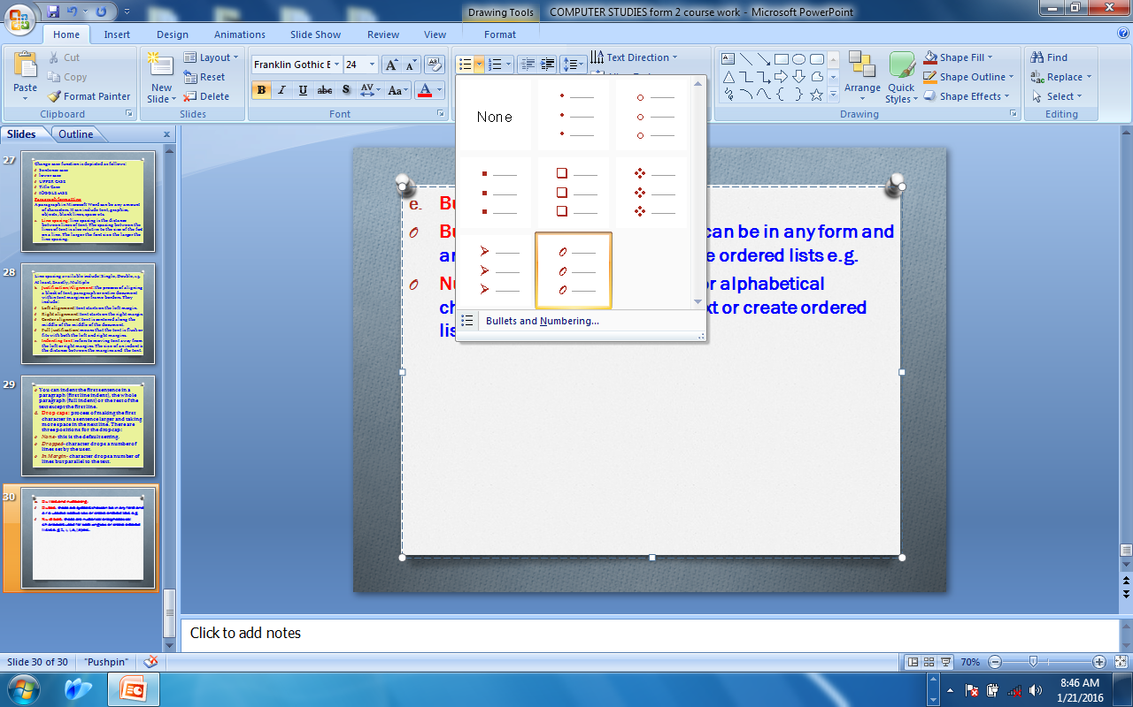
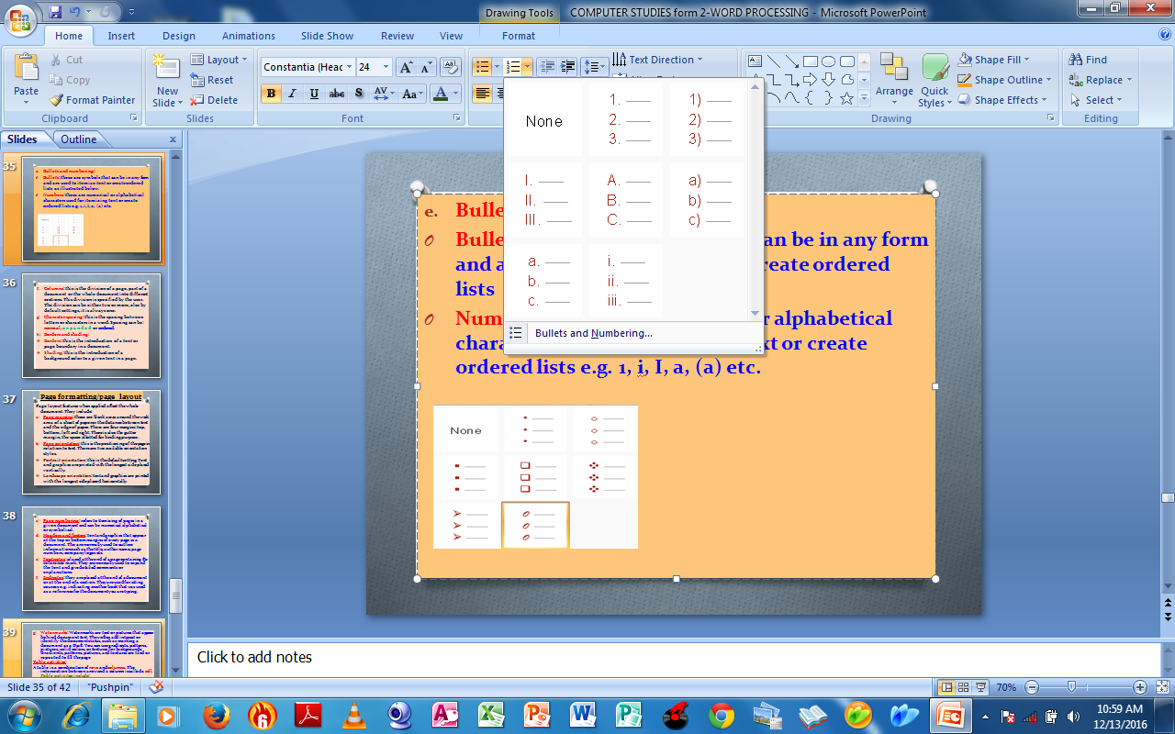
Bullets and numbering:
Bullets: these are symbols that can be in any form and are used to itemize text or create ordered lists.
Numbering: these are numerical or alphabetical characters used for itemizing text or create ordered lists e.g. 1, i, I, a, (a) etc.
Bullets
Numbering

Slide 36
Columns: this is the division of a page, part of a document or the whole document into different sections. This division is specified by the user. The division can be either two or more, else by default settings, it is always one.
Character spacing: this is the spacing between letters or characters in a word. Spacing can be: normal, expanded or condensed.
Borders and shading:
Border: refers to a frame that is introduced around a page or paragraph to demarcate the boundaries along the margins.
Shading: this is the introduction of a background color to a given text in a page.

Slide 37
i) Section Breaks
A section break is a mark inserted to show the end of a part or a block of text. It is mainly used to divide the document so that each document can be formatted separately.
You can use section breaks to change the layout or formatting of a page or pages in your document. For example, you can lay out part of a single-column page as two columns.
You can separate the chapters in your document so that the page numbering for each chapter begins at 1. You can also create a different header or footer for a section of your document.

Slide 38
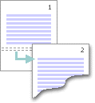

Types of section breaks
The Next Page command inserts a section break and starts the new section on the next page. This type of section break is especially useful for starting new chapters in a document.
The Continuous command inserts a section break and starts the new section on the same page. A continuous section break is useful for creating a formatting change, such as a different number of columns, on a page.

Slide 39
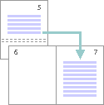
The Even Page or Odd Page command inserts a section break and starts the new section on the next even-numbered or odd-numbered page. If you want document chapters always to begin on an odd page or on an even page, use the Odd page or Even page section break option.

Slide 40
Widow and orphan
Widow: A paragraph-ending line that falls at the beginning of the following page or column, thus separated from the rest of the text.
It is the last line of a paragraph, all alone on the other side of a page break.
Orphan: A paragraph-opening line that appears by itself at the bottom of a page or column, thus separated from the rest of the text.
NB: In typesetting, widow and orphan are lines at the beginning or end of a paragraph, that are left dangling at the top or bottom of a page or column, separated from the rest of the paragraph.

Slide 41
3.PAGE FORMATTING/PAGE LAYOUT
Page layout features when applied affect the whole document. They include:
Page margins: these are blank areas around the work area of a sheet of paper or the distance between text and the edge of paper. The various types of margins available include:
Left margin: blank space on the left edge of the work area.
Right margin: blank space on the right edge of a work area.
Top margin: blank space on the top edge of a work area.
Bottom margin: blank space on the bottom edge of a work area.
Gutter margin: this is an additional space to the right or left margin provided for binding a document. Gutter also refers to the space between columns.
NB: page margins can also be adjusted using the rulers on the top and left side of the work area.

Slide 42
b)Page orientation: this is the positioning of the page in relation to text. There are two available orientation styles.
Portrait orientation: this is the default setting. Text and graphics are printed with the longest side placed vertically.
Landscape orientation: text and graphics are printed with the longest side placed horizontally.

Slide 43
Page numbering: refers to itemizing of pages in a given document and can be numerical alphabetical or symbolical.
Headers and footers: text and graphics that appear at the top or bottom margins of every page in a document. The are normally used to outline information such as the title, author name, page numbers, company logos etc.
Footnotes: placed at the end of a page containing the reference mark. They are normally used to expand the text and give detailed comments or explanations.
Endnotes: they are placed at the end of a document or at the end of a section. They are used for citing sources e.g. indicating another book that was used as a reference for the document you are typing.

Slide 44
Watermark: Watermarks are text or pictures that appear behind document text. They often add interest or identify the document status, such as marking a document as a Draft. You can use gradients, patterns, pictures, solid colors, or textures for backgrounds. Gradients, patterns, pictures, and textures are tiled or repeated to fill the page
Table activities:
A table is a combination of rows and columns. The intersection between a row and a column is called a cell. Table activities include:
Inserting or drawing tables.
Adjusting rows and columns (resizing).
Inserting rows and columns.
Merging cells.
Splitting cells.
Deleting rows and columns.
Performing simple calculations on data in the tables (=SUM(ABOVE), =SUM(BELOW), =SUM(LEFT), =SUM(RIGHT).
Converting table to text and vice versa.

Slide 45
To perform simple calculations on data in a table, the following summation formulae are applied depending on the position of the figures and the cell in which the results are to be held:
=SUM(ABOVE)
=SUM(BELOW)
=SUM(LEFT)
=SUM(RIGHT)
The name of a specific cell can also be used. Cells are named according to column letter (alphabets) followed by the row number (numbers). The columns are named starting from the left and the rows are numbered starting from the first row.

Slide 46
Ms Word: performing arithmetic calculations in a table.
A
B
1 | NAME | MARKS
2 | Mohammed Ali | 78 (This Is Cell B2)
3 | Jackson Kimeu (this is cell A3) | 56
4 | David Kemboi | 52
5 | Onyango Mindika | 90
6 | TOTAL | 276 ( this cell contains the formula, =sum(above)
Assignment:
Describe the following:
template, widows, orphans, leaders, tracking and kerning

Slide 47
Inserting graphics:
The term graphics herein refers to non-text images generated by a computer. This includes photographs, drawings, and graphs or charts. Graphics enhance the presentation of a document. Ms Word provides a wide selection of clip art which can be inserted into documents. You can also scan drawings or photos using a scanner or download graphics from a digital camera or the internet. They can then be saved in a graphics folder for future use.
Text wrapping: refers to the placing of text above, below, next to or around an object.
Inserting symbols and special characters:
In a number of cases, the user may be required to enter symbols or characters that do not appear on the keyboard. These symbols are found in the ‘symbol’ dialogue box.

Slide 48
MAIL MERGE
These feature is used to produce large volumes of personalised letters, mailing labels, memos and e-mails without having to type each one individually for each recipient.
Merging requires the use of three files: a main document (primary file), a data source (secondary file) and the merged file.
Data from the data source is inserted into the main document to produce personalised documents.
The Main document (primary file) contains the letter or other document meant for the recipient. It also contains the merge fields, which are positioned at the points where the information from the data source is to be inserted.
The data source (secondary file) contains the personalised information that would vary in each document such as names and addresses of individuals.
The merged file is created after combining the contents of the main document with the contents of the data source.

Slide 49
Printing word documents
Printing produces hardcopy output of a document. Before printing, it is important that the document be previewed to confirm that no details are outside the printable area, and that the document layout is satisfactory. This is done using the print preview command.
On selecting the Print command, the print dialog box appears and has the following print options:
Printer name selection: in order to print, the printer must be installed. If several printers have been installed in the computer, their names will appear on the printer Name box. By clicking the drop down arrow, all the installed printers will be displayed. Select the printer to use.

Slide 50
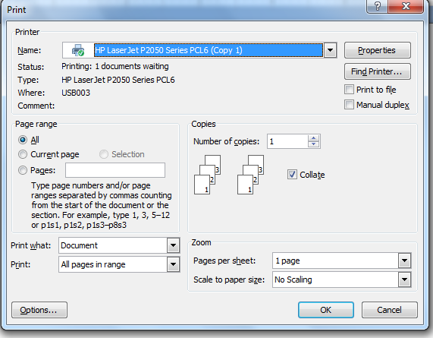
The Print Dialog Box

Slide 51
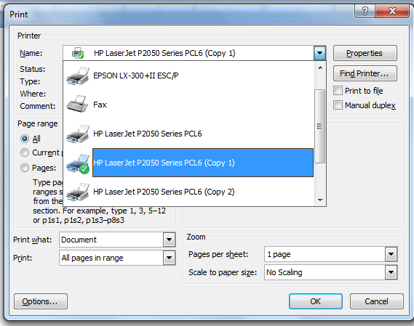
The Print Dialog Box showing a list of installed printers

Slide 52
Number of copies: this options specifies the number of copies to be printed per page.
Collate: it refers to collecting and combining of data in proper order or sequence for printing. This command is used when more than one copy of a document is to be printed. The command is activated using a checkbox.
Page range: this command is used to specify the range of pages to be printed. By default, the All option is always selected by an option button. The page range options are illustrated in the table bellow.
Page range | Function
All | Print all the pages available in the document.
Current page | Print only the page currently displayed on the screen.
Pages | Allows the user to type the specific number of pages to be printed. e.g 1,2,4,7-15.
Selection | Allows the user to print only the highlighted text or pages

Slide 53
Print: this option enables the user to select the range of printing expected. For instance, the user can select whether to print All pages in range, odd pages or even pages only.
Zoom: this option enables the user to select the paper under scale to paper size option and to select the number of pages to appear on each paper at pages per sheet option.

Slide 54
~THE END~

